Slide 1
Pobl sy’n ein helpu
Gweithgaredd 2c
Ysgol – Cardiau lleoliad
© Copyright of Gwent Police © Hawlfraint Heddlu Gwent

Slide 2
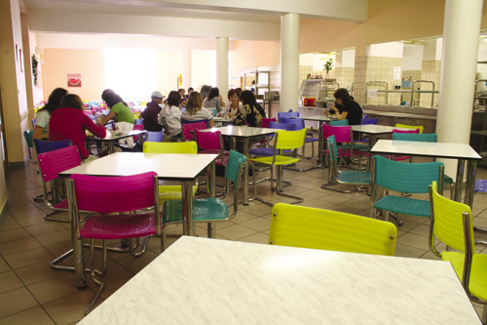
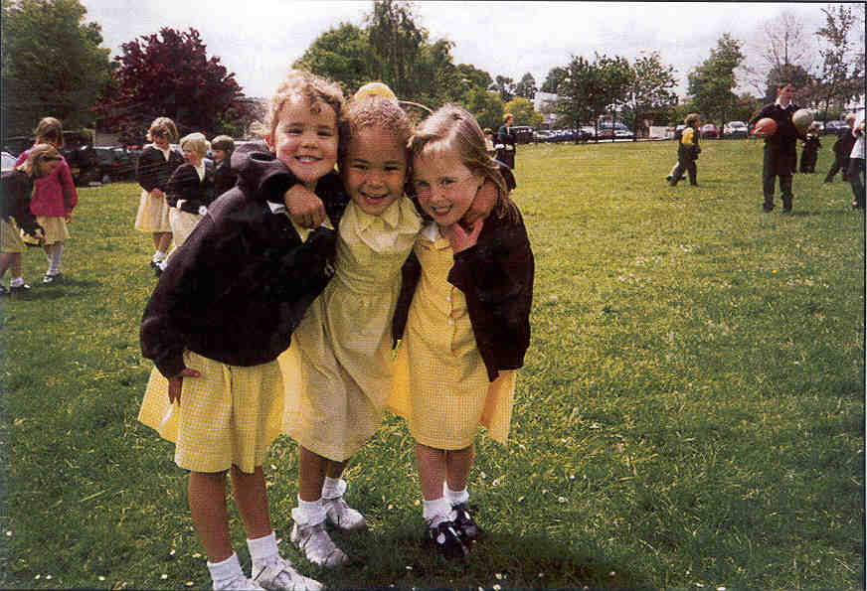
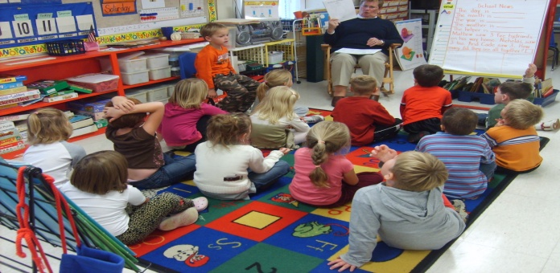
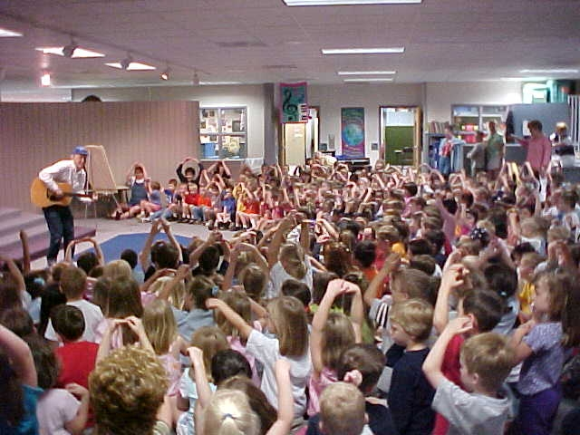
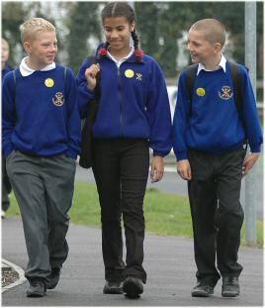
Ysgol – Cardiau lleoliad
© Copyright of Gwent Police © Hawlfraint Heddlu Gwent

Slide 3
© Copyright of Gwent Police © Hawlfraint Heddlu Gwent

Slide 4
© Copyright of Gwent Police © Hawlfraint Heddlu Gwent

Slide 5
© Copyright of Gwent Police © Hawlfraint Heddlu Gwent

Slide 6
© Copyright of Gwent Police © Hawlfraint Heddlu Gwent

Slide 7
© Copyright of Gwent Police © Hawlfraint Heddlu Gwent

