Slide 1
People who help us
Activity 2d
Home - People cards
© Copyright of Gwent Police © Hawlfraint Heddlu Gwent

Slide 2
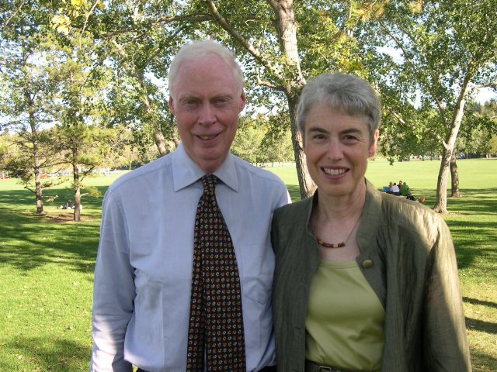
© Copyright of Gwent Police © Hawlfraint Heddlu Gwent

Slide 3
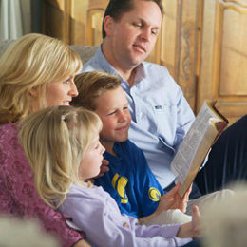
© Copyright of Gwent Police © Hawlfraint Heddlu Gwent

Slide 4
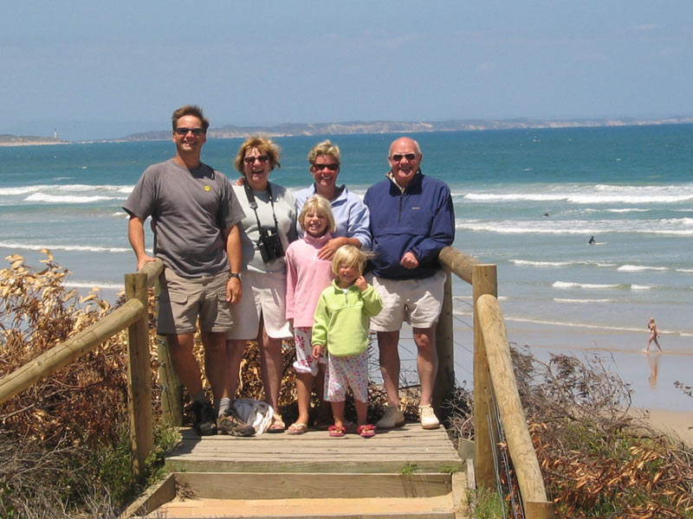
© Copyright of Gwent Police © Hawlfraint Heddlu Gwent

Slide 5
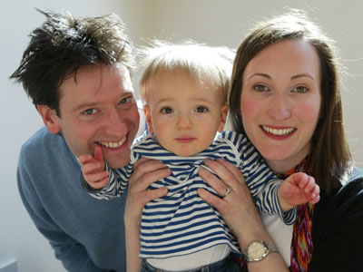
© Copyright of Gwent Police © Hawlfraint Heddlu Gwent

Slide 6
© Copyright of Gwent Police © Hawlfraint Heddlu Gwent

Slide 7
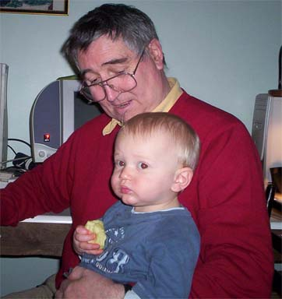
© Copyright of Gwent Police © Hawlfraint Heddlu Gwent

Slide 8
© Copyright of Gwent Police © Hawlfraint Heddlu Gwent

Slide 9
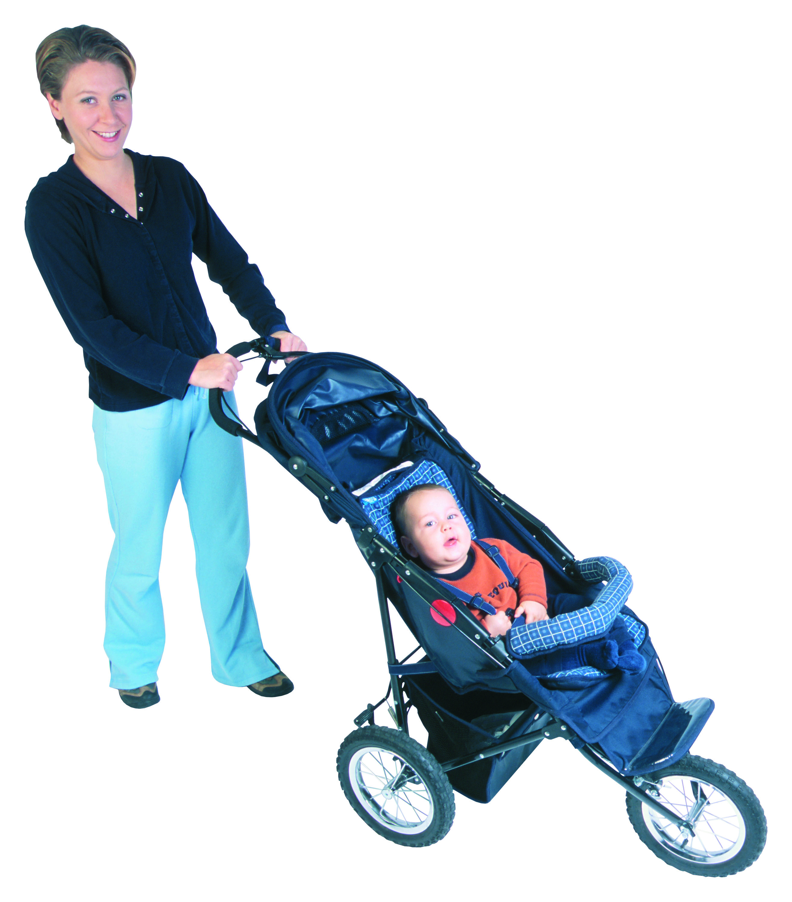
© Copyright of Gwent Police © Hawlfraint Heddlu Gwent

Slide 10
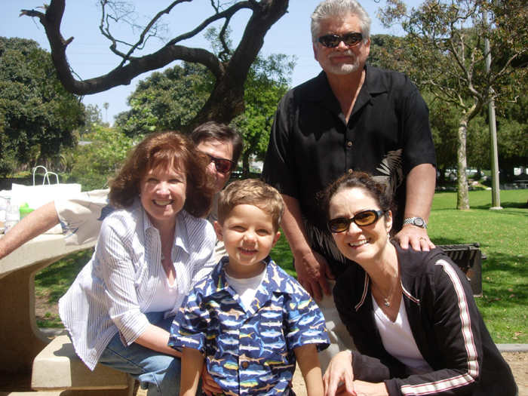
© Copyright of Gwent Police © Hawlfraint Heddlu Gwent

