Slide 1
How would you feel?

Slide 2
In pairs, say how you would feel if…

Slide 3
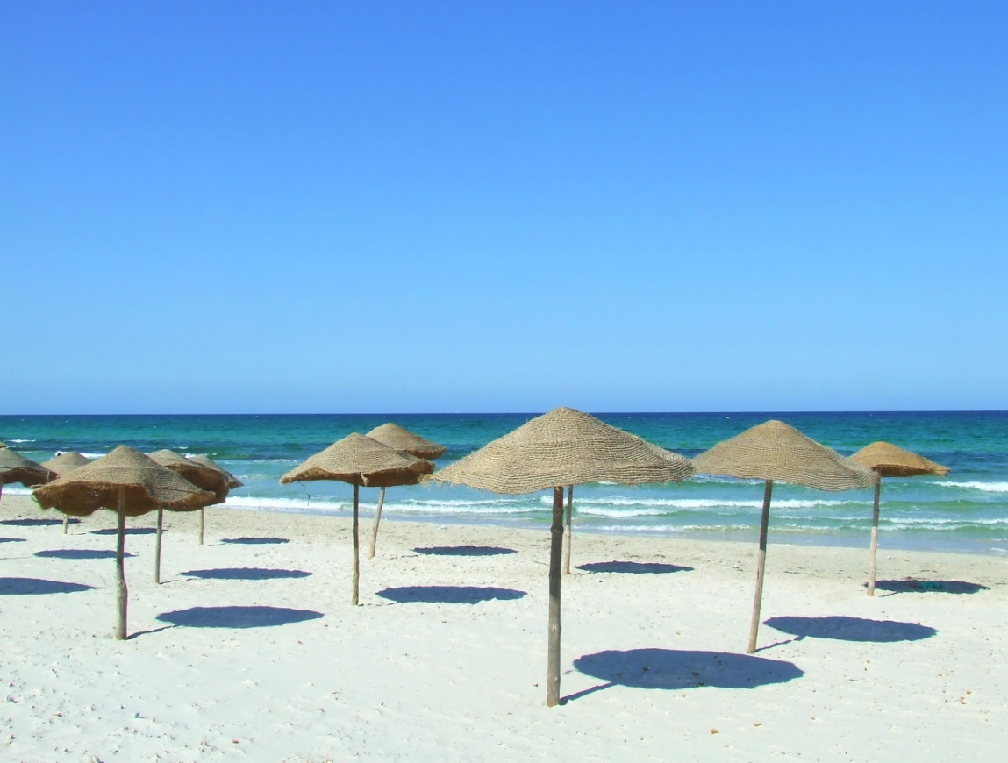
You just won a trip to Florida!

Slide 4
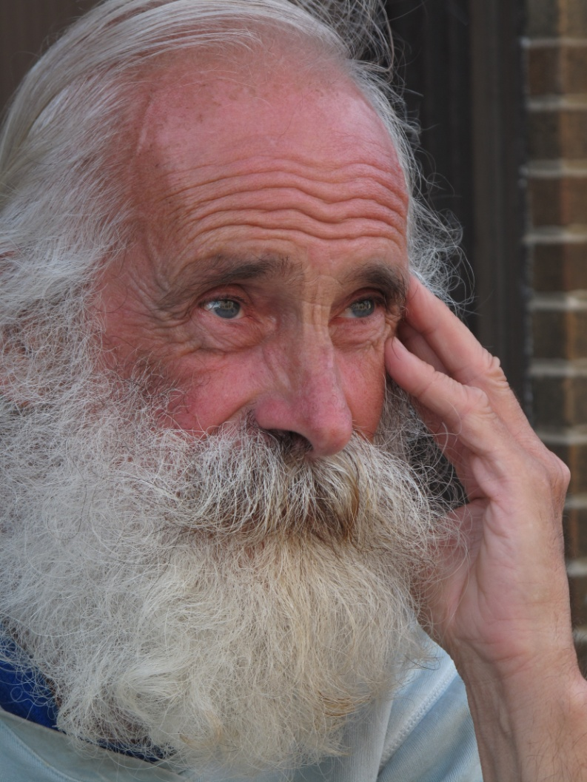
An older person you do not know walks up to you when you are waiting for your mum or dad

Slide 5
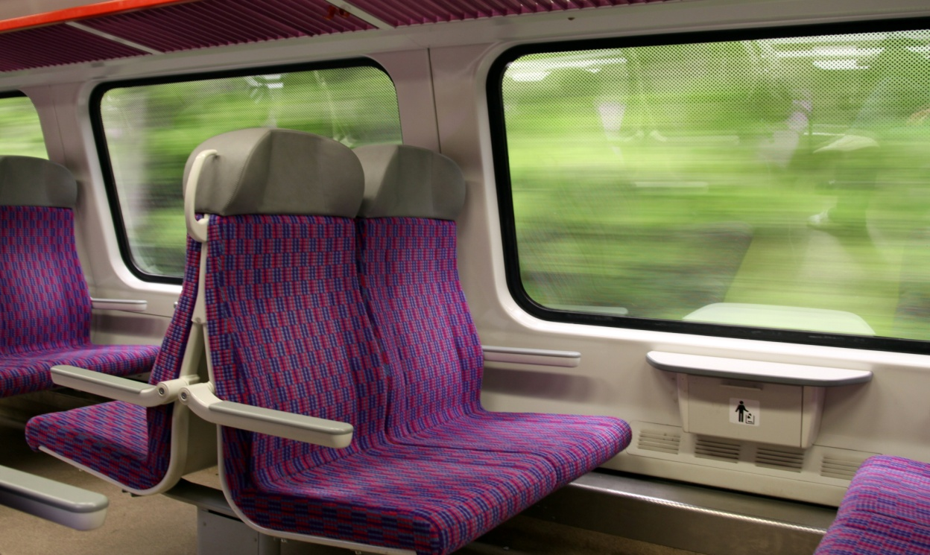
If the only seat left on the train was next to a person who smelt of alcohol

Slide 6
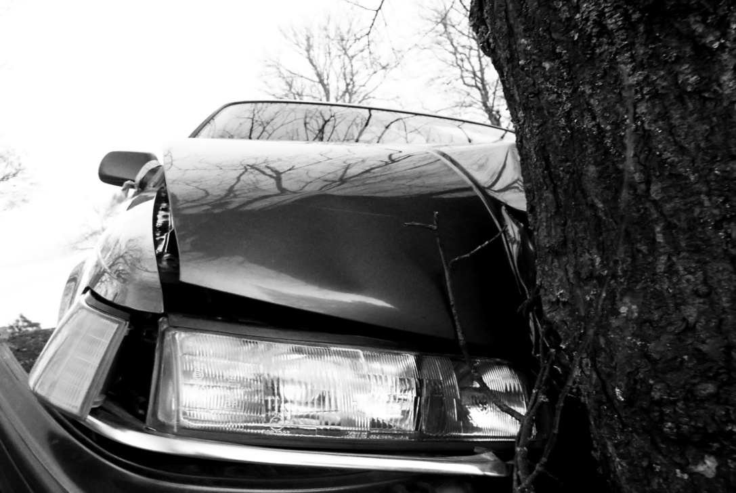
You saw a car accident
in the street

Slide 7
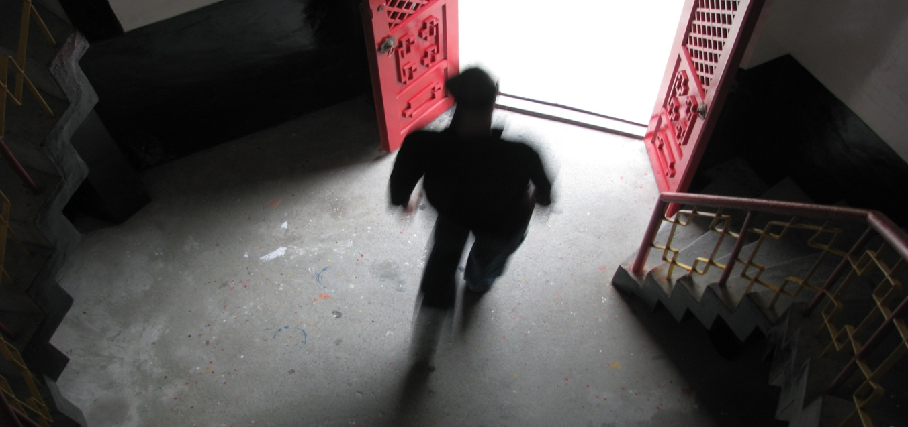
A tall dark figure came to the front door who you did not recognise and your mum had popped out for 5 minutes

