Slide 1
Internet Safety
The following have been reported
By young people of your age.

Slide 2
I met Sam in an internet chatroom. We have been in contact for a few weeks. He wants to meet. What do you think? Jillian, age 12
Meet up, you get on well
I would take my friend with me to the meeting
Don’t meet up, but there is no harm in chatting
Tell your parent where and when you meet and take them with you

Slide 3
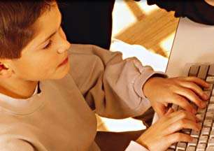
Gwyn has asked for my phone number and e.mail address. We have been in contact for a few weeks. We get on really well we are Man U fans. What should I do? Ian age 11
This is a good idea
Continue to chat but do not give him personal details
Stop chatting immediately
Continue to chat and discuss with a trusted adult

Slide 4
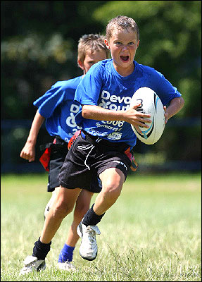
Jack sent me a photo of him playing rugby He wants a photo of me. What should I do? Sian age 12
This is a good idea
Don’t send a photo, tell an adult
Don’t send but carry on chatting
Send only a photo of Sian’s face

Slide 5
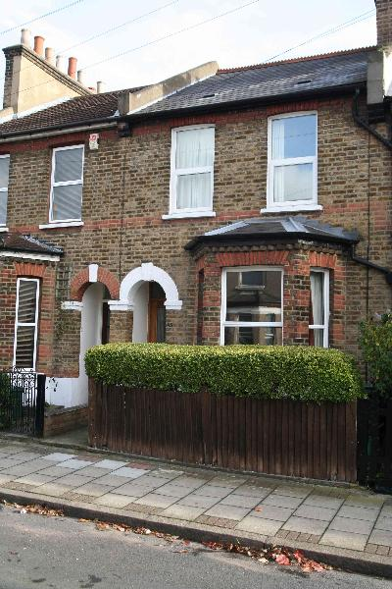
Sarah has asked for my home address. We have been friends on the internet for months. She wants to visit my home. What should I do? Janet age 13
This is a good idea
Continue to chat but do not give your personal details
Stop chatting immediately
Continue to chat and discuss with a trusted adult

Slide 6
Because I refused to meet with Gary my chatroom “friend”. Now he is threatening to write nasty things about me. What should I do? Lowri age 11
Don’t tell anyone else
Save the message and report it
Agree to meet, to stop him carrying out his threat
Talk to a trusted adult

Slide 7
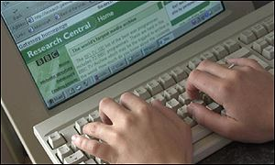
For the past month some people on my MSN contact list are always writing nasty and horrible things about me. What should I do? Imran age 12
Keep it to yourself, ignore them
Save the messages and report them
Stop chatting immediately
Talk to a trusted adult

