Slide 1
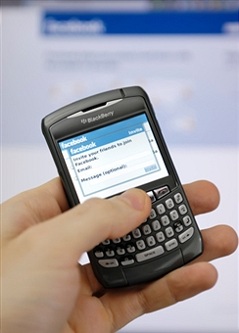
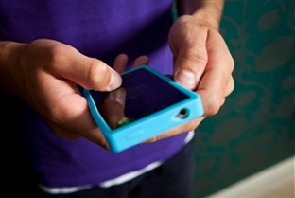
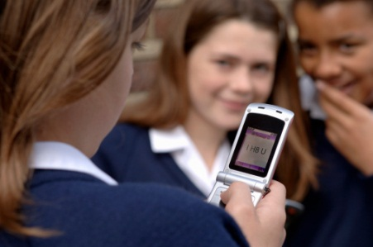
cyberbullying
is when…
someone hurts, threatens or frightens you regularly by sending messages or images using the Internet, mobile phones or other forms of digital communication
Resource 3a

Slide 2
Staying in control
What should you do if you receive a nasty text message?
What is spam?
Why should you never send a picture to anyone you do not know in the real world?

Slide 3
Staying in control
Why should you never give your mobile number to anyone you do not know in the real world?
Why should you never meet up in real life with someone you have met on the internet
What should you do to report a mobile phone call that upsets you?

Slide 4
Mobile phone safety advice
Meeting someone you have only been in touch with online can be dangerous
Respect your friends’ privacy
Only give your mobile number out to people you already know and trust
Learn how to block other users.

Slide 5
Mobile phone safety advice
Get your friend’s permission before taking pictures of them
Look after each other and think carefully about what you send to others
Never reply to messages from people you don’t know

Slide 6
Mobile phone safety advice
O2 08705214000
Vodaphone 0870 0700191
Orange 07973 100450
T-Mobile 0845 4125000

