Slide 1
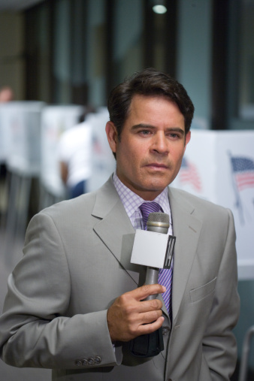
Resource 5a
The Jerome acyle show!
“They think he is grooming me – but we are in love! He just wanted to keep it secret to be more romantic.”

