Slide 1
(2b) Gang culture

Slide 2
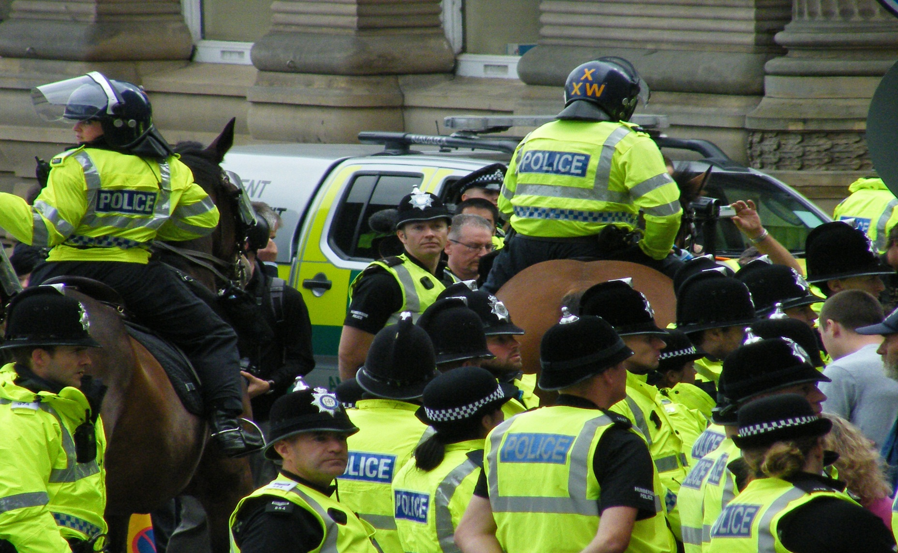
Police in riot gear

Slide 3
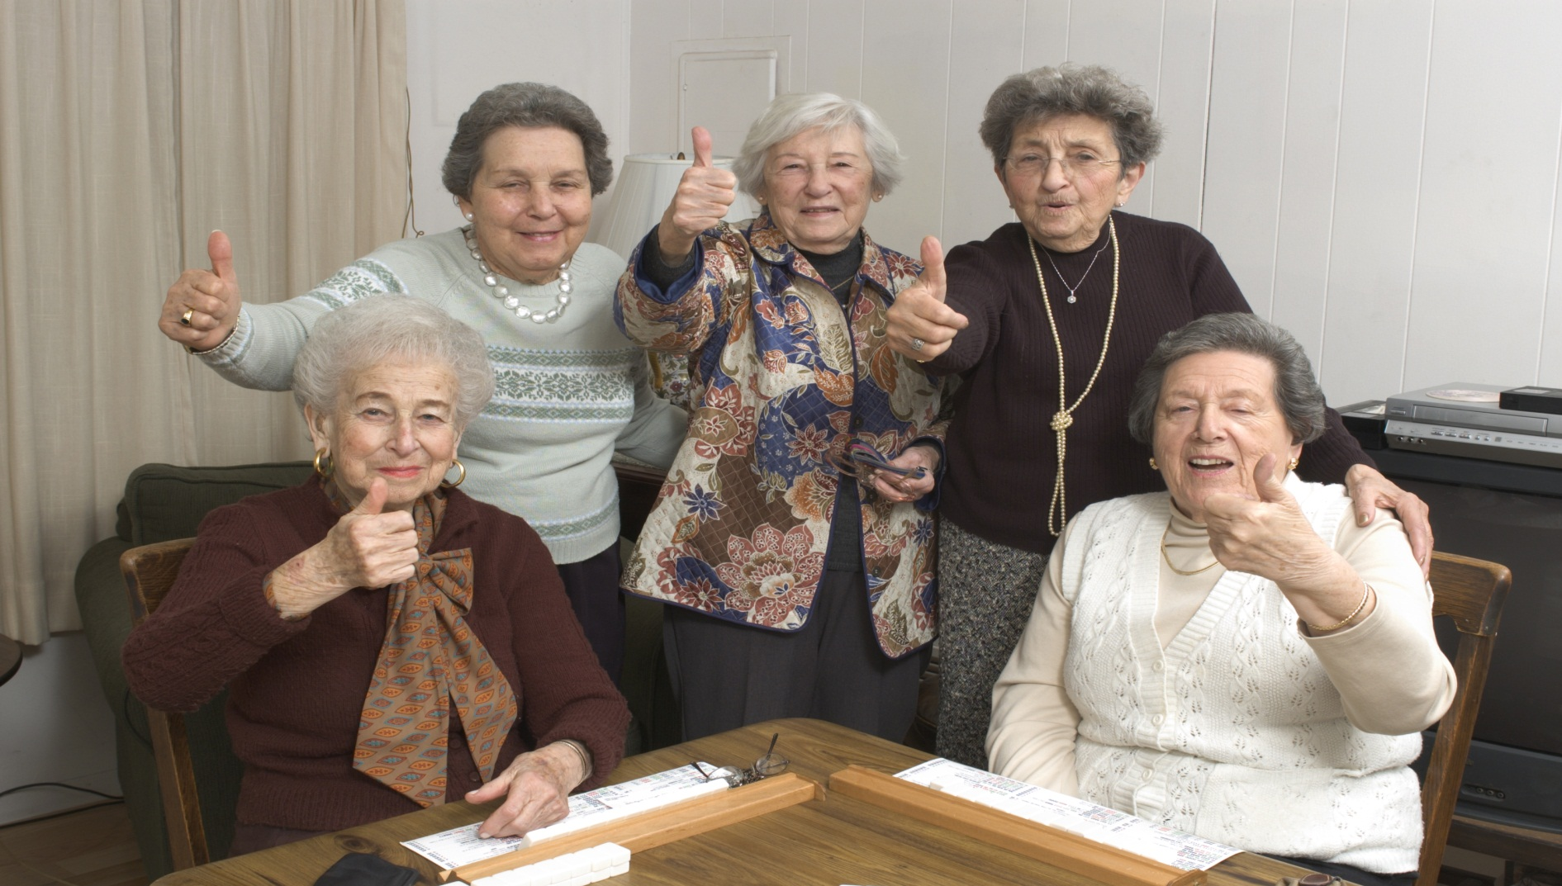
Senior citizens

Slide 4
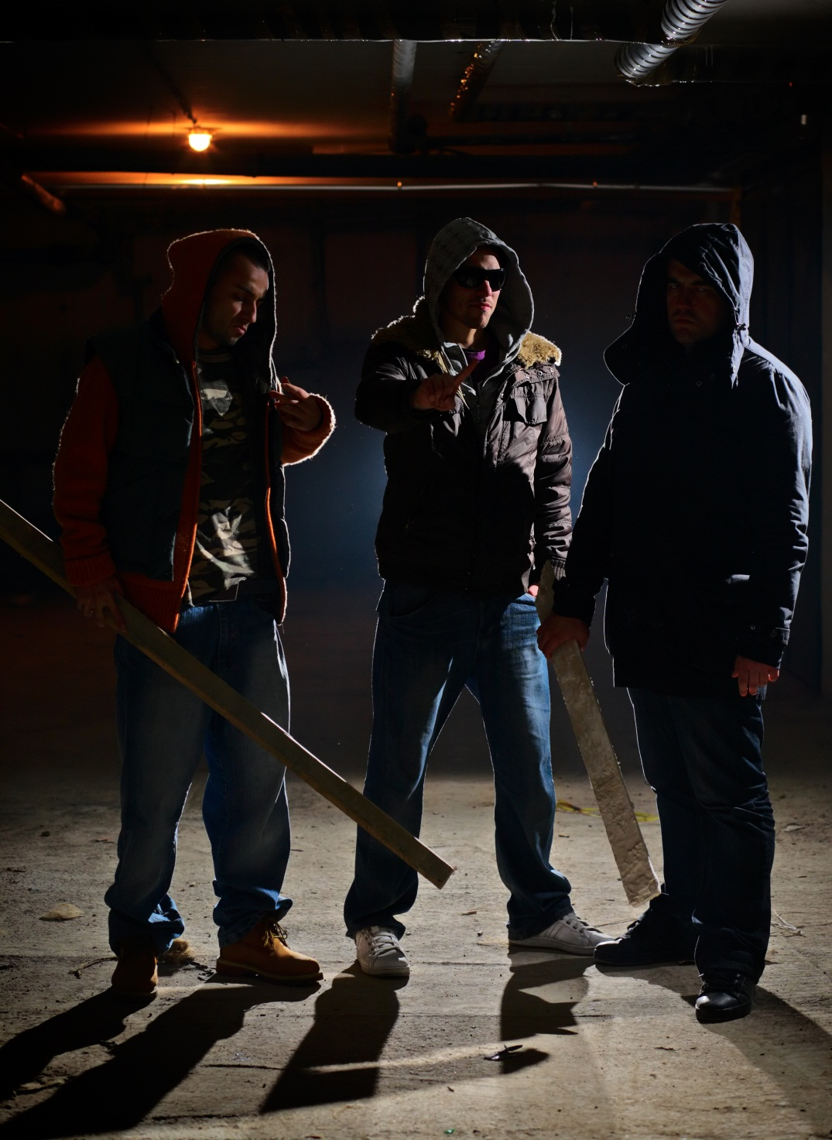
Hooded youths

Slide 5
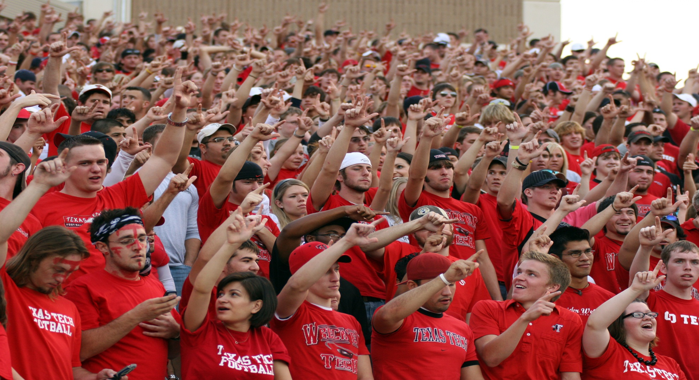
Sporting fans

Slide 6
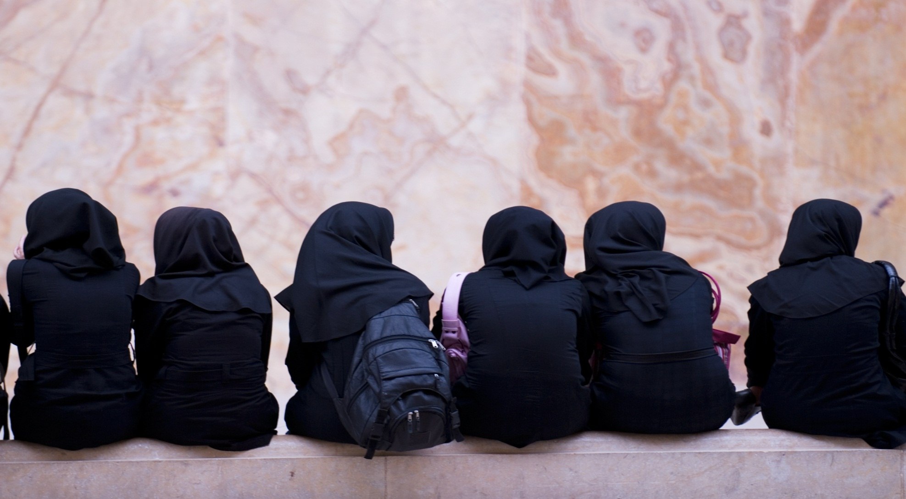
Muslim girls

Slide 7
Medical staff

Slide 8
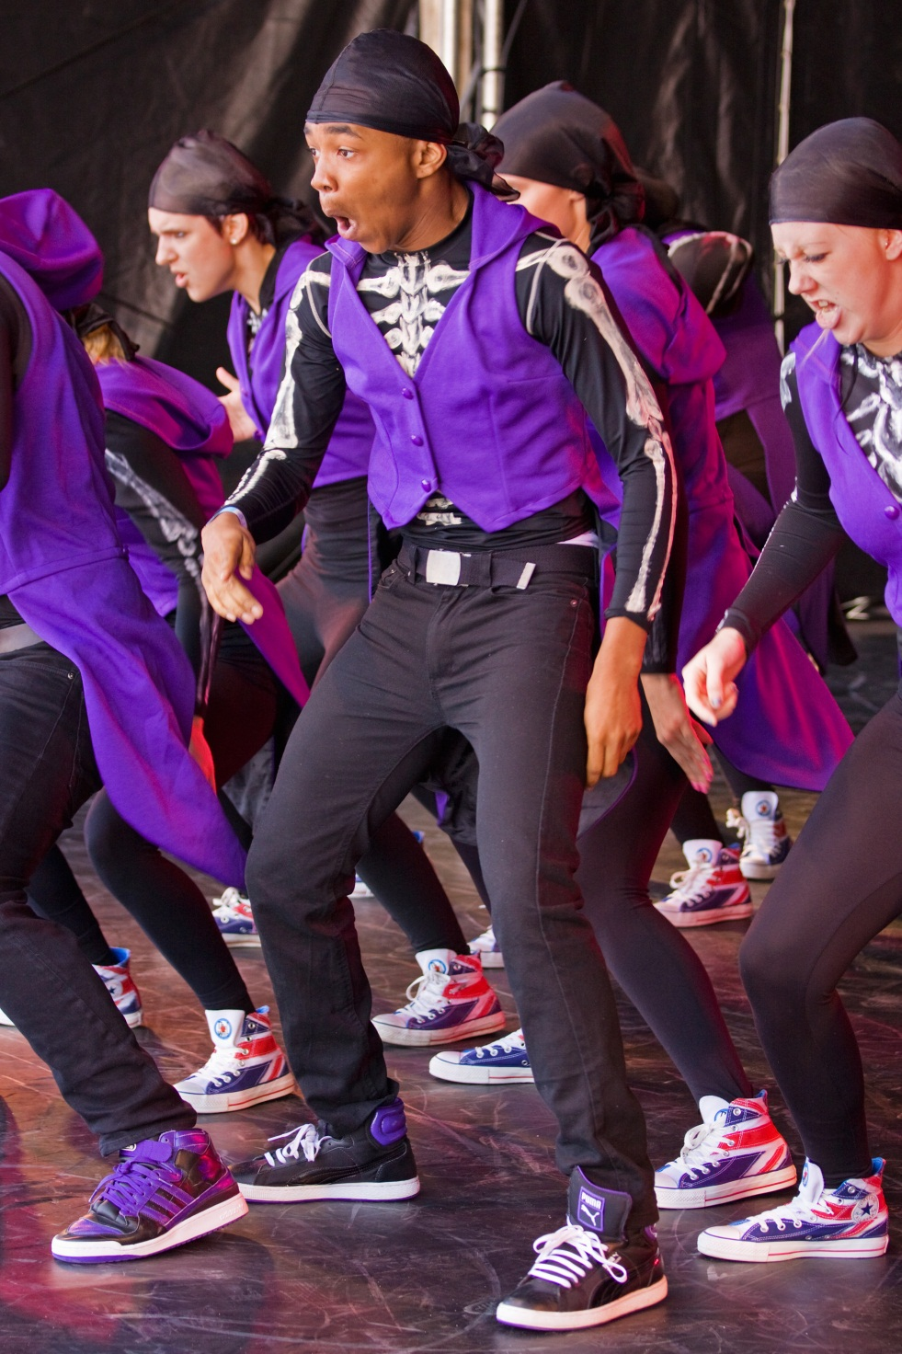
Dancers

Slide 9
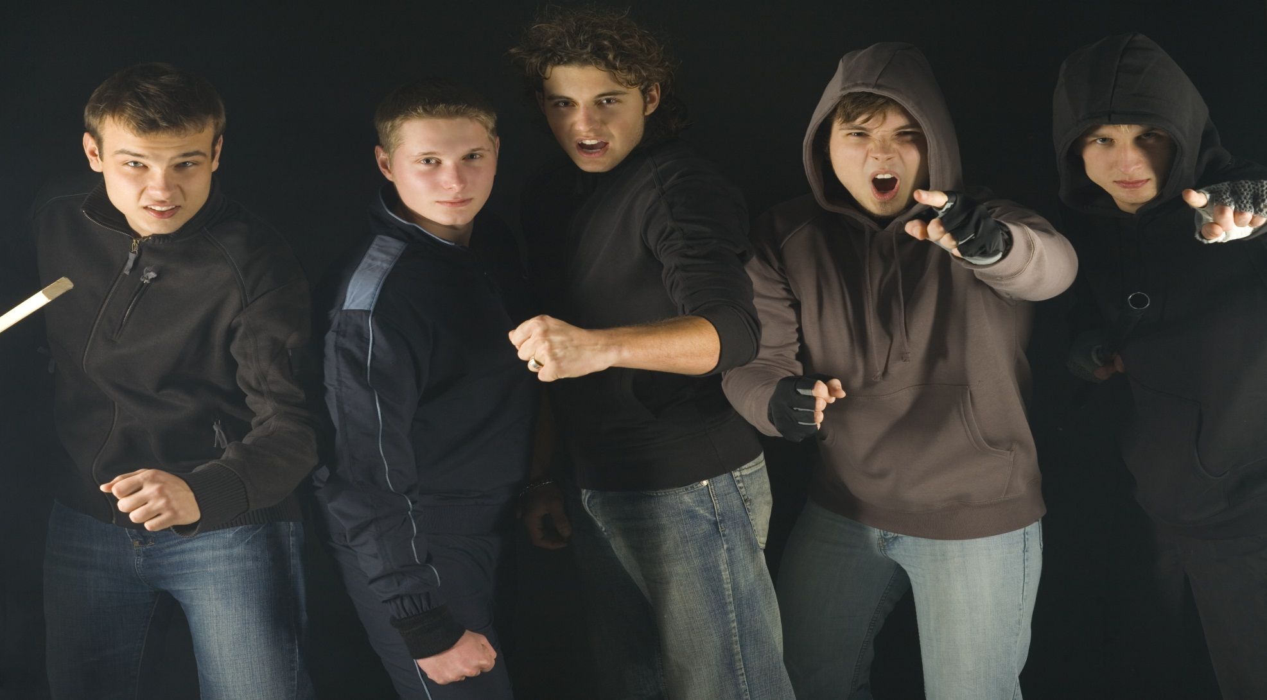
Teenagers

Slide 10
Friends

Slide 11
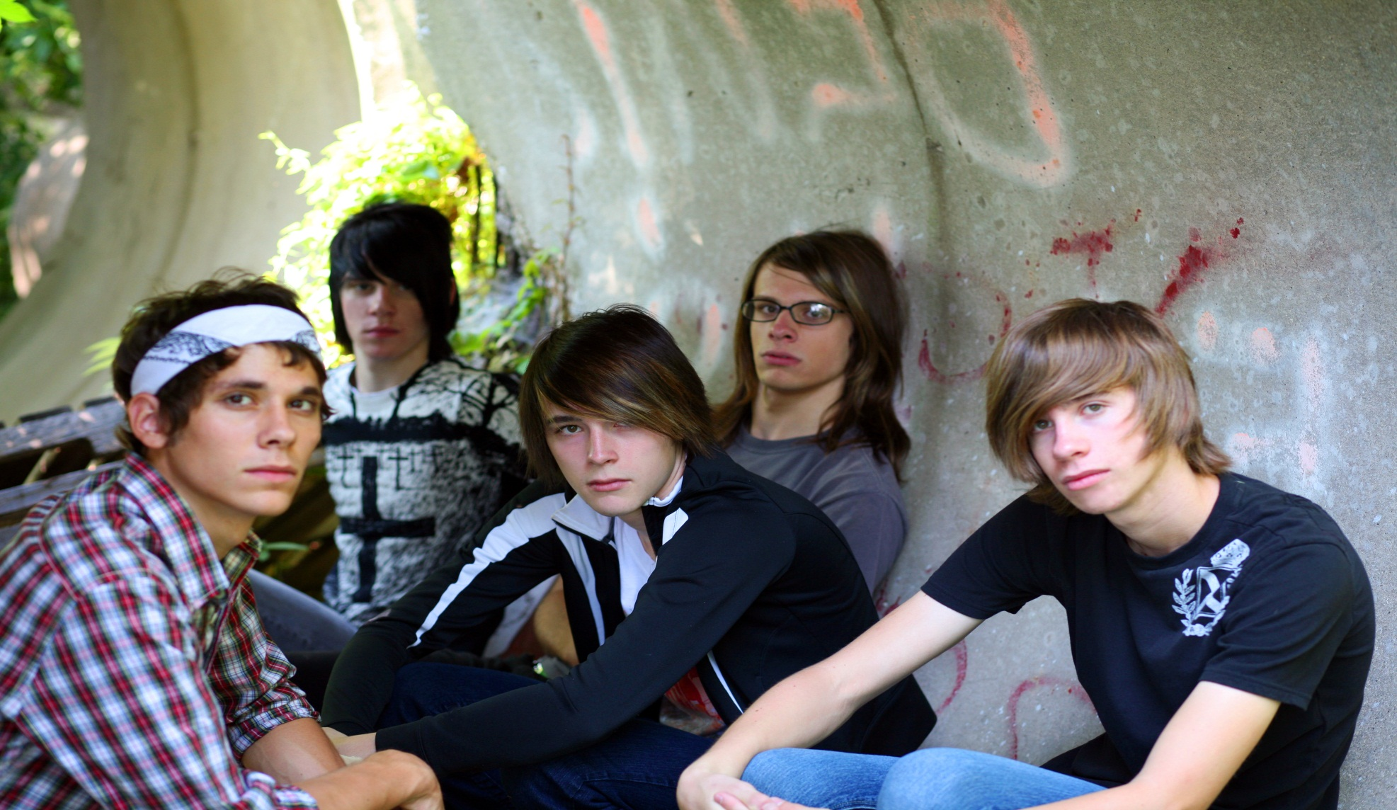
Boys together

Slide 12
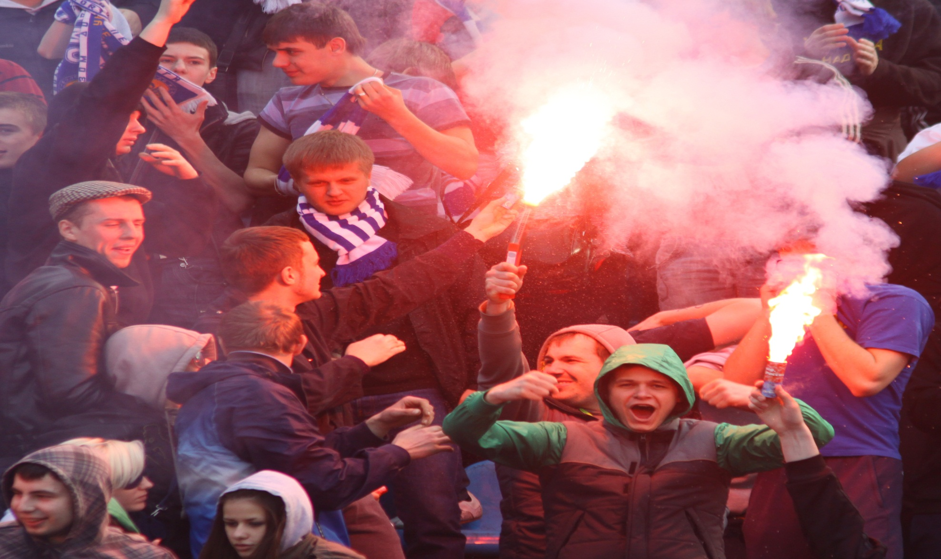
Supporters

Slide 13
Youths disagreeing

