Slide 1
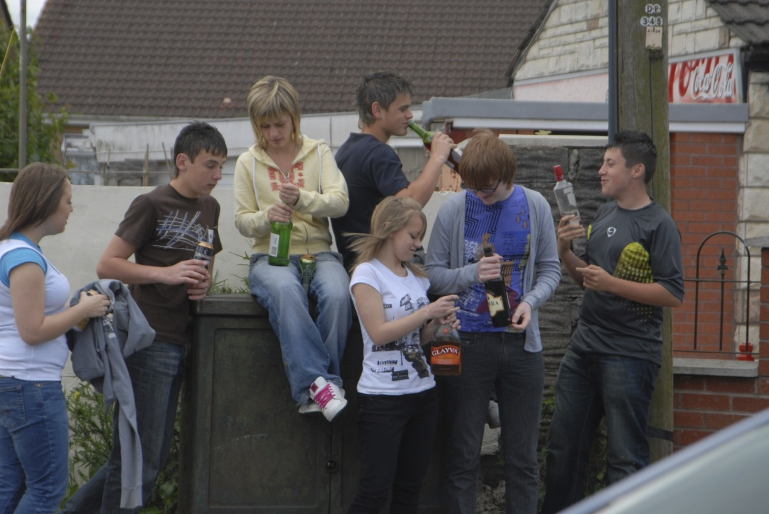
Alcohol, Young People and the Community
Facts and Consequences
Activity1

Slide 2
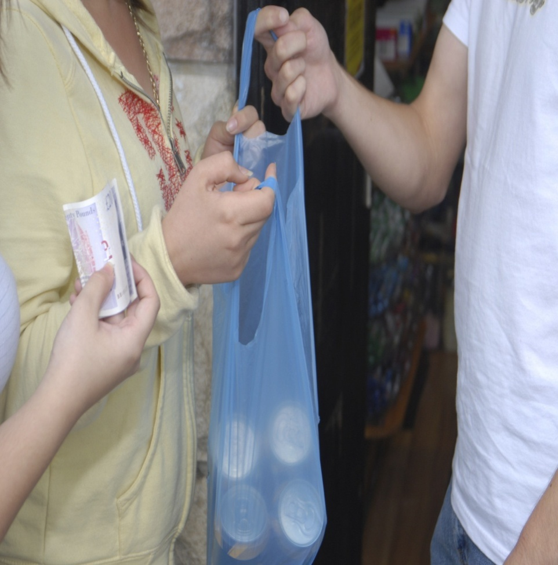
Where do they get it?
10% of 12-15 yr-old drinkers say they buy their own alcohol.
63% of 16-17 yr-olds have bought their own booze in pubs, nightclubs and bars.

Slide 3
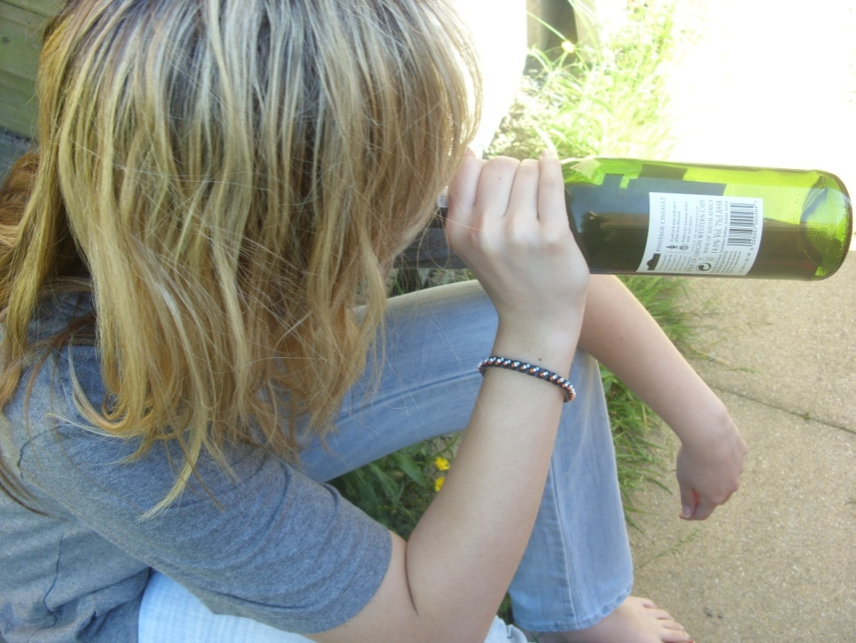
What do young people drink?
Beer and lager are the most popular drinks among under 18s, with spirits, wine and alco-pops also popular.

Slide 4
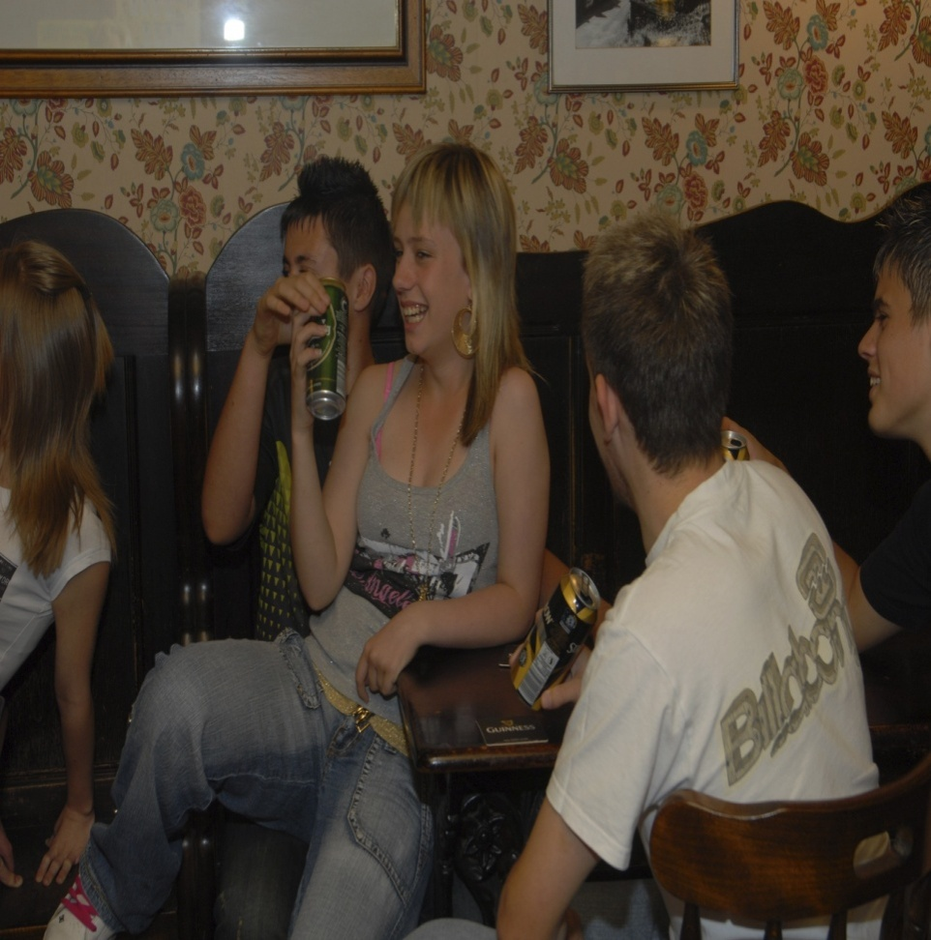
Where do they do it?
54% of 11-12 year olds said they drank at home or at someone else's home.
33% of 15 yr-olds drank alcohol in a pub or bar.
26% of 14-yr-olds said they drank at parties with friends.

Slide 5
How much do they drink?
The average alcohol consumption over the past week of boys aged 11-13 has shot up from 3.6 units in 1992 to 8.6 units in 2006.
Girls in the same age group now drink an average of 7.9 units in a week, up from 3.1 in 1992.
For boys aged 15 that figure rises to 13.1 units a week, and 10.5 units a week for girls.

Slide 6
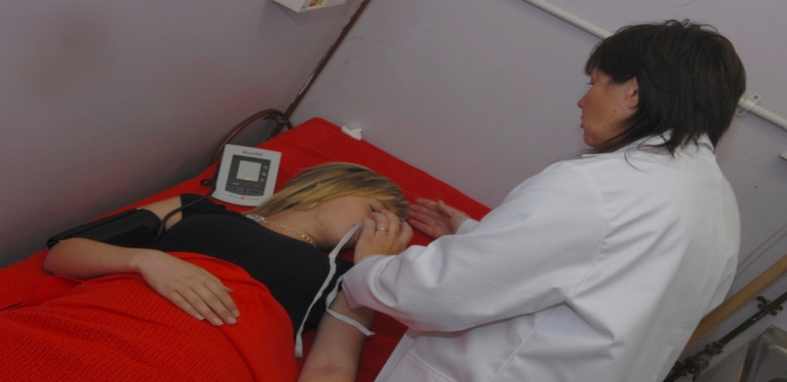
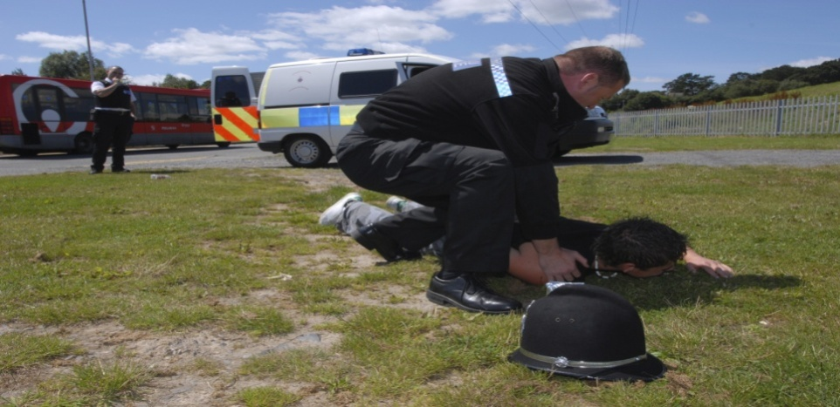
Why Worry?
A survey of underage binge drinkers aged between 14-17 asked the teenagers what problems their binge drinking had led to. Answers included unsafe sex, injury, anti-social behaviour, criminal damage, drug taking, involvement in dangerous driving and problems with the police.

Slide 7
Fact
The ages of children admitted to hospital for alcohol-related problems are getting higher. The number of eight-year-old-boys who drink has doubled from 5 per cent in 1995 to 10 per cent in 2005. The number of 11-year-old girls who drink has increased from 15 per cent in 1995 to 25 per cent in 2005. Many experts believe country is in the grip of a hidden epidemic - one that, like alcoholics themselves, the country is in denial about.

Slide 8
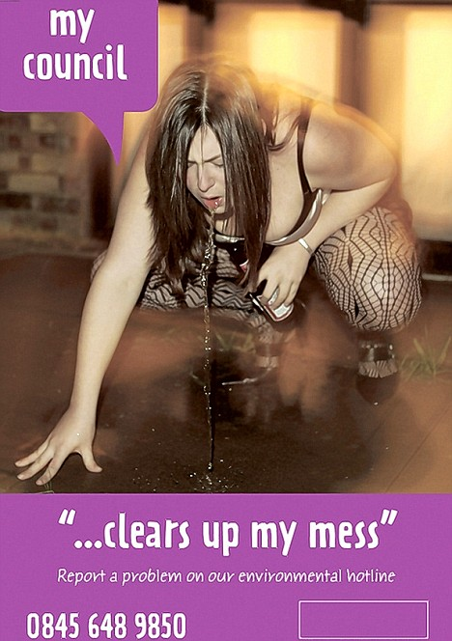
Task - How does binge drinking affect other people in the community?
We don’t always think about the consequences binge-drinking has on others in the wider community.
Your task is to design a poster that reflects how young peoples’ behaviour under the influence of alcohol affects your local community.

