Slide 1
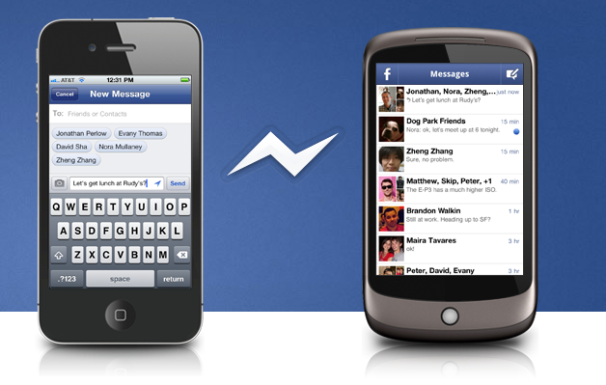
Jellibean and Surferboi
Resource 2a.
Jellibean
Hi..nice pic!

Slide 2
Group work
Exchange of Personal Information
Exchange of personal details, e.g. area location, school attended, home address, age, real name, telephone numbers, pictures, GPS position.
Small Talk
Use of small-talk or banter to build a social bond.
Activities
Exchange of information about interests, likes, dislikes, hobbies. Offline and online behaviour. Sexual and non-sexual behaviour. In the past, present, future or planned behaviours/activities
Compliments
Praise and compliments on target’s appearance, ability, skills, personality and possessions.
Relationships
Discussion about feelings whilst probing for information about the personal relationships of the targeted person with the significant people in their lives, i.e. family, boyfriend/girlfriend/friends.

Slide 3
Exchange of Personal Information
Exchange of personal details, e.g. area location, school attended, home address, age, real name, telephone numbers, pictures, GPS position.

Slide 4
Small Talk
Use of small-talk or banter to build a social bond.

Slide 5
Compliments
Praise and compliments on target’s appearance, ability, skills, personality and possessions.

Slide 6
Relationships
Discussion about feelings whilst probing for information about the personal relationships of the targeted person with the significant people in their lives, i.e. family, boyfriend/girlfriend/friends.

Slide 7
Activities
Exchange of information about interests, likes, dislikes, hobbies. Offline and online behaviour. Sexual and non-sexual behaviour. In the past, present, future or planned behaviours/activities.

Slide 8
Jellibean

Slide 9
Jellibean & Surferboi

Slide 10
In reality who is Surferboi?

Slide 11
Clare thought she knew…
schoolbeat.org/youtube/clares-story

Slide 12
Definition
Grooming is the way in which an adult deliberately befriends a young person and gains their trust so that they can sexually harm them.
Groomers can be young or old and any sex.

Slide 13
Strategies to stay safe online
1
2
3
4
5
6
7
8
9
Rank according to what you think is the most important strategy to reduce online risks and make Internet use safer for young people.

Slide 14
Reporting

Slide 15
Finish the sentence….
If someone you are talking with makes you feel uncomfortable you should…
If someone sends you an inappropriate picture or message you should…
If someone you only know online asks you to meet up you should….
If someone says something inappropriate when you are gaming you should…
If someone claims to be a friend of a friend and wants you to accept their friendship request you should…
If someone you only know online wants to Skype call with you, you should…

