Slide 1
The Law and the Offence of Grooming
Resource 5a.

Slide 2
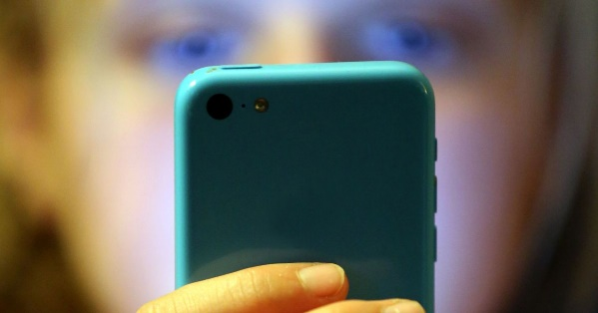
Definition
Grooming is the way in which an adult deliberately befriends a young person and gains their trust so that they can take advantage of them and or sexually harm them.
Groomers can be young or old and any sex.

Slide 3
What is online sexual harm?
Starting sexual conversations
Asking for naked pictures or videos
Asking for you to do something sexual on a webcam
Sending you naked pictures or videos
Asking to meet you in person.
(Under 18)

Slide 4
Grooming and the Law
Grooming - The offence under section 15, Sexual Offences Act 2003 is that of meeting a child with the intent to have sexual contact with him or her.
A new offence, Sexual Communication with a Child, came into effect on 3 April 2017, and covers both online and offline communication; including through social media, e-mail, and letters.
Adult groomers face up to two years in prison and being automatically placed on the Sex Offender Register.

Slide 5
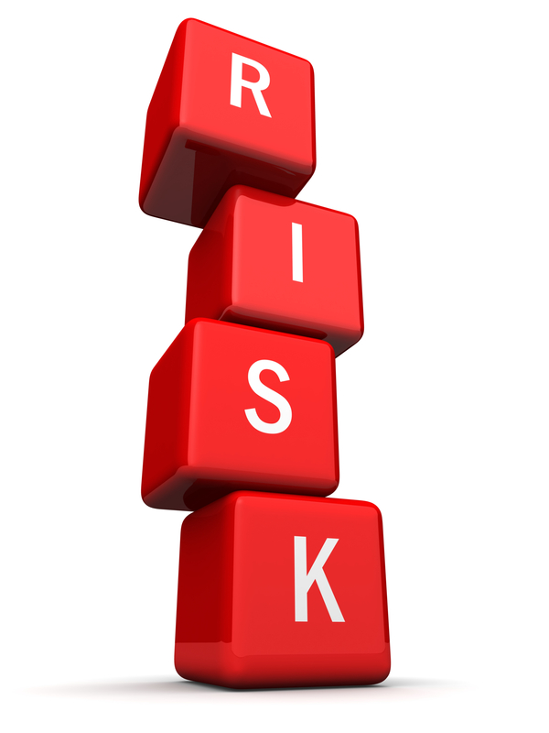
Scenario cards
Recognising risk is an important skill to help keeping you safe online.
Complete Resource 5b. Who’s at risk? Scenarios.
Identify who is most at risk of harm.

Slide 6
Janie

Slide 7
Mike

Slide 8
Rhian and Fatima

Slide 9
Owain

Slide 10
Molly

Slide 11
A.J.

Slide 12
Raisa

Slide 13
Post-it notes
What advice would you give those identified as being at risk of harm, to reduce their risk and be safer online?
Write your suggestions on Post-it notes.

Slide 14
Remember…

Slide 16
Write down one thing you are going to do differently as a result of today’s lesson.
?

