Slide 1
Gweithgaredd Meddyliau a Theimladau
Thoughts and Feelings Activity
Resource 10a.

Slide 2
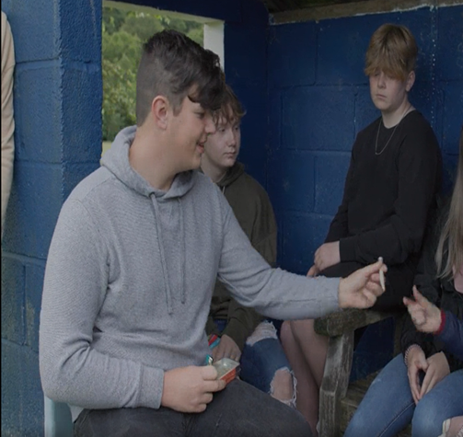
When you are a dealer
Thoughts
___________________________________________________________________________________________________________________
Feelings
____________________________________________________________________________________________________________________________________

Slide 3
When you are arrested by the Police
Thoughts
___________________________________________________________________________________________________________________
Feelings
____________________________________________________________________________________________________________________________________

Slide 4
When your room is searched
Thoughts
___________________________________________________________________________________________________________________
Feelings
____________________________________________________________________________________________________________________________________

Slide 5
When you are reprimanded
Thoughts
___________________________________________________________________________________________________________________
Feelings
____________________________________________________________________________________________________________________________________

Slide 6
When you consider your future
Thoughts
___________________________________________________________________________________________________________________
Feelings
____________________________________________________________________________________________________________________________________

