Slide 1
Cosbau Dosbarthiad Cyffuriau
Law and Penalties
Resource 7f.

Slide 2
Possession means having an illegal drug

Slide 3
There is a strong possibility YOU will be arrested.
The police have three options of punishment

Slide 4
A Warning is put on local police file. If you offend again this may influence the Police to charge you.
OR

Slide 5
A Final Warning is when a central police record is held for 5 years. If you offend again this can be used against you.
OR

Slide 6
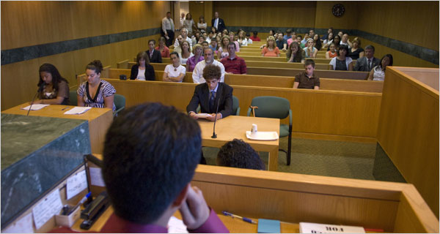
The third option is to charge you with an offence leading to a youth court hearing.

Slide 7
If you had any intention of dealing (which can include giving or sharing drugs) it is considered as possession with intent to supply.

Slide 8
If you have a drugs record then obtaining a visa to travel to some countries may be difficult or even denied.

Slide 9
It could affect your job prospects.
An employer may check if you have a criminal record.

Slide 10
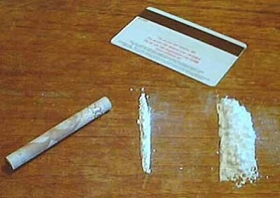
Class A
Includes cocaine, crack, ecstasy, heroin and LSD
Maximum penalties are:
7 years prison and / or a fine for possession
Life imprisonment and / or an unlimited fine or seizure of assets for supply

Slide 11
Class B
Includes Speed (amphetamines), GHB and Cannabis
Maximum penalties are:
5 years prison and / or a fine for possession
14 years prison and / or an unlimited fine and seizure of assets for supply

Slide 12
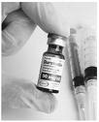
Class C
Includes the supply of anabolic steroids, tranquillisers, possession of temazepam and rohypnol
Maximum penalties are:
2 years prison and / or a fine for possession
14 years prison and / or an unlimited fine and seizure of assets for supply

