Slide 1
Metal detectors and body scanners
Activity 3
Why Weapons?

Slide 2
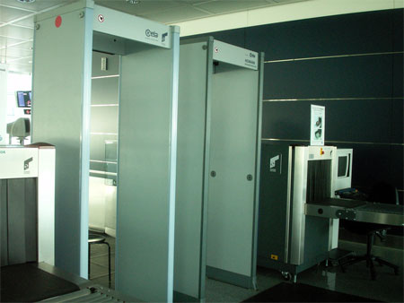

Slide 3
Hightown Secondary School
Memo from the Head teacher, Mr Solomon
For the attention of every member of the School Council
School Council Agenda Item
Scanner Report
(To be discussed at the next meeting of the school council to be held on ….)
Metal detectors are a familiar site at airports, football matches, concerts, nightclubs and museums.
Scanners quickly identify persons carrying hidden knives or weapons.
Many schools are beginning to use metal detectors but this can be controversial.
Some believe their use in schools is a good way of tackling knife crime, but many teachers and MPs and see them as a threat to civil rights.
The argument looks set to continue for a long time but metal detectors in schools have been common in the United States for many years, supervised by security guards and teachers.
Other technology that can help detect weapons includes CCTV systems.
Many schools have found that CCTV has lead to many other improvements including;
- reduction in violence - reduction in vandalism & graffiti - reduction in pupils carrying drugs and weapons to school - reduction in theft - general improvement in pupil behaviour
Activity 3a) Why weapons? – School Council scanner report

