Slide 1
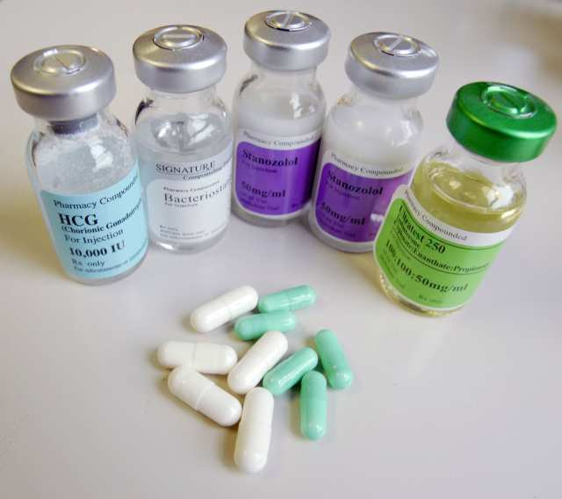
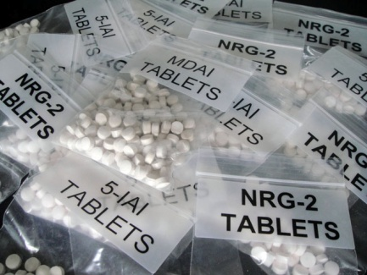
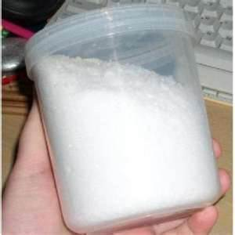
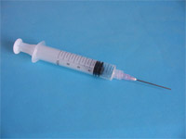
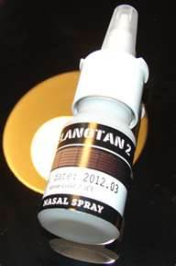
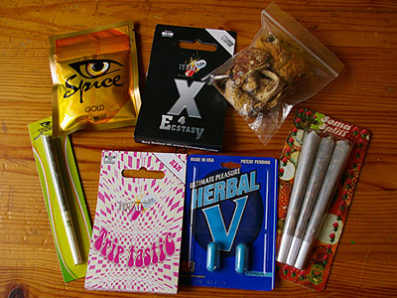
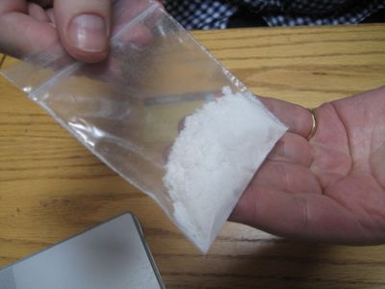
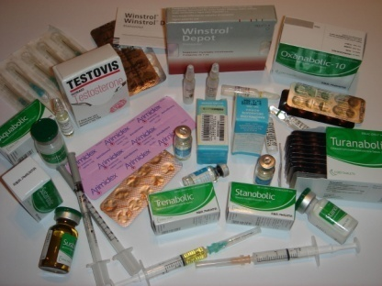
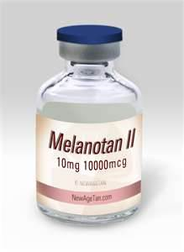
New Psychoactive Substances (NPS)
and performance enhancing drugs

Slide 2
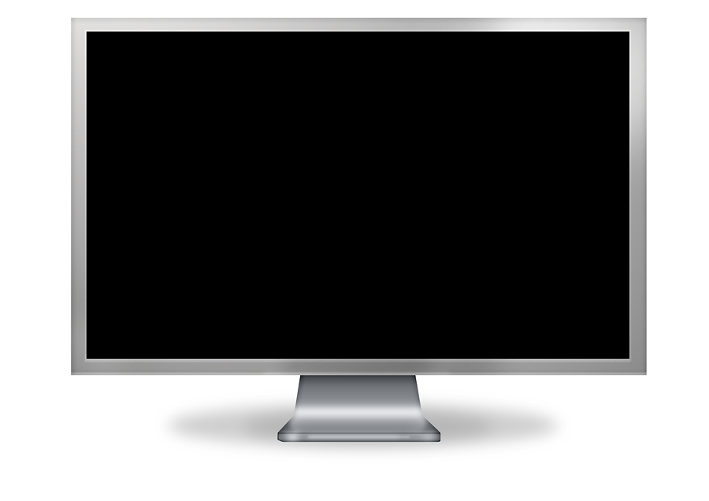
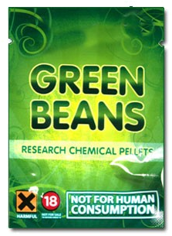
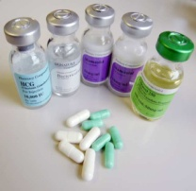
NPS are psychoactive substances or drugs that are controlled under the Psychoactive Substances Act 2016. It illegal to produce, supply, offer to supply, possess on custodial premises or advertise them. You could go to jail for 7 years!
Notes:
Explanation: Psychoactive drugs are chemical substances that affect the brain functioning, causing changes in behaviour, mood and consciousness.

Slide 3
Activity 1
NPS
Myth
FACT
or
1) NPS are safer because they are new
2) NPS are more pure than illegal drugs
3) You can't get arrested if you have them
4) Young people can get easy access to them
Notes:
This first activity will raise awareness of 4 key messages around NPS. The activity will offer an opportunity to explore 4 statements and determine whether they are fact or myth.

Slide 4
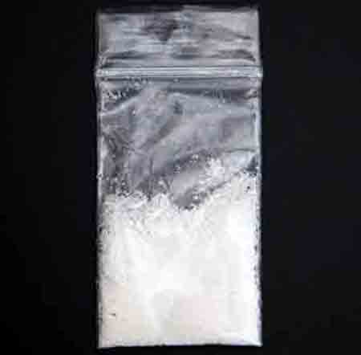
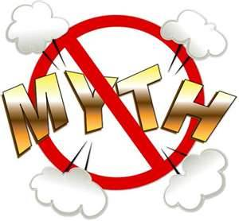
Myth or fact number 1 – NPS are
safer because they are new!
supplied from
an unsafe source
no instructions for
use and warning
of side effects
content unknown
Notes:
The substances may have come from anywhere - a dealer or the internet. The true source is unknown.
It is not prescribed by a doctor, supplied by a pharmacy, under strict licensing, or properly trialled to determine safety for use.
Unlike a genuine medicine; where the container not only tells us what’s in the drug but also, instructions for use and warnings of possible side effects, this substance’s packaging tells us nothing. Real medicines have a bar code that means the batch can be tracked precisely at the manufacturers. Producing safe medicine is a costly process but essential for consumers. Doctors and pharmacists are experts in prescribing medicines and supervise their use. Eg. If you had an allergic reaction you could go back to your GP for advice. Your GP is sworn by a Hippocratic oath to do everything possible to preserve your life.
Does the supplier of this unknown substance care about what happens to you?
The substance in the unmarked bag, offers no instruction how to take it or how much. We have no idea of what is exactly in the bag, just some kind of white crystal. There is no advice or warnings. We literally have no reliable information about this substance. The motive of the supplier of the drug is clearly to make money! There is no care or responsibility towards the user of the drug. Even if there is a name of the chemical formula on the packet or a street name there is no guarantee that the drug is what it says it is, as there is no regulation to protect us.

Slide 5
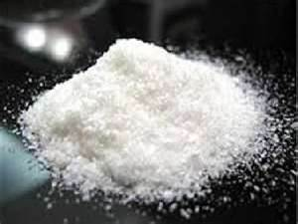
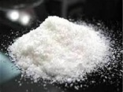
Myth or fact number 2 - NPS are
more pure than other illegal drugs
May be cut with different substances by dealers
With online suppliers there are no standards
enforced on the products
Notes:
Illegal drugs are usually cut with other substances to bulk them out and so the dealer can make more money. This is happening with NPS also. Once dealers catch on that there is profit to be made in NPS they stock pile them and then can treat them as they would the illegal substances they sell. Cutting legal substances on the same work surfaces as illegal can lead to cross contamination. Also even amongst online suppliers there is no standards enforced on the products they are selling. So even from amongst the same batch the strength and chemical composition may differ. No agency is controlling the quality or content of these NPS, so until they are analysed in a lab there is no way to know what exactly is in them.
Purity also does not determine safety in a drug. Purity means that there is less other fillers present and that the potency of a drug is potentially much stronger. This can be extremely dangerous and lead to accidental over dose when users take a quantity of a new batch of drugs equal to what they had previously taken, only to find that this new batch has a higher proportion of a dangerous substance that may be double or triple the strength they had previously encountered. Until a substance is analysed there is no way to know what substances it contains and in what measure.

Slide 6
Key message 2 about NPS
There is no telling
exactly what is in
any NPS
Notes:
There is no telling exactly what is in an NPS! This is important, as young people may inadvertently think that just because they buy something from the internet that it is going to be safe or exactly what it claims to be on the website. For example if you purchased NRG1 you may expect that NRG2 was the same drug, however, this is not necessarily the case. Sometimes if an NPS becomes illegal then it’s name may be used for a new substance that has a different chemical makeup. This can be very misleading for anyone thinking of using a substance.. Some of these internet substances were initially designed for the pharmaceutical industry and were found to be too potent or dangerous for use in people and therefore were not given licences for use in medicine.

Slide 7
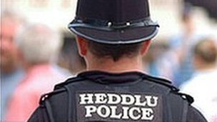
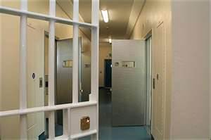
Myth or fact number 3 - You can't
get arrested if you have them!
The substance would be sent for
analysis. You could be charged
if it contains any illegal substances.
If found in possession
of an unknown substance
you would still be arrested
Notes:
If a young person is then caught with an NPS then what would happen? The young person can expect to get arrested on the basis that the police officer would have reason to believe he/she had in their possession a controlled substance. This would mean the experience of being taken to the police station, further searched and their parents being informed, and their home searched. What a young person may believe to be an unclassified and ‘legal’ substance, may in fact contain substances that are banned class A, B or C drugs and that would make them illegal to possess. When these substances are purchased from either a dealer or the internet we can not be sure what they contain until they are analysed.
Some NPS have actually had traces of cocaine or MDMA or other illegal substances in them. Another drug called ACMD or O-desmethyltramadol is currently being recommended by the Advisory Council on the Misuse of drugs to be consider for becoming a controlled substance. This drug has an opiate effect and has been found as an ingredient in the production of synthetic canabinoids. Herbal matter is sprayed with a substance to create a psychoactive effect. MXE (a ketamine like drug) is to become a Class B drug After being banned for most of 2012 it has been decided that MXE will become a controlled substance under the Misuse of Drugs Act and become a class B drug. Like Ketamine this drug can make people feel very chilled out, relaxed and euphoric. Some users have said that they feel ‘enlightened’ when taking MXE. Others have reported being agitated. MXE can produce a feeling of ‘floating away’, as if the mind and body are separated (called a ‘dissociative state’). You could feel completely detached from your body and surroundings, putting yourself in danger of accidentally being hurt or being hurt by others.

Slide 8
Key message 3 about NPS
NPS are often illegal
to possess and are
never legal to supply
Notes:
NPS are often illegal to possess and are never legal to supply! NPS will invoke the same response from the police with regards to arrest, searching, parents involvement and possibly even being charged and convicted. It is not worth the risk as a drugs conviction will impact on a young persons life in the long term not just short term.

Slide 9
Myth or fact number 4 - Young
people can get easy access to them!
Notes:
Many unclassified NPS can be purchased over the Internet which makes them very accessible to young people, who make a lot of their purchases through the use of the internet. Unscrupulous dealers will give away tasters to young people with the intention of creating a wider network of users. Friends who are not aware of the risks of taking unknown substances may also encourage others to take what they may believe is a safe and legal substance. Young people need to be empowered with the skills to resist unwanted peer pressure and to practice ways in which they can do this through classroom activity.

Slide 10
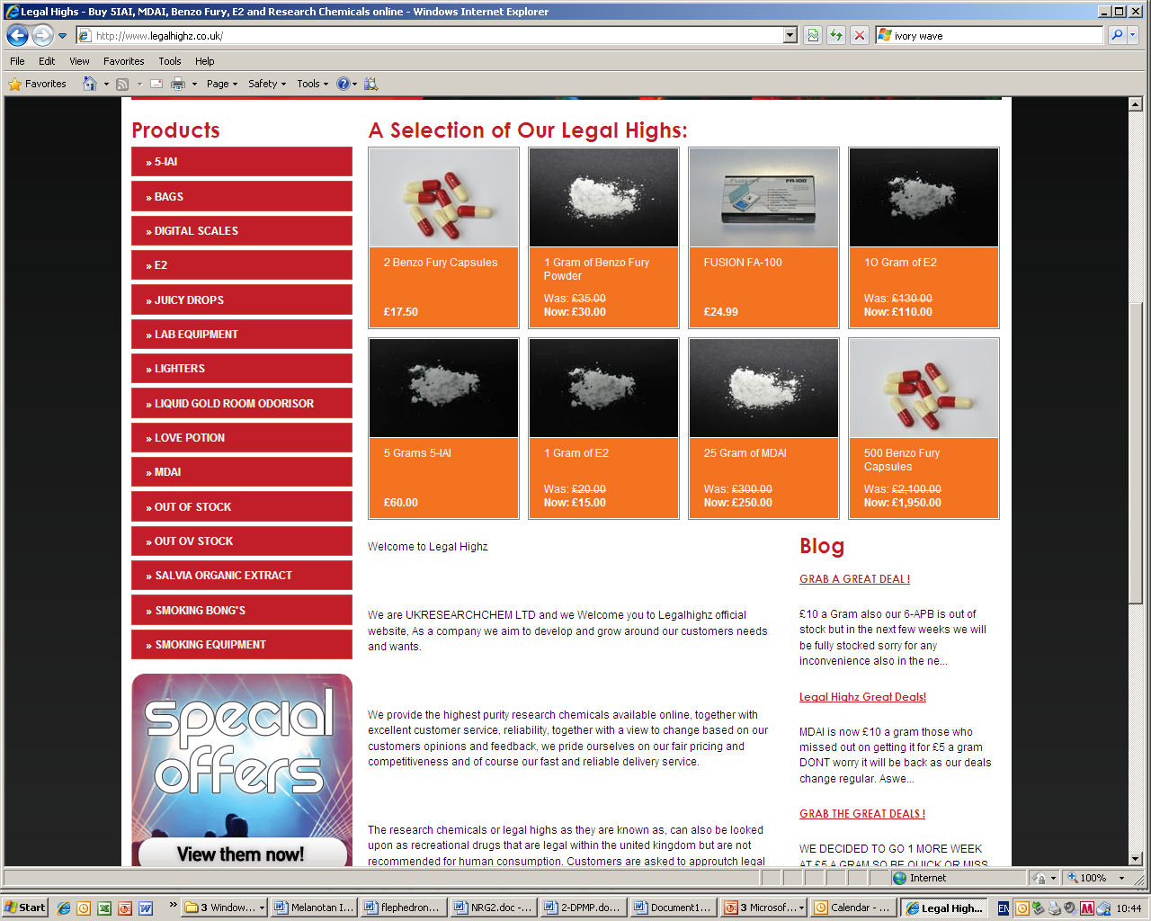
Key message 4 about NPS
Even though NPS are easily available,
it doesn’t make them safe!
Notes:
Many are easily available online. We do not want to raise the profile of where these drugs can be bought but we can not escape the reality of the domination of the Internet and the anonymity it appears to offer those buying products through it. There are countless drug forums where people speak at length about their drug use experiences and sometimes even post films on sites such as YouTube that show the effects of various different so-called legal substances. We must constantly encourage young people to question what they read on the Internet and to make informed choices that come from having a true picture of the risks associated with taking substances that we have so little knowledge about.
Even though these substances are easily available – it doesn’t mean that they are safe to take!

