Slide 1
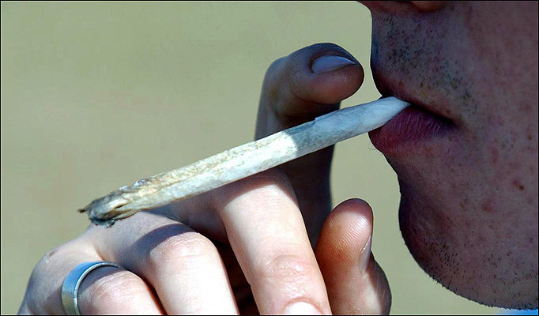
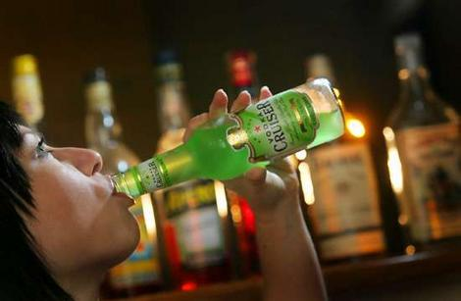
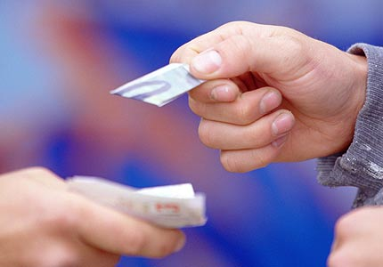
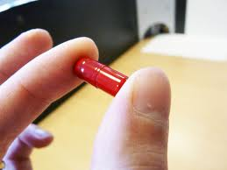

Opinion Finder
(full version)
AWSLCP
Substance Misuse
Notes:
1

Slide 2

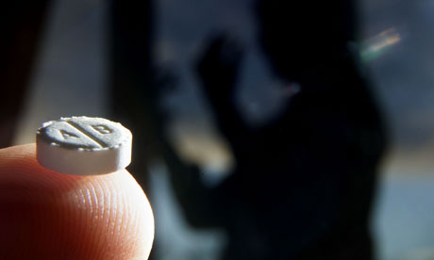
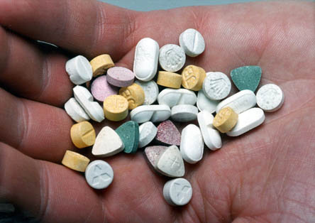
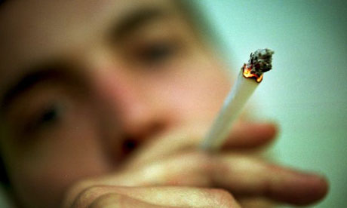
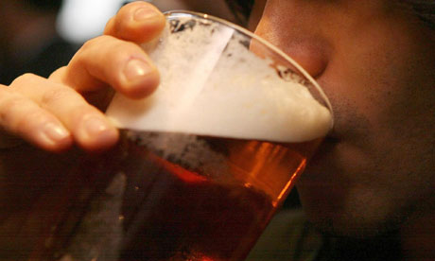
Opinion Finder Activity
agree
disagree
Notes:
New Psychoactive Substances are substances which produce the same, or similar effects, to drugs such as cocaine and ecstasy, but are not controlled under the Misuse of Drugs Act. They are controlled under the Psychoactive Substances Act 2016 ::
It is illegal to produce, supply, offer to supply, possess with intent to supply, possess on custodial premises, import or export psychoactive substances. i.e. any substance intended for human consumption that is capable of producing psychoactive effects. You could go to jail for 7 years!
NPS may contain other controlled (illegal) drugs such as Cocaine, Ecstasy, Cannabis, Heroin, Amphetamines, Methamphetamines, Ecstasy and MCAT (Meow Meow) contrary to the Misuse of Drugs Ac 1971.
You could be arrested for being in possession of NPS because it might contain an illegal substance. If you are arrested, it will remain on police records and will show on any future Disclosure and Barring Service (DBS) checks.
Give out an opinion finder sheet to each pupil. Move freely amongst them asking each one in turn their opinion regarding the 6 statements.
A tally should be kept for each response. This activity can be found on the schoolbeat website. There are an additional 7 statements to choose from.
2

Slide 3

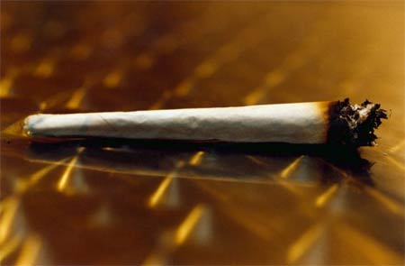
All pupils need to know, is how to say no to drugs
X
Notes:
The best approaches to drugs education involve providing up to date relevant knowledge that does not rely on ‘scare-tactics’ and that allows for pupils to develop appropriate skills relevant to making positive choices. Inputs from relevant professionals and agencies in addition to teacher inputs have been shown to be effective in helping pupils change opinions and reduce or take fewer risks. Pupils need to know about drugs from the perspective of the law, social impact and affects on health. SCPOs are best placed to deliver education as related to the law and social impact and are able to help schools deal with incidents of drug or substance misuse through implementation of the Crime Beat Protocol. This endeavours to reduce criminalisation of young people.
3

Slide 4

New Psychoactive Substances are a more socially acceptable form of drug taking
health risks
impact on community
social risks
safety risks
breaking of laws
impact on others
Notes:
Probably the most socially acceptable legal high (Over 18’s) is alcohol. There are many risks attached to New Psychoactive Substances. Health risks, social risks, breaking of laws through their influence and impact on the wider community through their use.
4

Slide 5
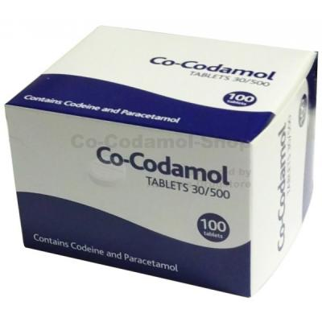
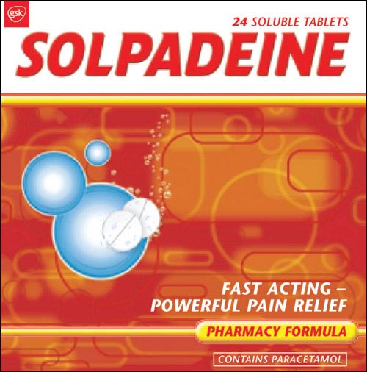
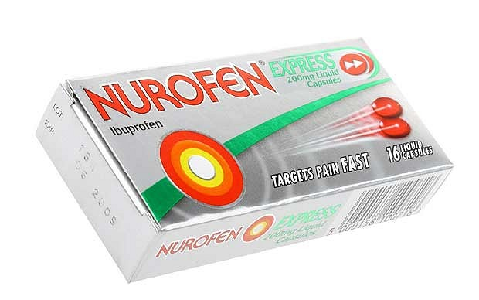
There is an unnecessary fuss over the care needed when using painkillers
Notes:
Over the counter painkillers can cause addiction in a week. The governments Medicine agency has warned that they may become addictive within a few days of use. New restrictions are being applied to medicines containing codeine; including Nurofen plus, and Solpadine, warnings will be clearly displayed on packs stating ‘Can cause addiction. For three days use only’. A survey found that Solpadine and Nurofen plus were the most commonly misused products, followed by generic co-codomol, Syndol and feminax. Women are feared to be at most risk. A headache that won’t go away can be a sign of painkiller addiction. The only cure for what neurologists refer to as “medication overuse headaches” is to switch to painkillers not containing added ingredients like opioids or caffeine, or going cold turkey and cutting out painkillers altogether.
5

Slide 6
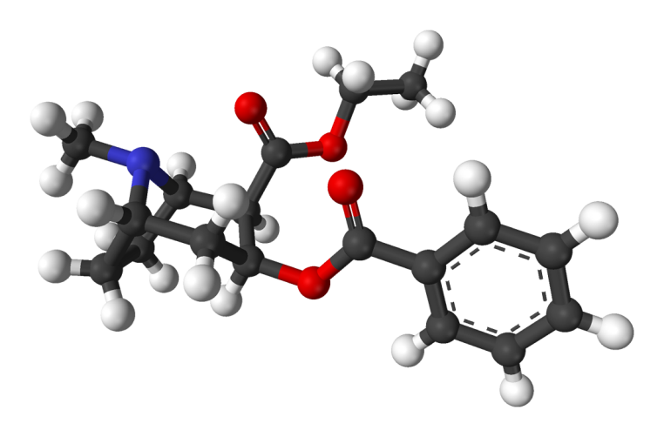
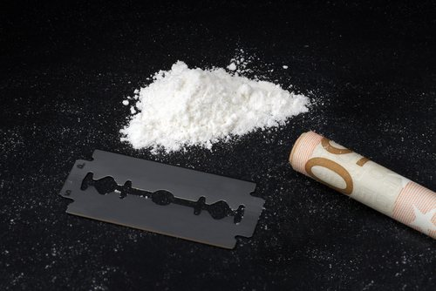
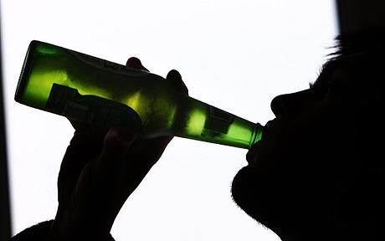
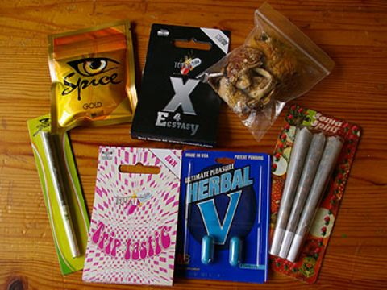
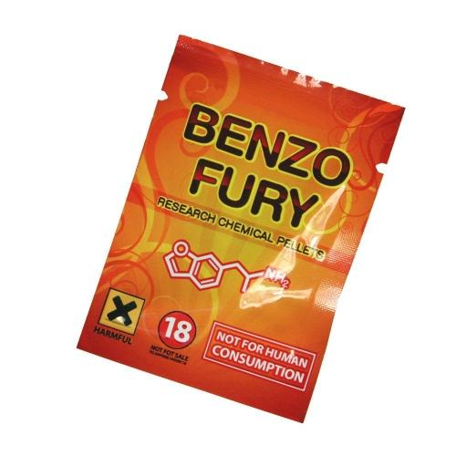
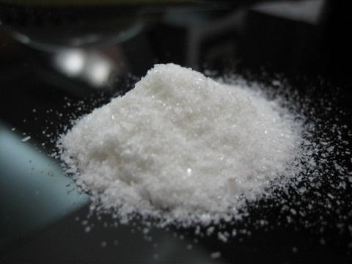

Festivals are all about opportunities to get high
+
=
Cocaethylene
Bromo Dragonfly
Notes:
In addition to great music and fun company, festivals have gained a reputation as being venues for substance misuse. There are significant risks attached to mixing drugs i.e. polydrug use eg. stimulants and depressants such as alcohol and cocaine. The effects of taking cocaine and alcohol together are far more dangerous than taking either drug alone. Cocaethylene is formed when alcohol and cocaine meet in the liver. This ‘metabolite’ remains in the body much longer, subjecting the heart and liver to a prolonged period of stress. That’s why some of the recorded deaths from Cocaethylene occur up to 12 hours after the user has mixed substances. The risk of sudden death is 18 times greater when alcohol and cocaine are used together. And what’s even worse is that you can’t see it coming, you could be feeling completely fine one minute and the next minute, BANG.
A class of substances called benzodifurans. Also known as Benzo fury, B dragonfly or fly and is known to have a similar effect to LSD although it is much longer lasting (1-3 days). Typically bought online it is taken orally in the form of blotter paper, liquid and less commonly pills. The onset of its effects can be delayed for up to six hours. This delay has resulted in the user ingesting more thinking the first dose was inadequate. It is a toxic substance and the risk of overdose is very high.
Risks of choosing to get high at festivals include:
The unknown element of buying substances without understanding effects and risks
Everyone responds differently to substances
Risk taking behaviour increasing in potentially unsafe environment
Substance misuse and driving issues
6

Slide 7
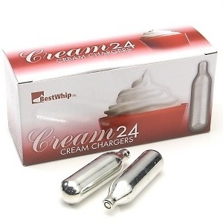
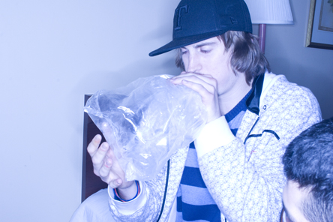
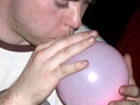
Inhaling Nitrous Oxide (laughing gas) is just a bit of a joke
Notes:
Nitrous oxide is a simple gas that when inhaled causes rapid pain relief, euphoria and mild sedation and sometimes psychedelic dissociation effects.
Used in form of whipped cream chargers dispensed into balloons. In the UK possession of nitrous oxide for non-inhalant use is legal for those over 18. It is illegal to inhale nitrous oxide and sell to under 18’s. Nitrous has gained the nick name ‘hippy-crack’ because it lends itself to repeated and compulsive use for some people. Any form of substance dependency or risk taking behaviour escalating under its influence is no laughing matter.
7

Slide 8

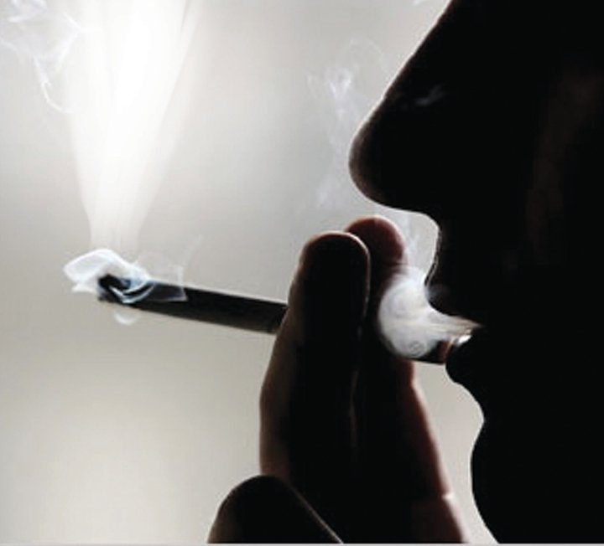
It is better for young people to drink alcohol, rather than take illegal drugs
Notes:
Alcohol is tolerated as a socially acceptable drug, yet it is recognised as being as one of the most harmful substances a young person can take. Safe levels for young people are unknown as all current guidance is produced for adults. Irresponsible use of alcohol ‘Binge drinking’ or drinking too much on a single occasion, can lead to:
ASB
Drink driving
Unsafe sex
Impaired brain development
Injury or death
8

Slide 9
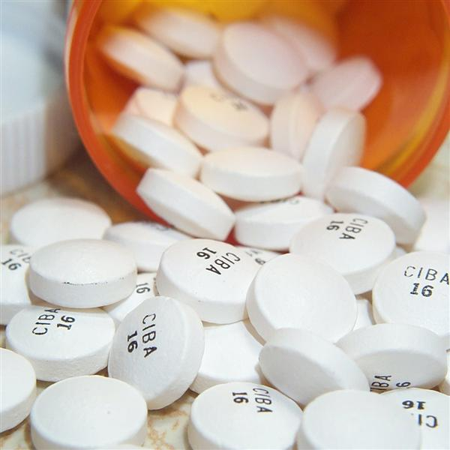
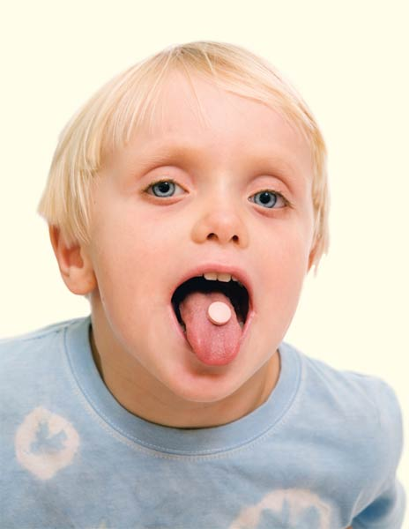
Pupils with ADHD should be medicated
Notes:
Ritalin, cocaine-like stimulant which, paradoxically, is said to calm down a child, it is a psychoactive drug.
66,000 prescriptions are dished out annually in Britain to treat ADHD, double the figure of 5 years ago.
Common Side Effects
Addiction
Nervousness including agitation, anxiety and irritability
Trouble sleeping (insomnia)
Decreased appetite
Headache
Stomach ache
Nausea
Dizziness
Heart palpitations
Other Serious Side Effects Include
Slowing of growth (height and weight) in children
Seizures, mainly in patients with a history of seizures
Eyesight changes or blurred vision
9

Slide 10
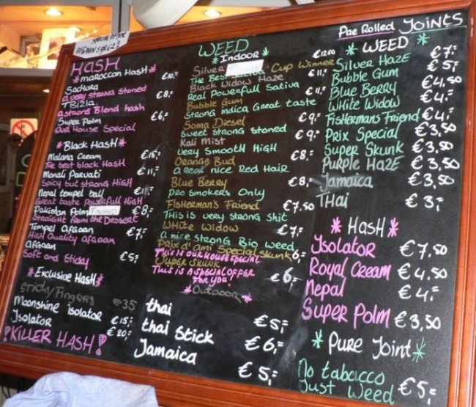
The taking and selling of legal drugs should be controlled through licensed premises (like pubs in UK or café’s in Holland)
Notes:
According to a UK Ofcom report, parents in Wales appear to be less concerned about how their children use the internet. They are less likely to say they have internet parental controls set– 37 per cent in 2010 compared to 43 per cent in 2009. Those that don’t have parental controls mainly say it’s either because they trust their child or because they are supervising them. It is important
to note that Legal Highs are easily available in numerous online sites and many substances can be purchased cheaply. You tube has numerous films posted of young people taking legal highs along with other forums that advise how to take these drugs by other users.
10

Slide 11
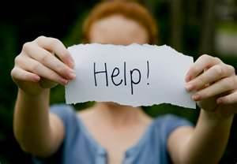
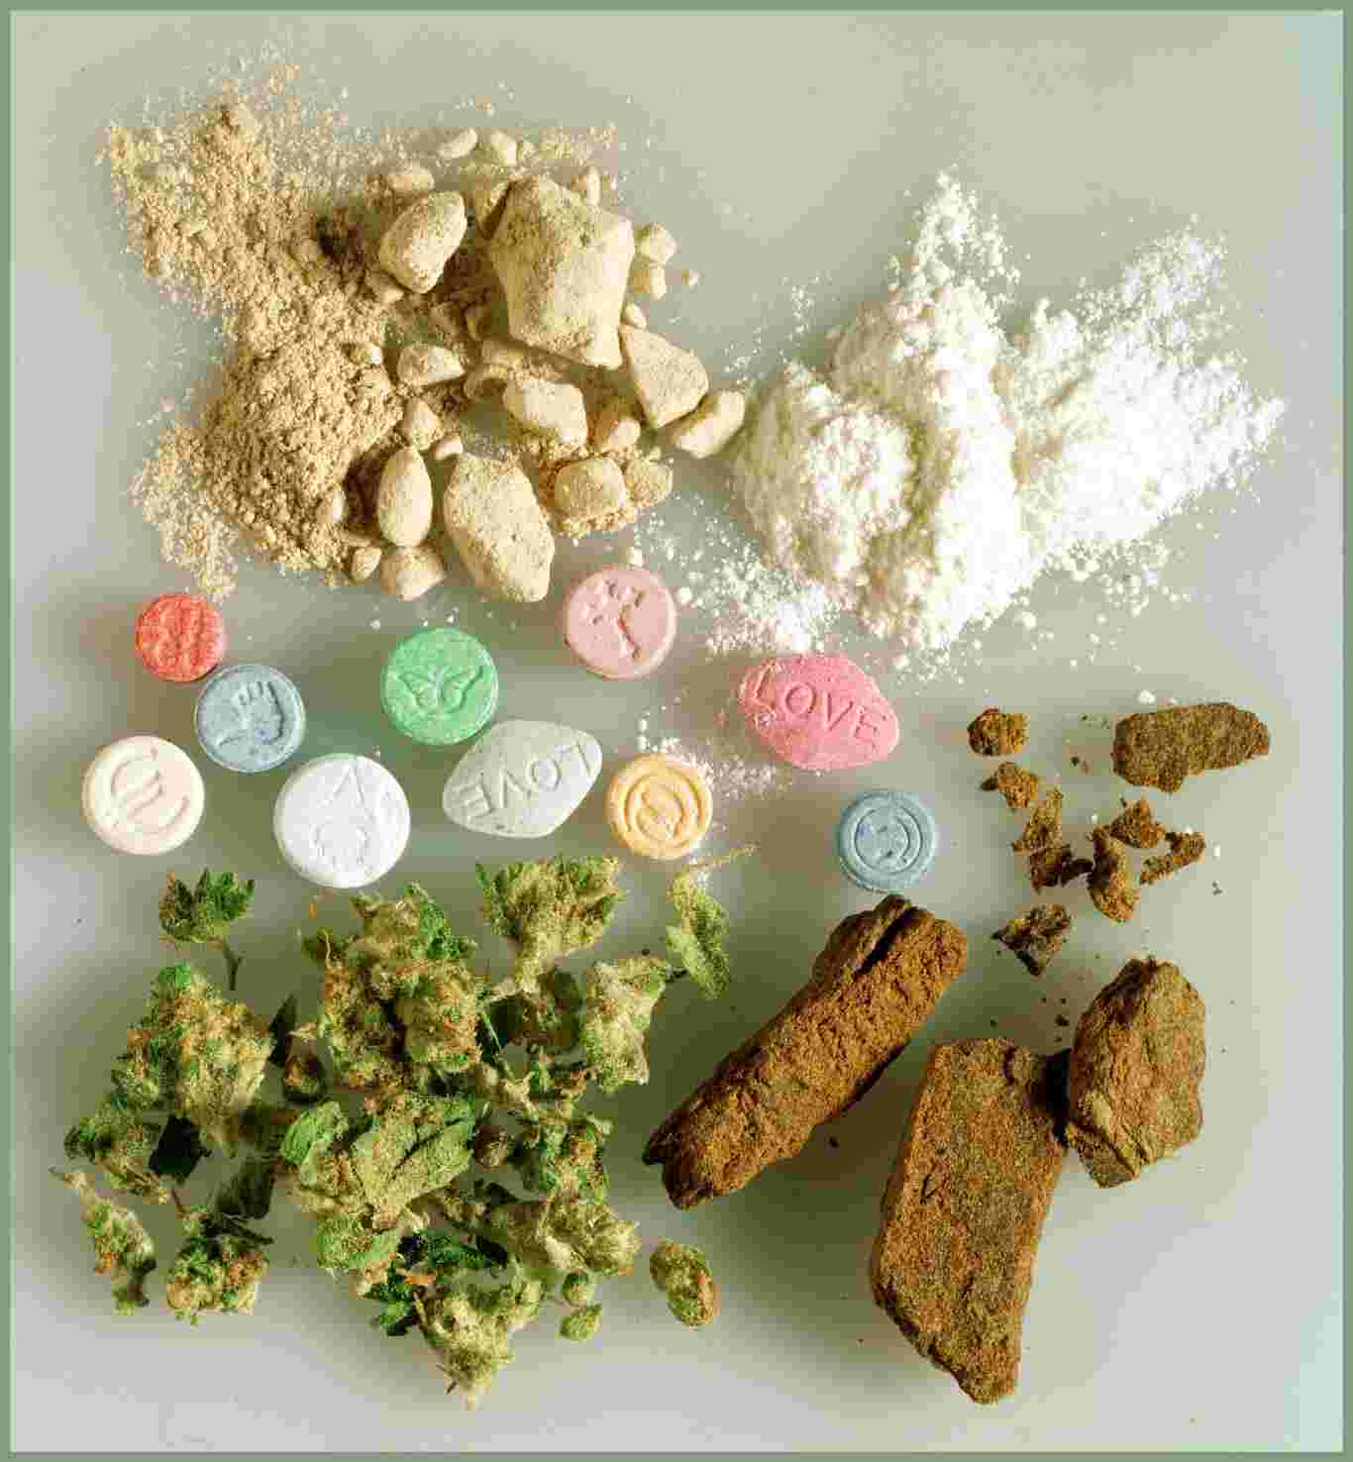
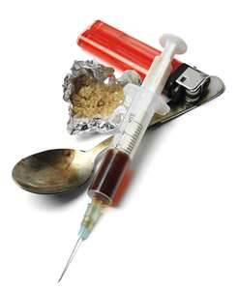
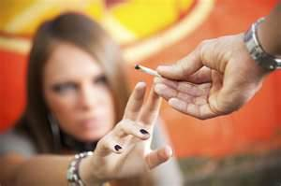
Drugs are a necessity to help people cope with the challenges of life
Notes:
There are instances where because of illness people need their doctor to prescribe medicines to help alleviate or cure symptoms. These drugs are strictly licensed and their use supervised by a qualified health practioner.
Stress is a very real part of life and strategies to deal with it are important. Having someone to talk to helps. It has been found recently that plenty of exercise and fresh air also helps produce endorphins in the body which help to keep people healthy and stress free.
Alcohol and misusing legal or using illegal drugs can mask stress. They don't help deal with the problems and usually make everything worse by exposing users to increased risks, health damage and impact on those around the user
11

Slide 12
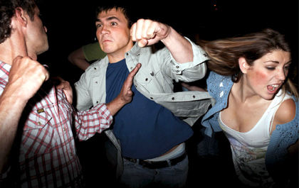
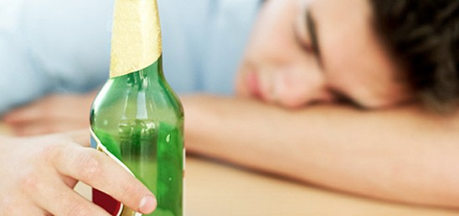
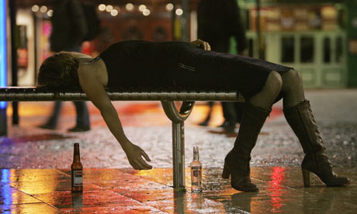
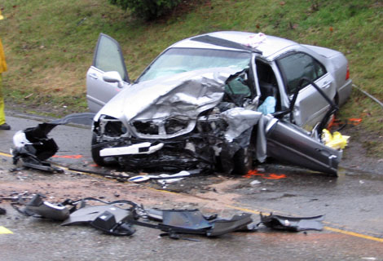
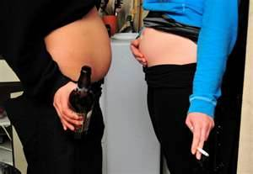
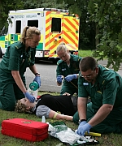
It’s an individual’s human right to decide what to take into his/her body
Notes:
This may be true as a general rule unless it impacts on the breaking of laws. Once an individual chooses to break laws then the police will become involved. It is important to be aware of the impact any choice to take drugs has on those around us, from family and friends to the wider community and the emergency services that have to supply support when risk taking behaviour gets a person into trouble or difficulty. Drinking alcohol or taking other drugs is extremely dangerous when driving. Think before accepting lifts with drivers. Have they taken any substance which is a drug? Dont take lifts with someone who is under the influence of any drug.
There many health implications for choosing to use/misuse substances.
The adolescent brain is designed to learn; yet the same plasticity that facilitates neuro-maturation also renders it particularly vulnerable to the damaging effects of alcohol.
12

Slide 13


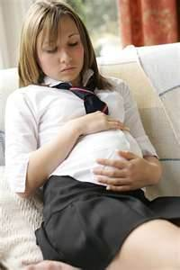
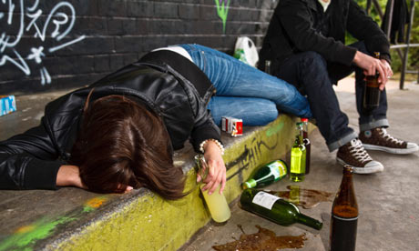
To avoid possible sexual offences from occurring young people should not mix alcohol with dating
Notes:
Alcohol is the most common drug implicated in date rapes. Alcohol’s direct action on the brain is as a depressant. It generally decreases the activity of the nervous system, alcohol can cause disinhibition, i.e. inhibits cells and circuits in the brain which themselves are normally inhibitory. In short you become less in control of your behaviour and may engage in sexual behaviours you may not if sober. Eg. acts of rape, unprotected sex with or without consent. There is a much higher risk of sexual assaults or unplanned pregnancy or transmission of sexually transmitted infections occurring when young people misuse Alcohol.
13

Slide 14
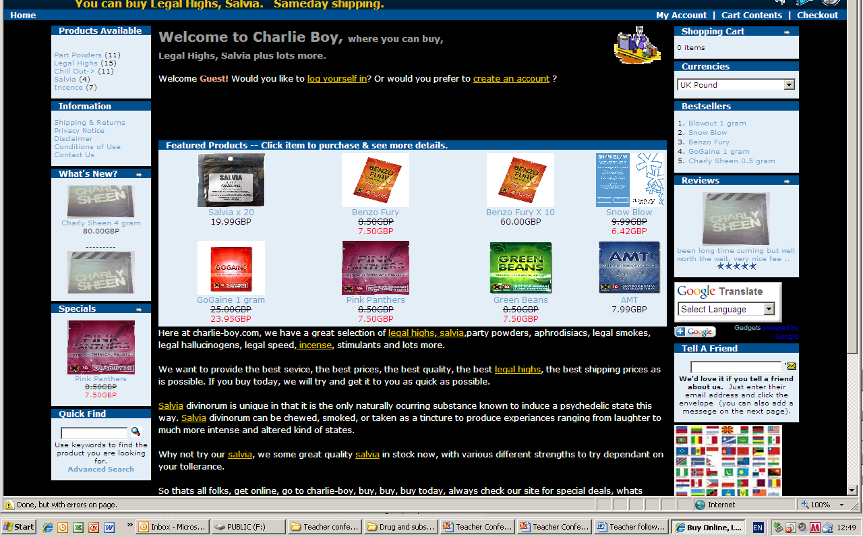
Parents should monitor the
sites their children visit
on the internet
Notes:
According to a UK Ofcom report, parents in Wales appear to be less concerned about how their children use the internet. They are less likely to say they have internet parental controls set– 37 per cent in 2010 compared to 43 per cent in 2009. Those that don’t have parental controls mainly say it’s either because they trust their child or because they are supervising them. It is important to note that NPS are easily available in numerous online sites and many substances can be purchased cheaply. You tube has numerous films posted of young people taking legal highs along with other forums that advise how to take these drugs by other users.
14

