Slide 1
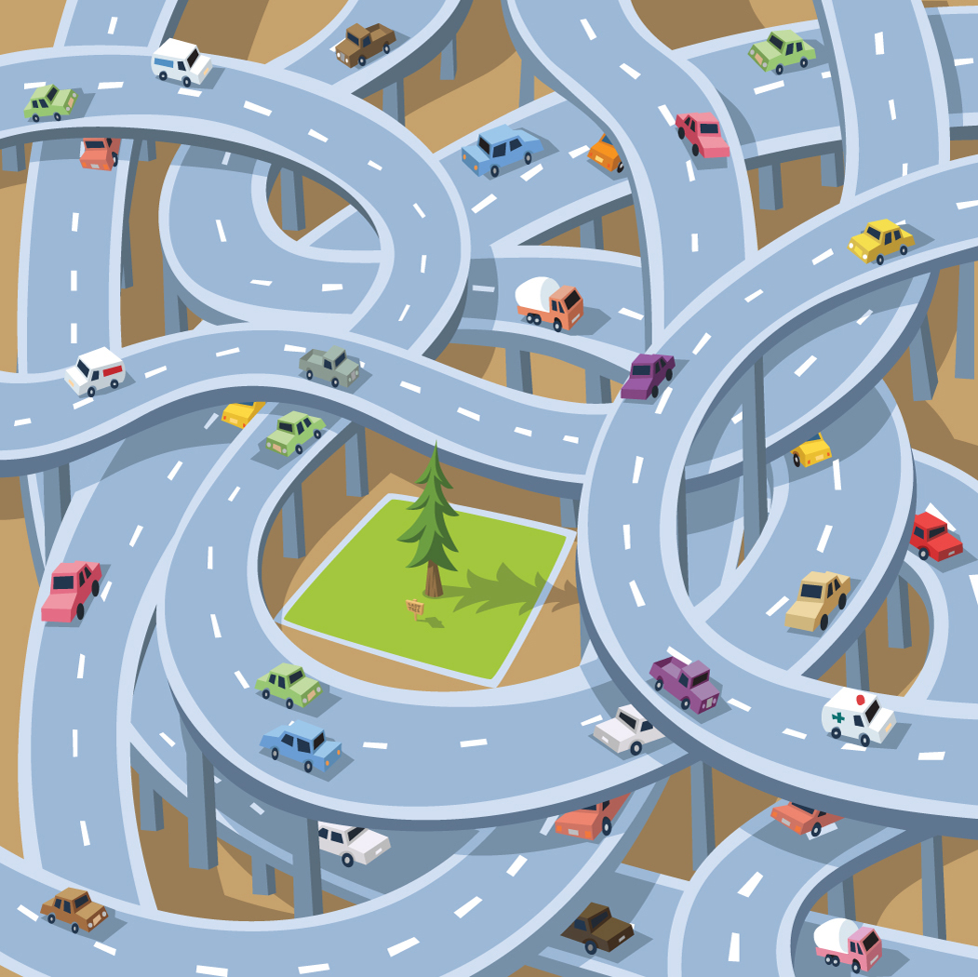
Resource 1.b
1. Everyone
COW
2. Just the driver
3. The driver and children
Activity 1.B

Slide 2
Who should wear a seat belt in your car?
1. Everyone
2. Just the driver
3. The driver
and children

Slide 3
Answer
Everyone must wear a seat belt

Slide 4
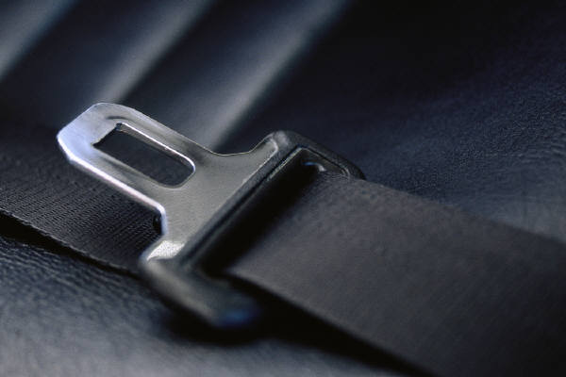
What does the law say about being responsible for wearing a seatbelt in a car?

Slide 5
Answers
The Law states that if you are over 135 cms in height you must wear an adult belt.
If under 135cms you must use a booster seat to enable you to wear an adult belt.

Slide 6
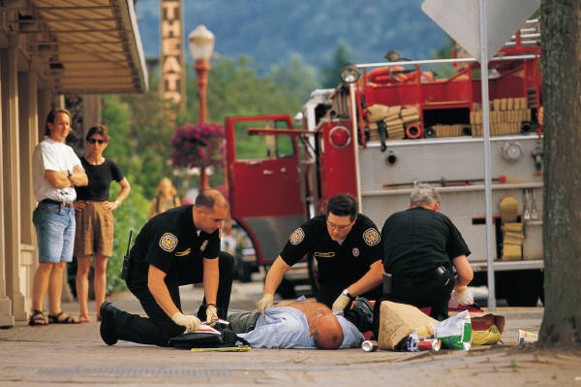

Why is drinking and driving dangerous?

Slide 7
Answers
1. Drinking slows down your reactions.
2. You are endangering yourself and others
3. It is illegal and you will be arrested
4. You might be sick when driving
5. You might fall asleep at the wheel

Slide 8
Why is loud music in a car dangerous?

Slide 9
Answers
1. The driver will play with the CD player
2. It annoys other drivers
3. It distracts the driver

Slide 10
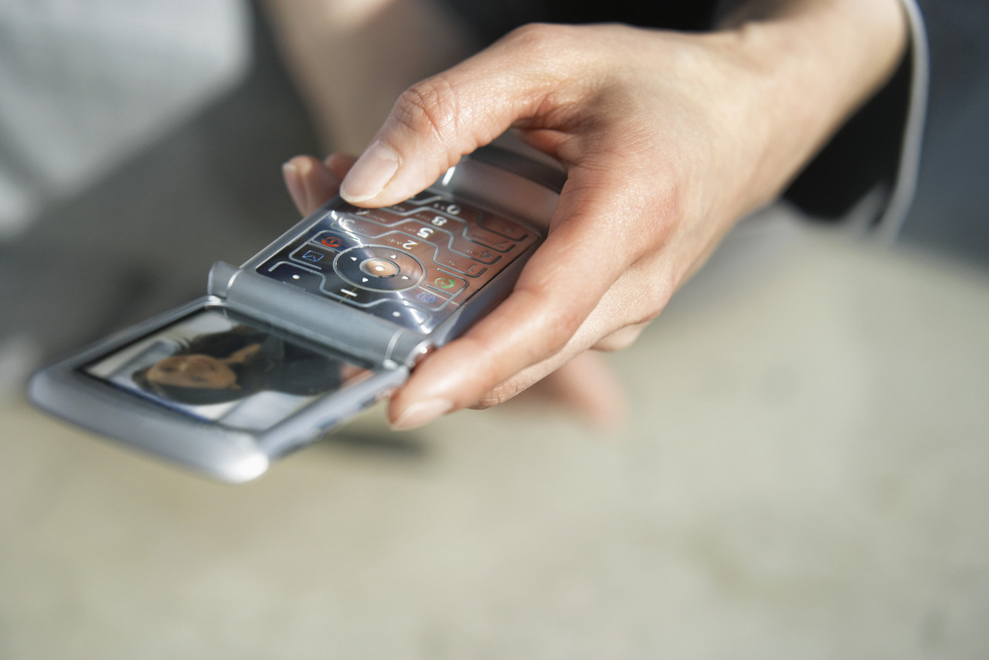
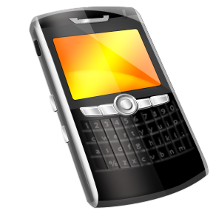
What does the law say about use of mobile phones in the car?

Slide 11
Answers
1. It is illegal to use a mobile phone in the car while driving
2. It is illegal to use a mobile phone while stationary when the car engine is still running
3. If you use a hands free mobile phone by dialling or holding the phone in any way it is an offence

