Slide 1
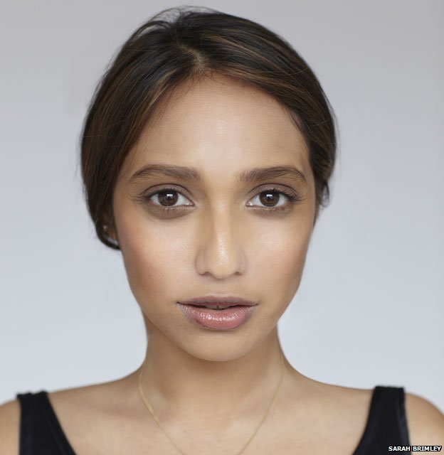
10
9
8
8
7
1
1
6
11
5
4
4
2
3
3
Resource 12b.

