Slide 1
Elusen ‘Missing People’
www.missingpeople.org.uk
Notes:
Hi, lovely to meet you all…….. Etc……..
We’re here to talk to you about our charity Missing People.
This is our phone number, lots of people call us to get help.
*Ask pupils to take a good look at the screen for a few seconds. We can then go back to this at the end and ask if anyone can remember the telephone number?

Slide 2
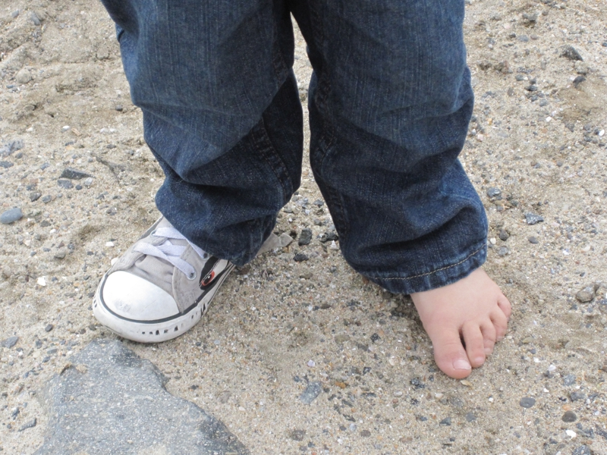
Allwch chi weld beth sydd ar goll?
Notes:
Explain what missing is – “missing means that something that should be there is not”
Can you spot what is missing in each of these pictures?
Explain that without the ‘missing’ part the jigsaw puzzle isn’t complete. And the child cannot walk or run properly with only one shoe.

Slide 3
Beth ydych chi’n meddwl yw person coll?
Notes:
Ask the kids first
A person is missing when there family and friends don’t know where they are. They will get worried about them and tell the police and us. Someone can be missing for half an hour or they can be missing for much longer.
This can be really scary for the family and for the person that has gone missing – they might not know how to get back to their family
There are lots of different reasons why someone might go missing. I will tell you a few of these later on.
Missing People is the charity we work for. A charity is basically a big company that sees a problem and tries to help fix it. At Missing People we are all about helping people. We want to help people that have gone missing and we want to help the families that are waiting to see them again.

Slide 4
Faint o bobl sy’n mynd ar goll?
Mae 250,000 yn mynd ar goll bob blwyddyn
Mae hynny’n un person bob dwy funud
Mae 140,000 o blant yn mynd ar goll
Mae 99% yn cael eu darganfod mewn llai na blwyddyn

Slide 5
Pam nad yw bod ar goll yn ddiogel?
Ddim yn teimlo’n dda
ac angen gofal
Oedolion sydd ddim yn ddiogel
Help gyda phenderfyniadau
da a chlyfar
Notes:
Talk through the reasons why missing is unsafe.
If you start to not feel well and need to be looked after but no one is around to help
Sometimes people are with adults who are unsafe and can’t look after them
If you’re not with anyone you trust then there’s no one to help make safe decisions like when to cross the road

Slide 6
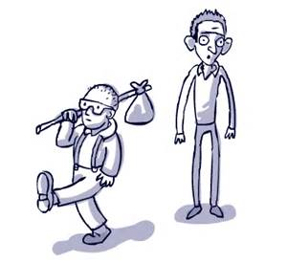
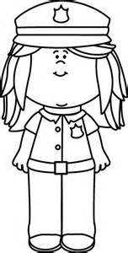
Pam mae rhai pobl yn mynd ar goll?
Mae rhai pobl yn gadael gan eu bod yn ofni neu’n drist ac mae angen i ni eu helpu i fod yn ddiogel.
Weithiau dydyn nhw ddim yn iach ac mae angen i ni wneud yn siŵr eu bod yn cyrraedd adref yn ddiogel.
Weithiau mae rhywun yn mynd â nhw ac mae’n rhaid i ni helpu’r heddlu i’w cael nhw’n ôl.
Notes:
Ask kids for their ideas first
Talk through reasons that people go missing

Slide 7
Sut ydyn ni’n helpu?
Gwefan
Siarad
a gwrando
Posteri
Yr heddlu
Notes:
We help people when they are missing by:
We have lots of helpful information on our website.
Most people need to talk if they ever have any problems or they’re scared. Anyone can call us, any time, even in the middle of the night when everyone is sleeping and they can talk to us.
We can put up posters of someone who is missing so everyone can see their face and help look for them. Sometimes we can even get photos of the person on to the TV so even more people can help.
The police do lots of work looking for people when they are missing. We help them when we can.
We help families when someone goes missing too.
This is because it is really sad and scary if someone you love goes missing. We will spend lots of time talking to people when they feel like this and try to help them however we can.
When someone is missing their families want to do everything they can to help find them. Sometimes they need help because they can’t do as much as they want so we will help.

Slide 8
Stori Tara
Dim ond 13 oed oedd Tara pan aeth hi ar goll
Roedd hi wedi gadael cartref heb ei ffôn ac roedd ei theulu’n ofidus iawn
Posteri, Twitter a Facebook
Dau ddiwrnod yn ddiweddarach cafwyd hyd i Tara yn ddiogel!
Mae hi gartref gyda’i theulu nawr

Slide 9
Sut i gadw’n ddiogel
Peidiwch â cherdded i ffwrdd i unrhyw le gydag oedolyn dydych chi ddim yn ei adnabod nac yn ymddiried ynddo.
Os ydych chi byth yn teimlo’n ofnus, neu’n
cael teimlad pryderus yn eich bola pan rydych chi gydag oedolyn newydd dwedwch wrth oedolyn rydych chi’n ymddiried ynddynt.
Dylech bob amser ddweud wrth eich rhieni neu oedolyn rydych yn ymddiried ynddynt ble rydych chi’n mynd a beth
fyddwch chi’n ei wneud.
Notes:
It’s really important that you always keep yourself safe.
Talk through the 3 points

Slide 10
Beth ydych chi’n ei gofio?
Beth oedd y rhif ffôn ar y sleid gyntaf?
www.missingpeople.org.uk
Notes:
Ask for hands up if they can remember the telephone number (116 000) for Missing People.

Slide 11
Diolch!
Notes:
Thank you so much for listening to us today. It was really nice to meet you all and we are so happy that you’re going to be helping us this year.

