Slide 1
Notes:
Introduction
In this assembly we are going to think about Stephen Lawrence, an 18 year old student who was stabbed and killed by a gang, in a severe act of hate crime in London in 1993.
Stephen’s story has two clear messages.
• The first is a message of grief and sadness, as a result of this terrible murder of an innocent young black person.
• The second is a message of hope, justice and inspiration as a result of Stephen’s family’s fight to see his murderers convicted.
This story gives us a reason to reflect on and understand how racism and discrimination can lead to horrendous hurt and tragedy.

Slide 2
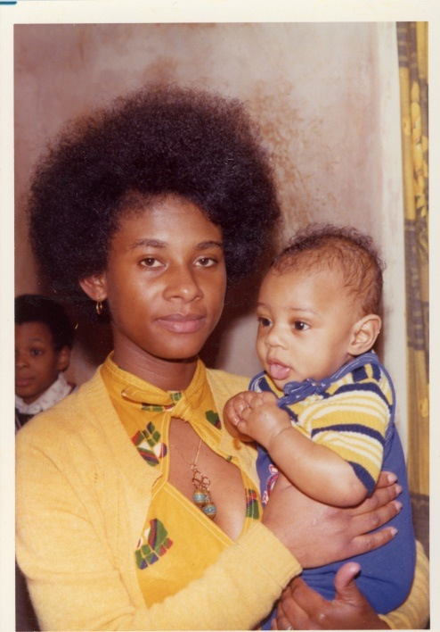
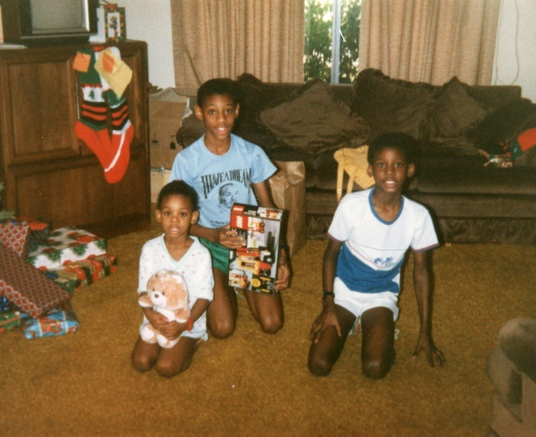
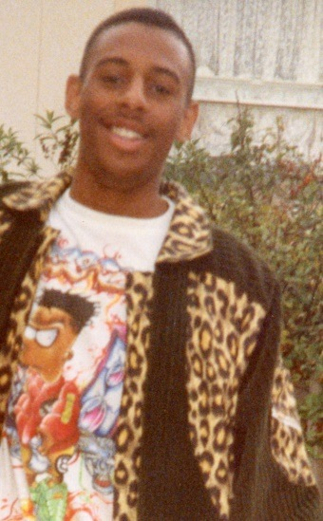
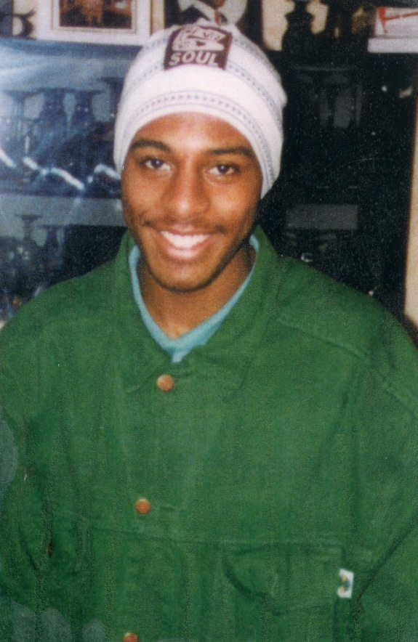
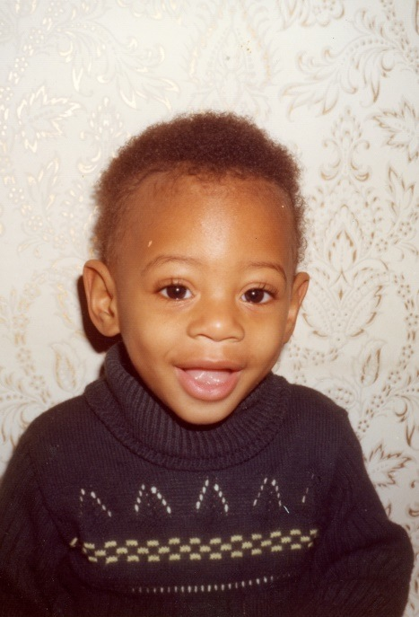
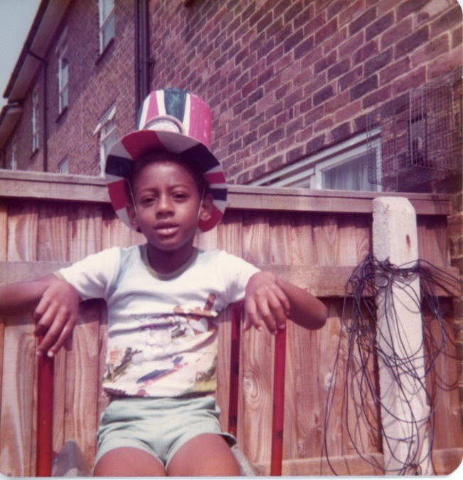
Notes:
Stephen’s background
Stephen was born to Doreen and Neville Lawrence on 13 September 1974. He was ambitious and talented, and aspired to be an architect, completing work experience in the school holidays with a young black architect named Arthur Timothy.
Stephen loved music and he enjoyed running as a member Cambridge Harriers, and he competed in a mini-marathon in 1988.
Stephen was well liked by his classmates and peers and often supported and included those who were less popular.

Slide 3
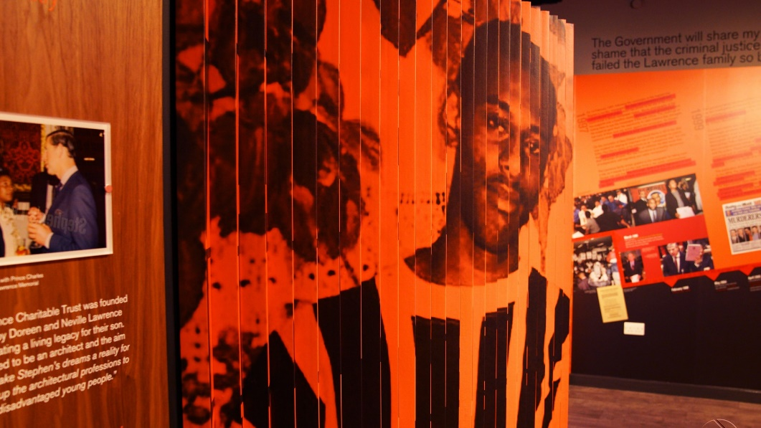
Stand Up To Racism
Learn more about British History
Carry Out Research
Stephen Lawrence Research Centre & Archive: DeMontfort University
Notes:
Racism as a driver of hate and hurt
On the evening of Thursday 22 April 1993, Stephen Lawrence and his friend Duwayne Brooks were travelling home in London. They got off the 286 bus and at approximately 10.35pm when a gang of white males approached them shouting racial abuse and then Stephen was attacked by the gang. The attack lasted seconds but in that short time, Stephen sustained two fatal stab wounds. The gang ran off.
Stephen managed to run a short distance before he collapsed. He was pronounced dead later in hospital.
Although the police had clear leads to follow, with suspects being identified the day after the murder, the charges were soon dropped and the evidence against the gang was not seen as strong enough to convict them. Five years after the murder, justice had still not been achieved.

Slide 4
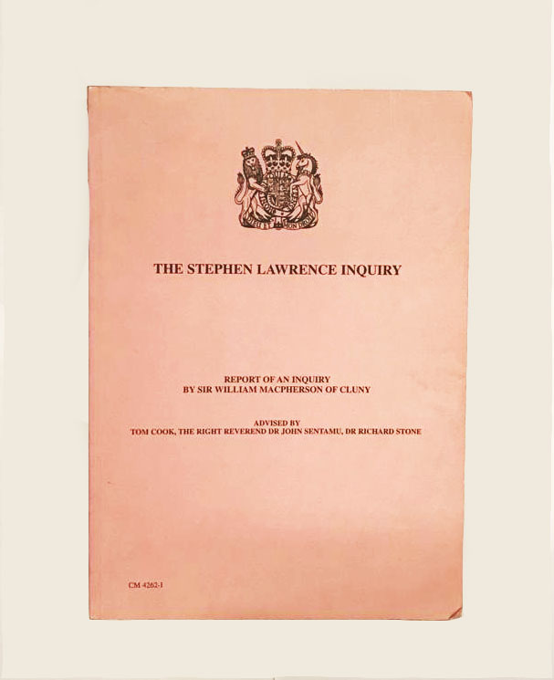
Stephen Lawrence Report (Macpherson)
Found evidence - Institutional Racism.
Changed the law - double jeopardy.
Proposed change to the school curriculum (Citizenship).
Strengthened Race Relations Act.
Notes:
An important report in 1999, led by Lord Macpherson, a retired judge, found that the failings by the police to get a conviction were partly caused by racism. Newspapers, like the Daily Mail, joined the family in their campaign, and the government even changed the law to ensure that people could be put on trial twice for the same crime. The turning point, however, came in 2007, when new forensic evidence came to light, allowing the case to go to court again.

Slide 5
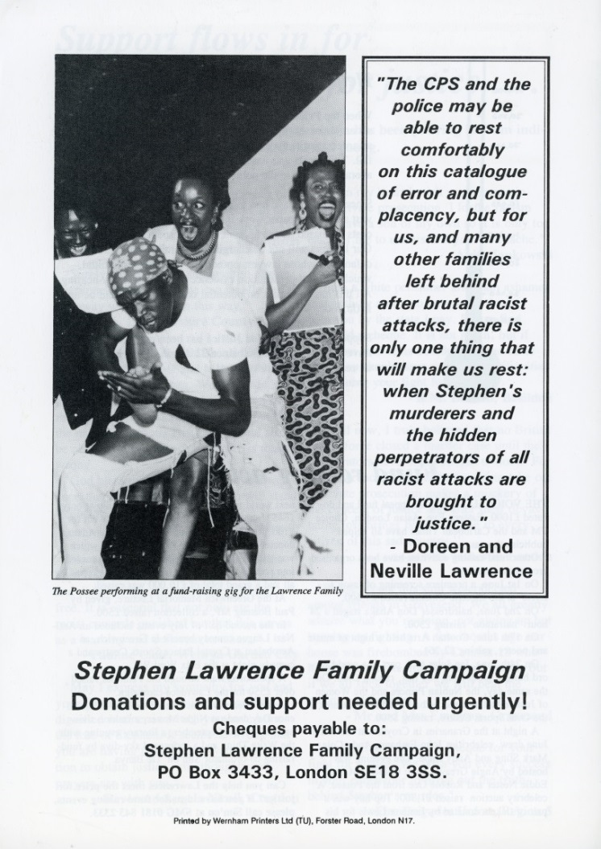
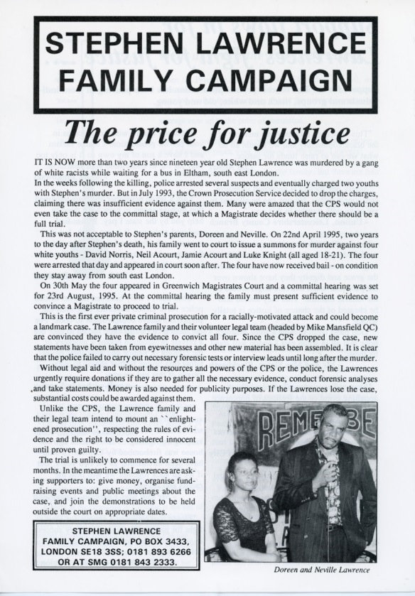
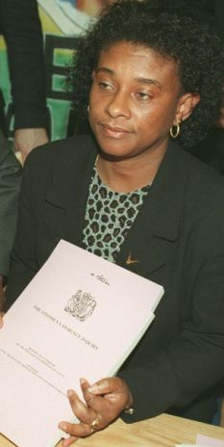
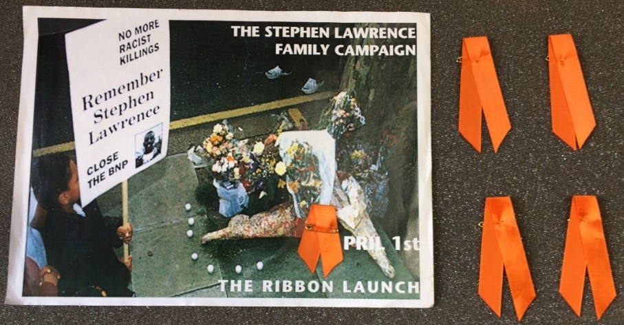
Stephen’s Family
Fought for Justice
Notes:
The fight for justice
This is a terrible story, but we should be pleased that partial justice was eventually achieved. On 3 January 2012, two men were given life sentences for Stephen’s murder. This should give us hope, knowing that eventually those who commit terrible crimes will not always be able to run away from them.
However, we must never forget that Stephen’s family had to fight for that justice. Their right to justice as British citizens was denied. They had to campaign, struggle and fight for it. Had they not, justice might never have been done.
Sometimes, you must fight for what you know is right. This is something that the great South African leader, Nelson Mandela also knew and he supported the Lawrence family to obtain Important changes to the law
The campaign for justice also led to some extremely important changes in society and in the law. We are now more aware of racism and the dreadful impact it has on individuals and communities.
Schools now must do everything they can to value cultural diversity and prevent racism. The murder led to new definitions of “racist incidents”, which means that any incident defined by the victim as “racist” is a racist incident, and “institutional racism”, which means that a whole organisation , a business, or even a school, can be classed as racist. This has led to more racial awareness training in many organisations and there is a greater awareness of the importance of treating people fairly and without discrimination.
We are all aware that sadly we still live with racism in society; with some knife crime among young people, and with discrimination of various kinds.

Slide 6
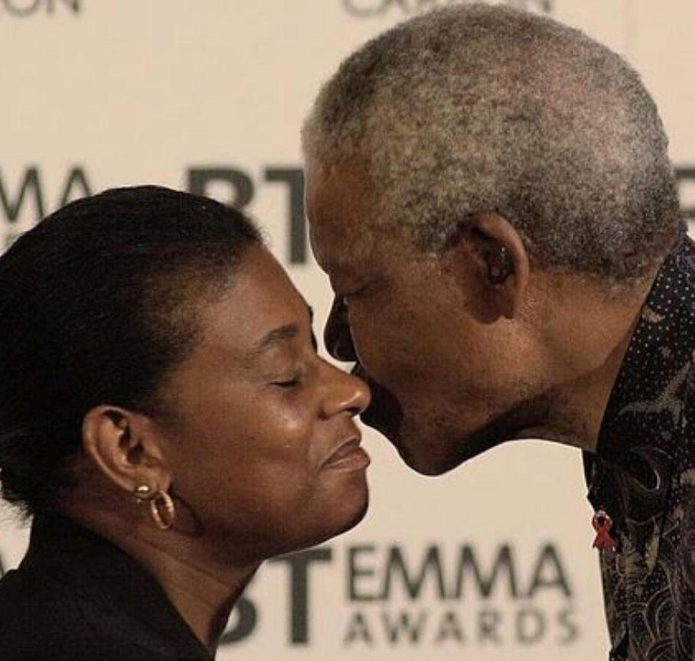
Hope
Nelson Mandela gave Doreen Lawrence Hope.
“Stephen has come to represent a wound that needs healing in our society.”
Mat Bickley, Stephen's cousin
Reference Stephen: The Murder that Changed a Nation (BBC Documentary)
Notes:
We need to balance the tragic story of Stephen’s murder with the positive outcomes from his life and legacy. People like Baroness Doreen Lawrence of Clarendon, OBE, and organisations like the Stephen Lawrence Charitable Trust give us reasons to be hopeful.
The Stephen Lawrence Charitable Trust has helped over 2,000 young people to fulfil their hopes and dreams in memory of Stephen. Their projects include helping young people into careers in architecture, journalism and filmmaking, ambitions which Stephen Lawrence could have realised himself.

Slide 7
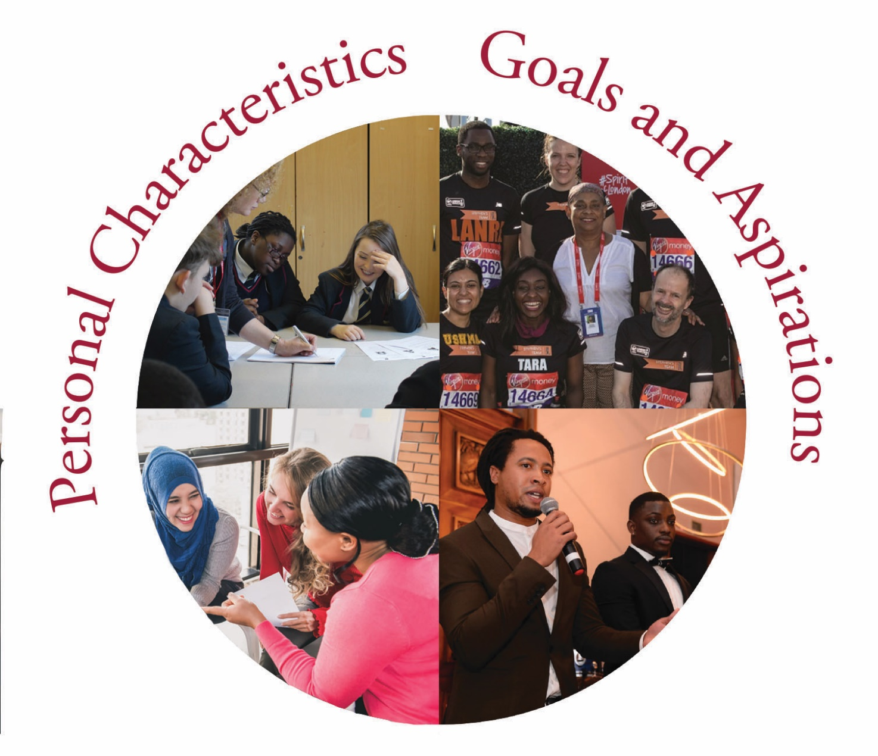
Live Our Best Life
Live Our Best Life
Notes:
A time for reflection: Live Our Best Life
The theme of Stephen Lawrence Day is Live Our Best Life. Today, we have heard about Stephen’s terrible death. We have heard about deep failings to get justice.
We have also heard about Stephen’s family; their remarkable love for their son; their persistence and determination, and their fight for justice, against all the odds, which led to two of the gang being sent to prison.
The youths who murdered Stephen were scarcely older than you. They are someone’s sons, brothers and grandsons. They influenced each other to commit a shocking crime, the result of which shattered the life of Stephen and his family.
Let us to take a few minutes to focus on how we live our life, and the changes we might want to make, in order to Live Our Best Life.
Let us take time to think about how our choices, words and actions affect others and:
Focus on how hate crime, in all its forms, impacts peoples’ rights to live safe, secure, joyful lives.
Think about how you might take a stand for what is right.
Think about how you might learn from Stephen’s family; from their love and fight for justice. Think about how your family loves you and how important it is to listen to and value family.
Finally, as we mark Stephen Lawrence Day, it is important that we learn lessons from Stephen’s murder, and that it took so long for justice to be done. It is also important that we celebrate the life we have at this moment. We all have great potential to achieve amazing things. We need to dream big and, like Stephen, work towards our goals. Sometimes this will mean that we will need to overcome barriers to get there, but don’t lose hope. Keep on striving for a better future and for the things you believe in. Let’s all try to live the best lives we can.

