Slide 1
Pobl sy’n ein helpu
Gweithgaredd 2e
Ysgol – Cardiau pobl
© Copyright of Gwent Police © Hawlfraint Heddlu Gwent

Slide 2
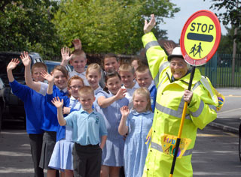
© Copyright of Gwent Police © Hawlfraint Heddlu Gwent

Slide 3
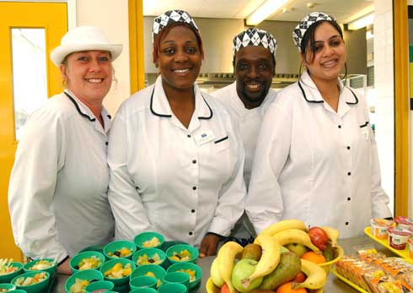
© Copyright of Gwent Police © Hawlfraint Heddlu Gwent

Slide 4
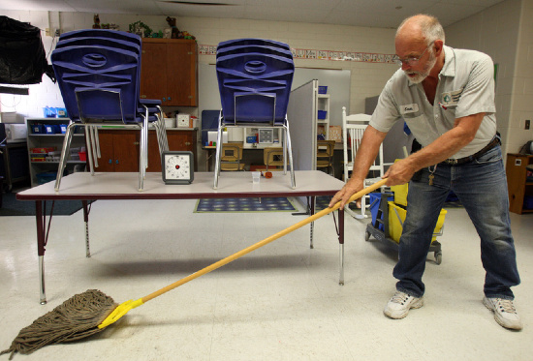
© Copyright of Gwent Police © Hawlfraint Heddlu Gwent

Slide 5
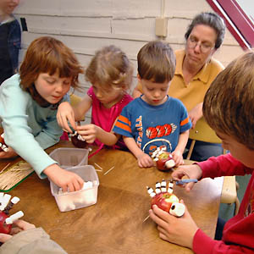
© Copyright of Gwent Police © Hawlfraint Heddlu Gwent

Slide 6
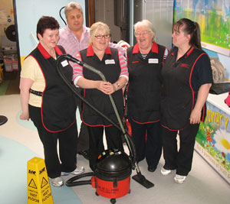
© Copyright of Gwent Police © Hawlfraint Heddlu Gwent

Slide 7
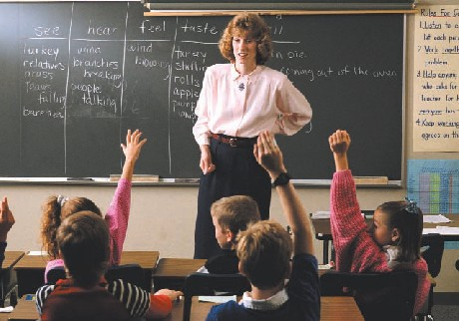
© Copyright of Gwent Police © Hawlfraint Heddlu Gwent

Slide 8
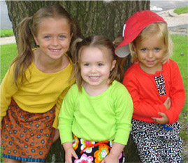
© Copyright of Gwent Police © Hawlfraint Heddlu Gwent

Slide 9
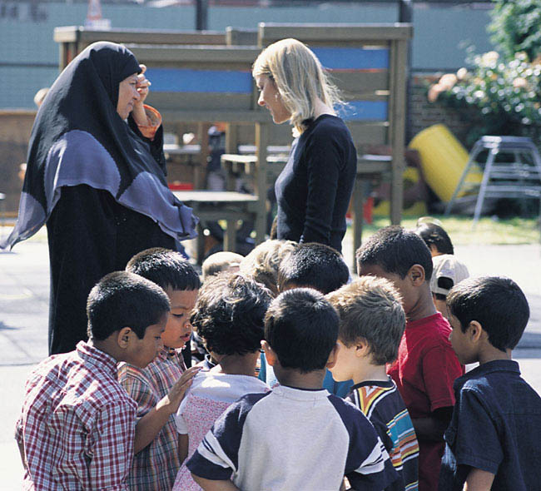
© Copyright of Gwent Police © Hawlfraint Heddlu Gwent

Slide 10
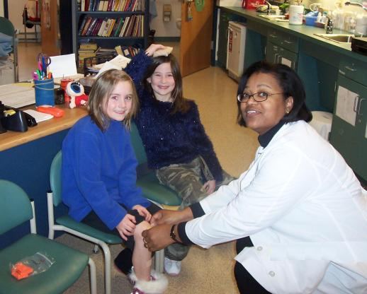
© Copyright of Gwent Police © Hawlfraint Heddlu Gwent

Slide 11
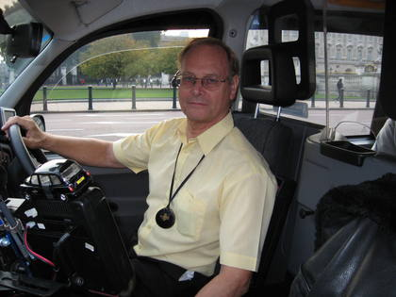
© Copyright of Gwent Police © Hawlfraint Heddlu Gwent

