Slide 1
People who help us
Activity 2c
School – Location cards
© Copyright of Gwent Police © Hawlfraint Heddlu Gwent

Slide 2
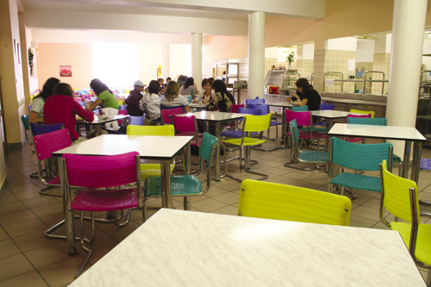
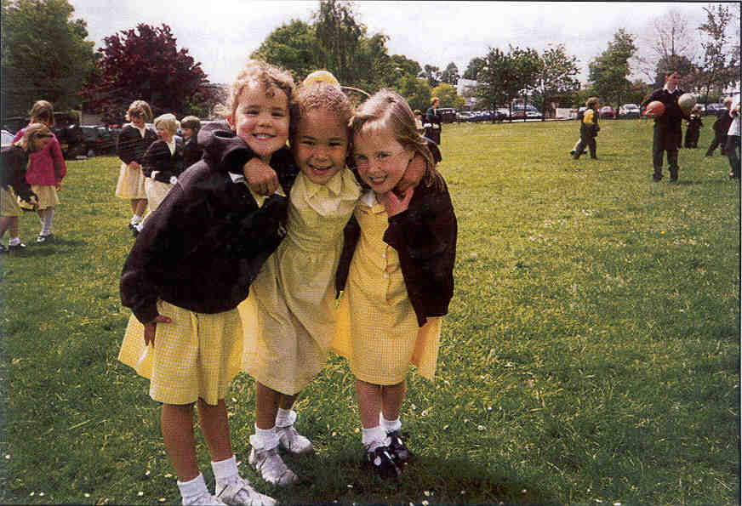
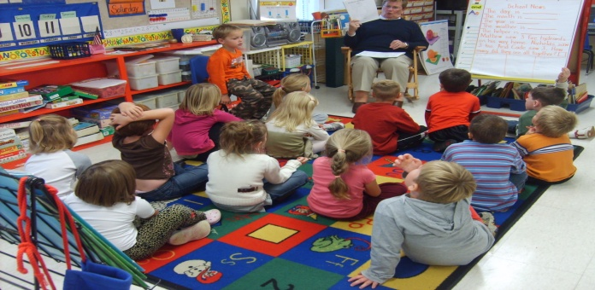
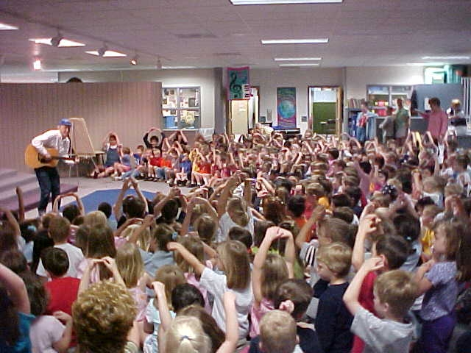
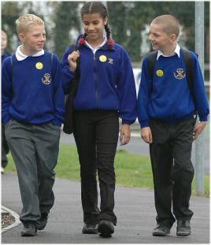
Activity 2 School - Location cards
© Copyright of Gwent Police © Hawlfraint Heddlu Gwent

Slide 3
© Copyright of Gwent Police © Hawlfraint Heddlu Gwent

Slide 4
© Copyright of Gwent Police © Hawlfraint Heddlu Gwent

Slide 5
© Copyright of Gwent Police © Hawlfraint Heddlu Gwent

Slide 6
© Copyright of Gwent Police © Hawlfraint Heddlu Gwent

Slide 7
© Copyright of Gwent Police © Hawlfraint Heddlu Gwent

