Slide 1
People who help us
Activity 2e
School – People cards
© Copyright of Gwent Police © Hawlfraint Heddlu Gwent

Slide 2
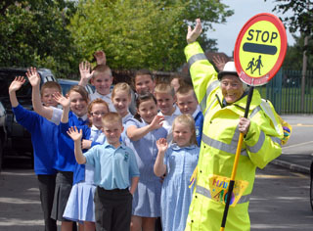
© Copyright of Gwent Police © Hawlfraint Heddlu Gwent

Slide 3
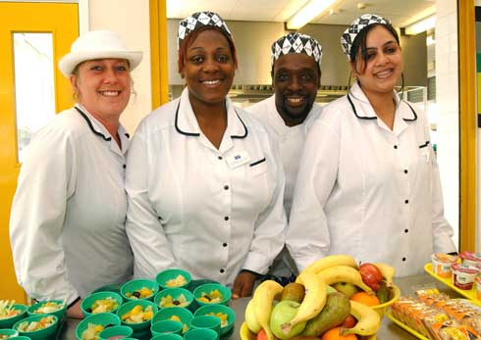
© Copyright of Gwent Police © Hawlfraint Heddlu Gwent

Slide 4
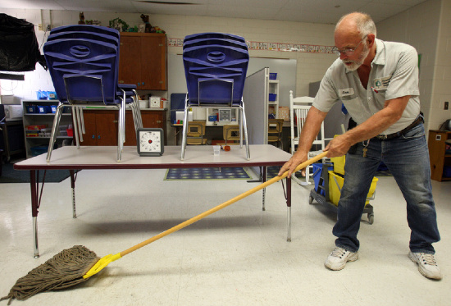
© Copyright of Gwent Police © Hawlfraint Heddlu Gwent

Slide 5
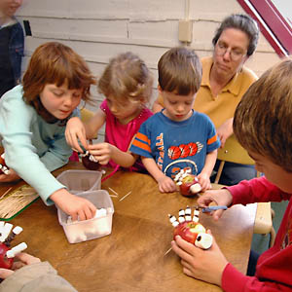
© Copyright of Gwent Police © Hawlfraint Heddlu Gwent

Slide 6
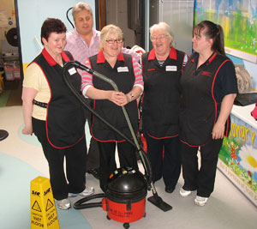
© Copyright of Gwent Police © Hawlfraint Heddlu Gwent

Slide 7
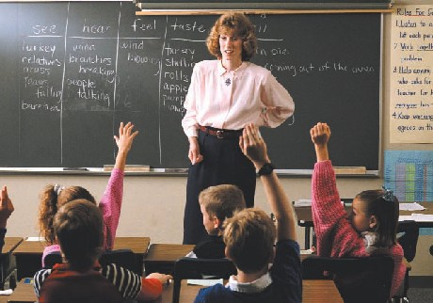
© Copyright of Gwent Police © Hawlfraint Heddlu Gwent

Slide 8
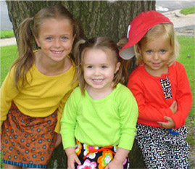
© Copyright of Gwent Police © Hawlfraint Heddlu Gwent

Slide 9
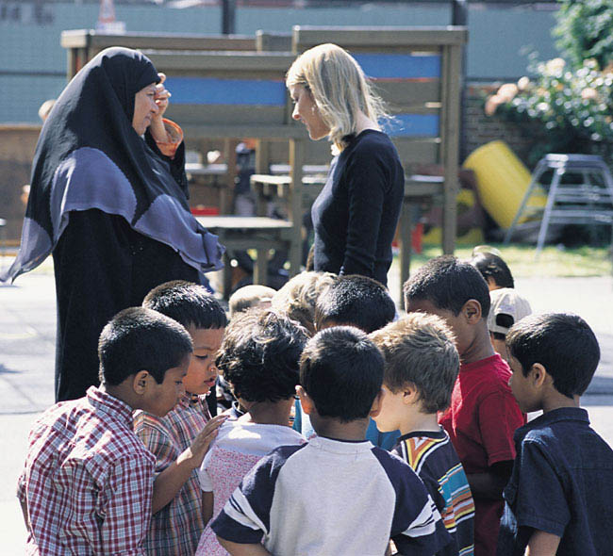
© Copyright of Gwent Police © Hawlfraint Heddlu Gwent

Slide 10
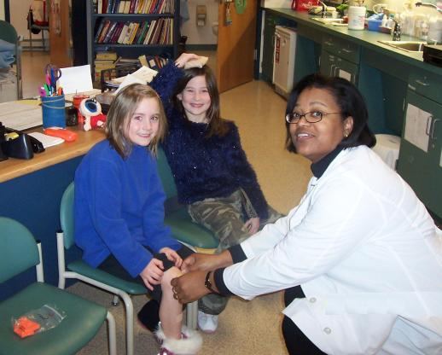
© Copyright of Gwent Police © Hawlfraint Heddlu Gwent

Slide 11
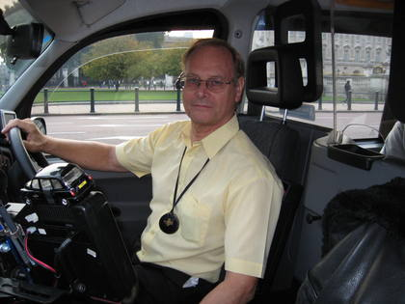
© Copyright of Gwent Police © Hawlfraint Heddlu Gwent

