Slide 1
caring
picture
cards
Activity 2f
© Copyright of Gwent Police © Hawlfraint Heddlu Gwent

Slide 2
© Copyright of Gwent Police © Hawlfraint Heddlu Gwent

Slide 3
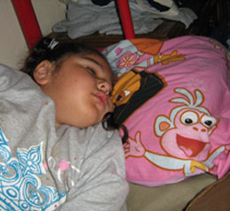
© Copyright of Gwent Police © Hawlfraint Heddlu Gwent

Slide 4
© Copyright of Gwent Police © Hawlfraint Heddlu Gwent

Slide 5
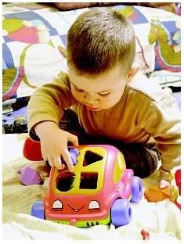
© Copyright of Gwent Police © Hawlfraint Heddlu Gwent

Slide 6
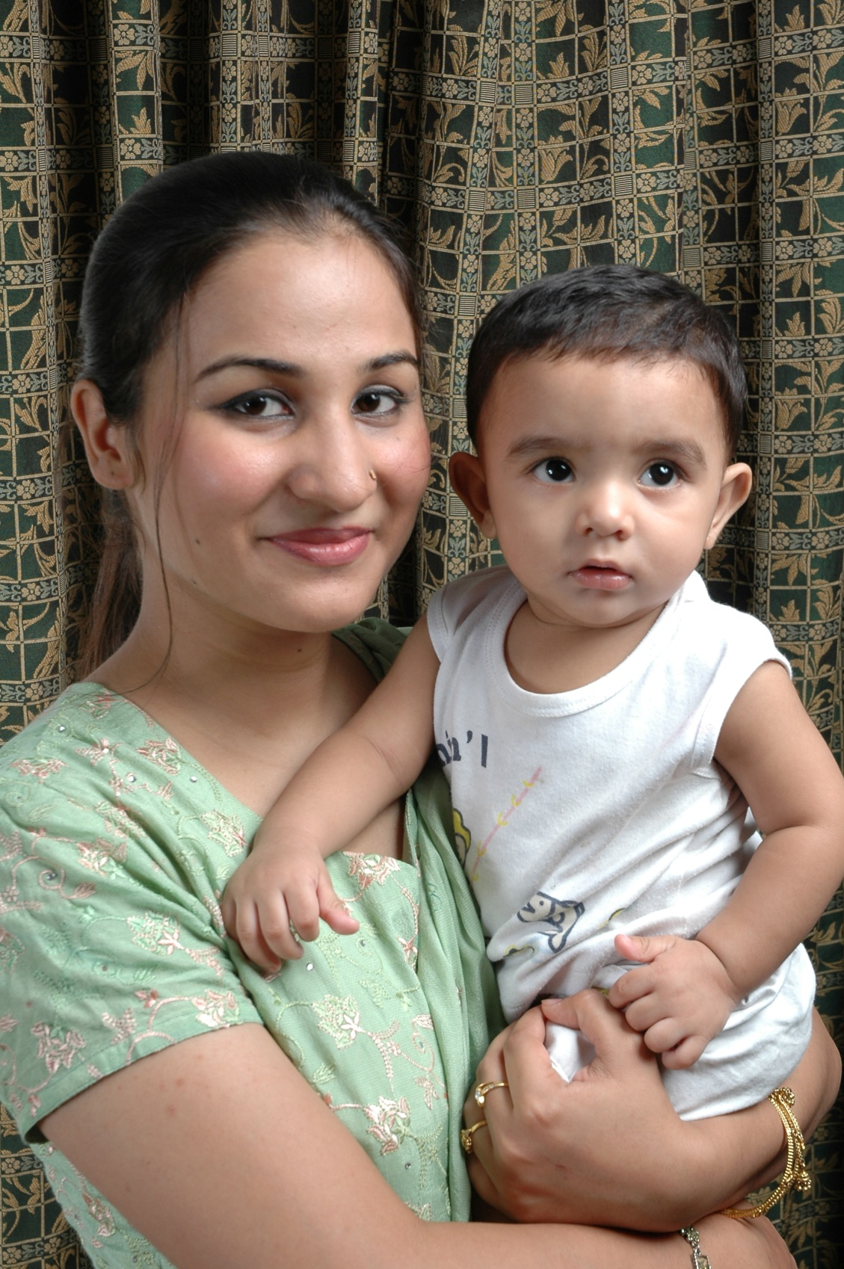
© Copyright of Gwent Police © Hawlfraint Heddlu Gwent

Slide 7
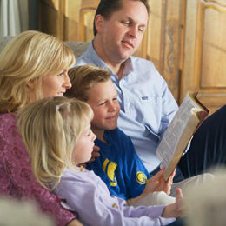
© Copyright of Gwent Police © Hawlfraint Heddlu Gwent

Slide 8
© Copyright of Gwent Police © Hawlfraint Heddlu Gwent

Slide 9
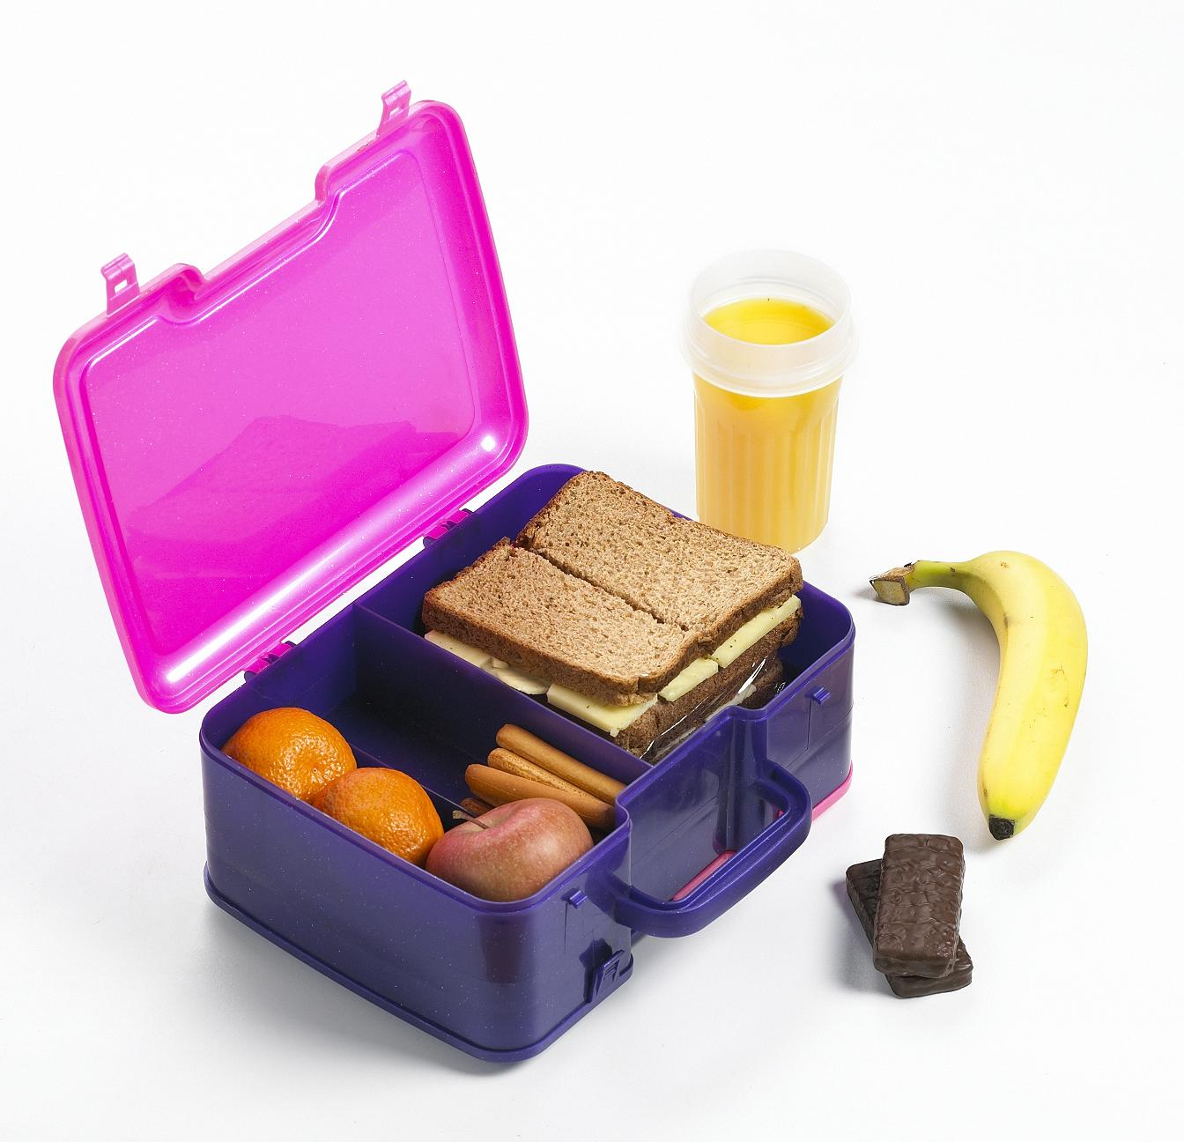
Activity 2 People who help us - Caring picture card
© Copyright of Gwent Police © Hawlfraint Heddlu Gwent

Slide 10
© Copyright of Gwent Police © Hawlfraint Heddlu Gwent

Slide 11
© Copyright of Gwent Police © Hawlfraint Heddlu Gwent

Slide 12
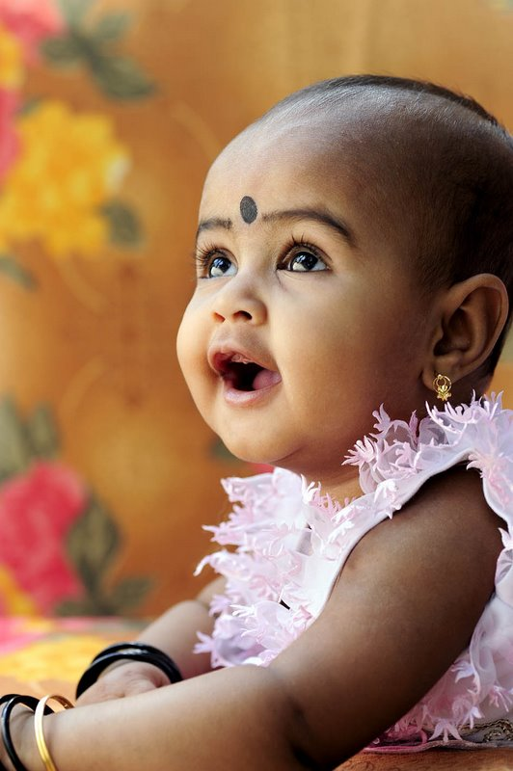
© Copyright of Gwent Police © Hawlfraint Heddlu Gwent

