Slide 1
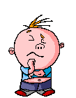
Who can I trust?

Slide 2
Make some faces!
Click on the link below and have a go at making...
some faces you can trust, and
some faces you cannot trust!
http://flashface.ctapt.de/

Slide 3
Group task
Group task – Put the list in order of who you would trust most and least on the diamond. Can you say why?
Lollipop person | Teacher
Police officer | Builder
Man walking dog | Couple in the park
Brother | Traffic warden
Boys playing football | Some girls smoking
Shopkeeper | Fire officer
Paramedic | Elderly person

Slide 4
Game – What would you do?
Get ready with your A, B, C and D cards!
Read the following stories and
think,
pair, and
share!

Slide 5
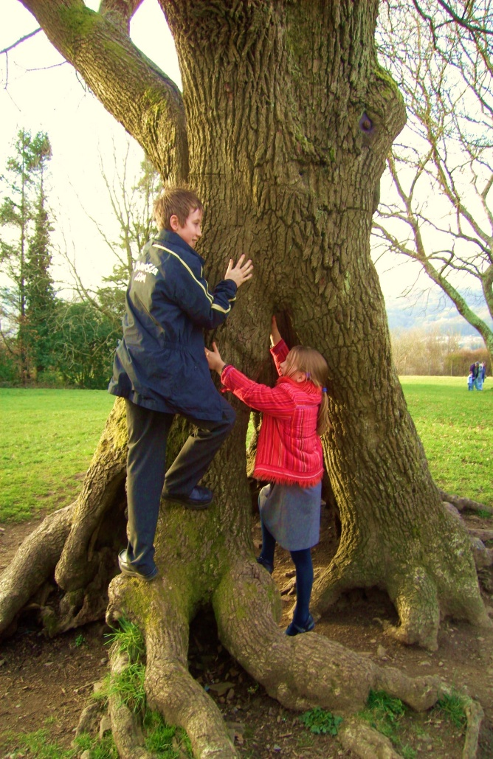
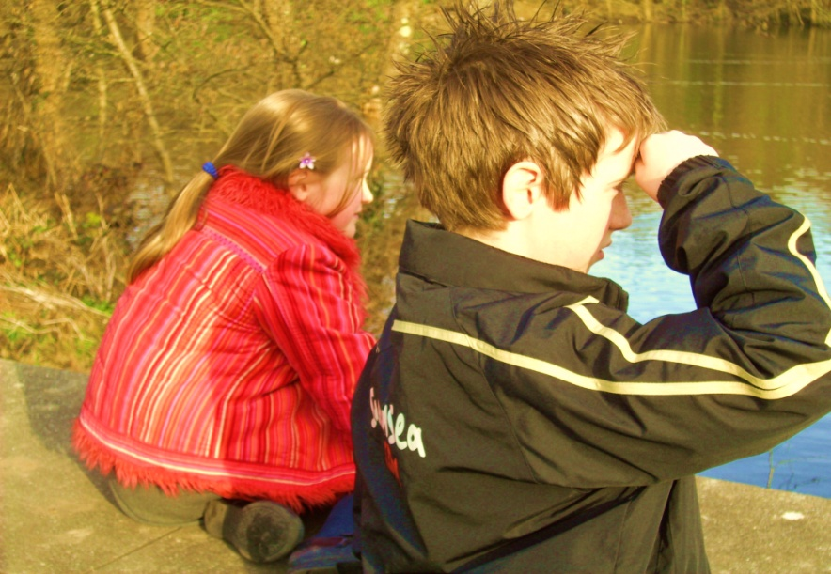
Scene 1 – Lost at the park
It was a beautiful afternoon so Joseph and Anna decided to go to the park to play and to look at the ducks on the pond.

Slide 6
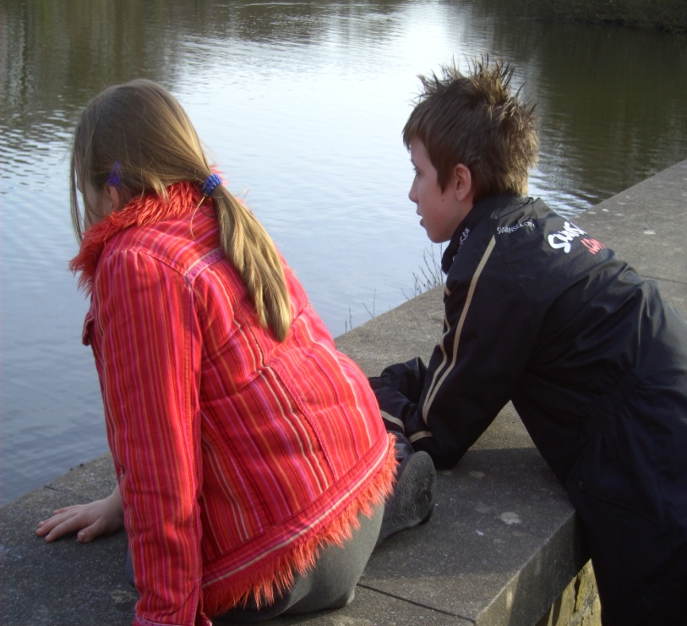
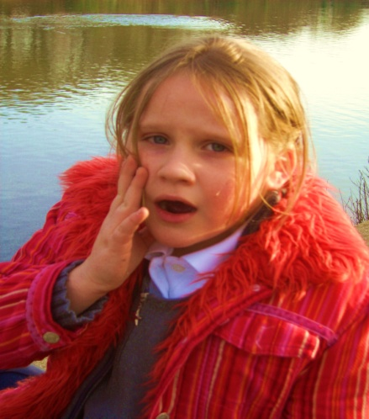
It is lovely here!
They were both enjoying the peace and quiet but it was time to go home.
Anna had not listened to her brother. He had gone without her!
I know, but we have to go now!

Slide 7
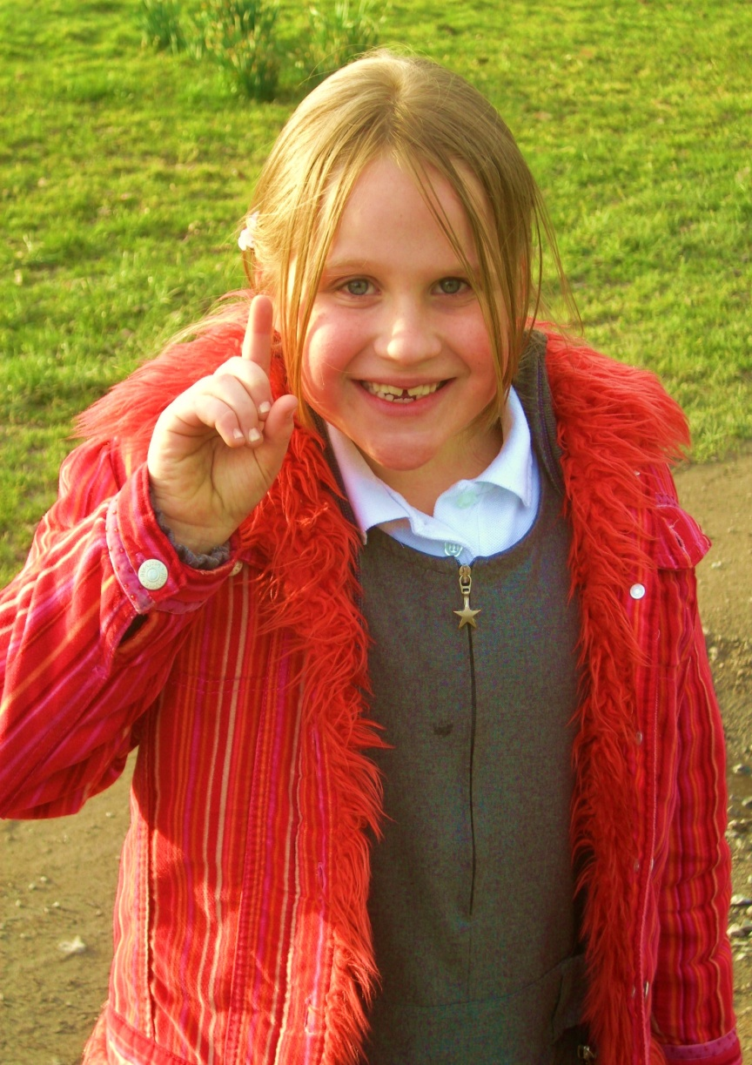
No problem!
I know what to do.
Anna had an idea.
She would go and ask someone to help her find her brother.

Slide 8
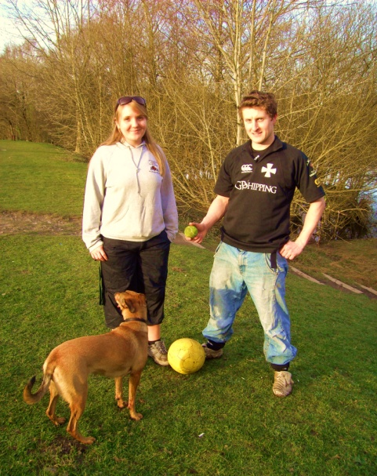
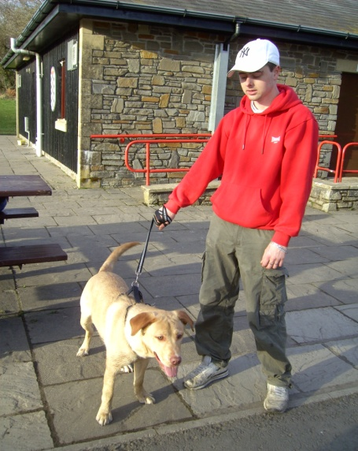
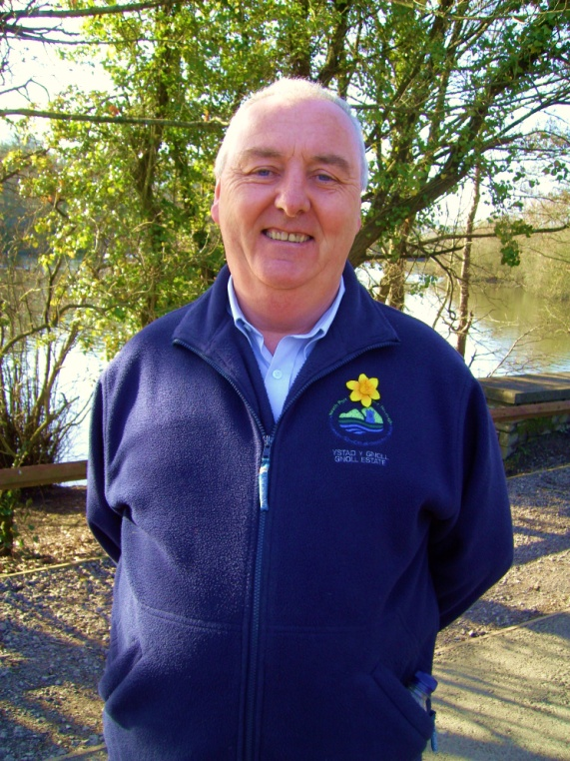
Who should she ask for help?
Man walking his dog
B
A
D
Couple playing with a ball
C
A family with children
The park warden

Slide 9
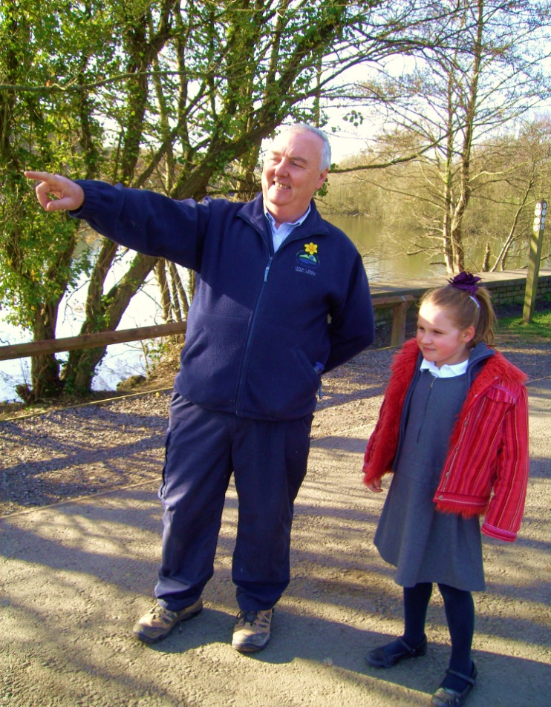
Who? Hold up your answer!
Ready?
D
The park warden

Slide 10
The park warden was a kind man and he knew the park well.
He showed Anna the way to the Park Café and walked there with her.
At last, she found her brother Joseph who was thrilled to see her safe and sound.

Slide 11
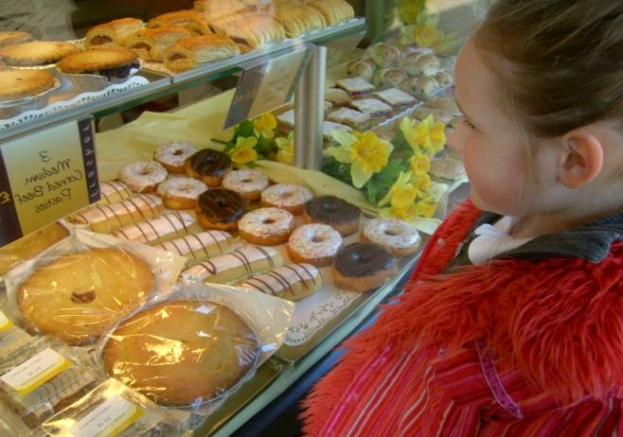
Scene 2 – The town centre
One fine, sunny morning, Anna was walking to school with her dad.
It was “eco friendly” week at school, so they decided to leave the car at home.
She loved the wonderful smells from the baker’s, so she stopped to take a look at all the lovely cakes in the window.

Slide 12
All of a sudden, she realised her dad had walked on to school without her.
She had been daydreaming about the delicious cakes.
She stood wondering what to do now!
What should she do?

Slide 13
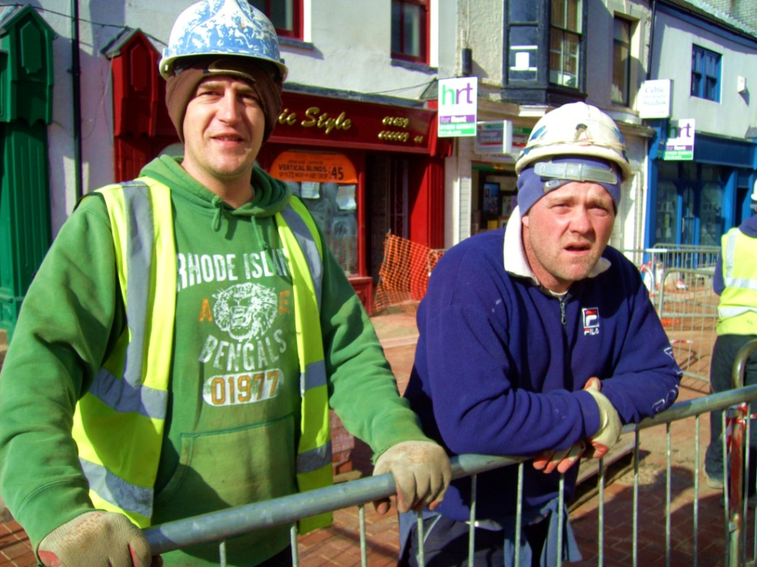
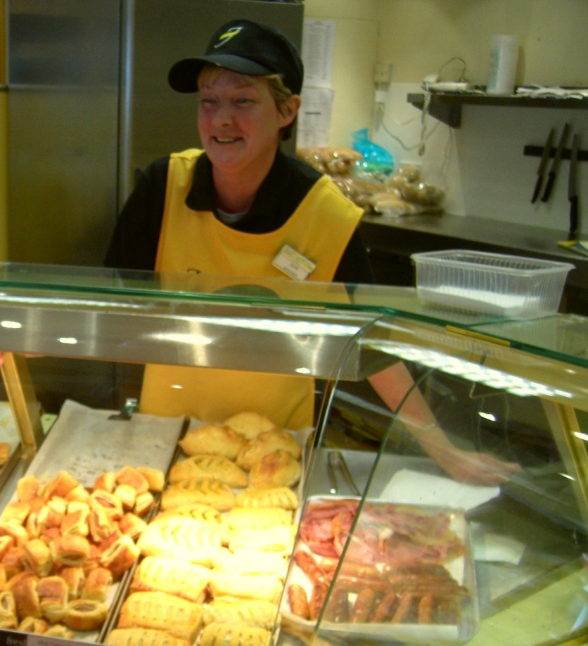
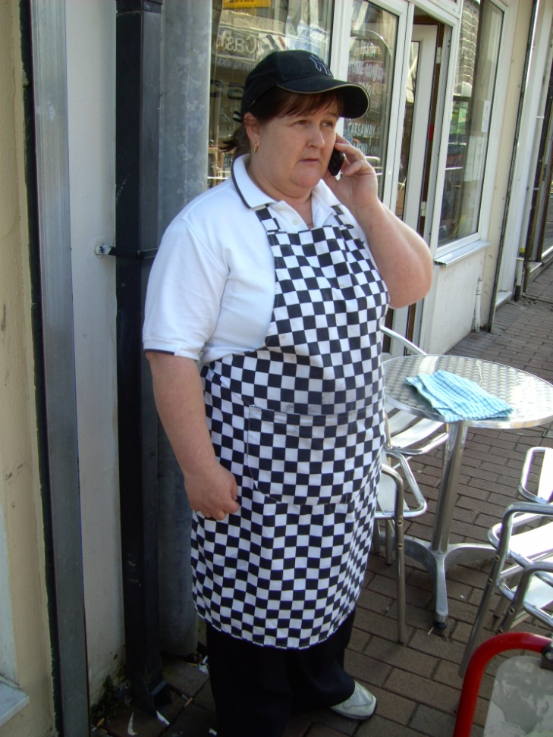
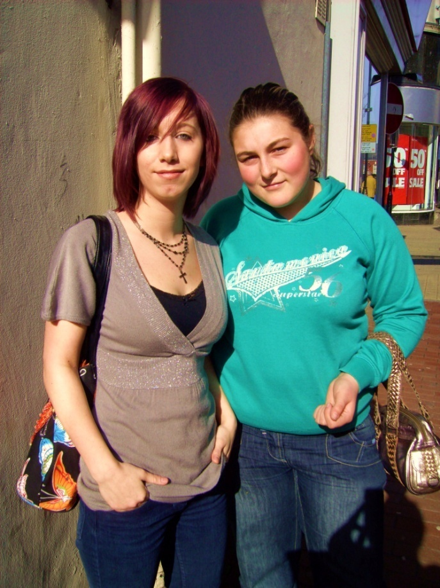
Ask for help – but who?
A
Builders
C
Lady in the baker’s shop
B
D
A café worker
Teenagers

Slide 14
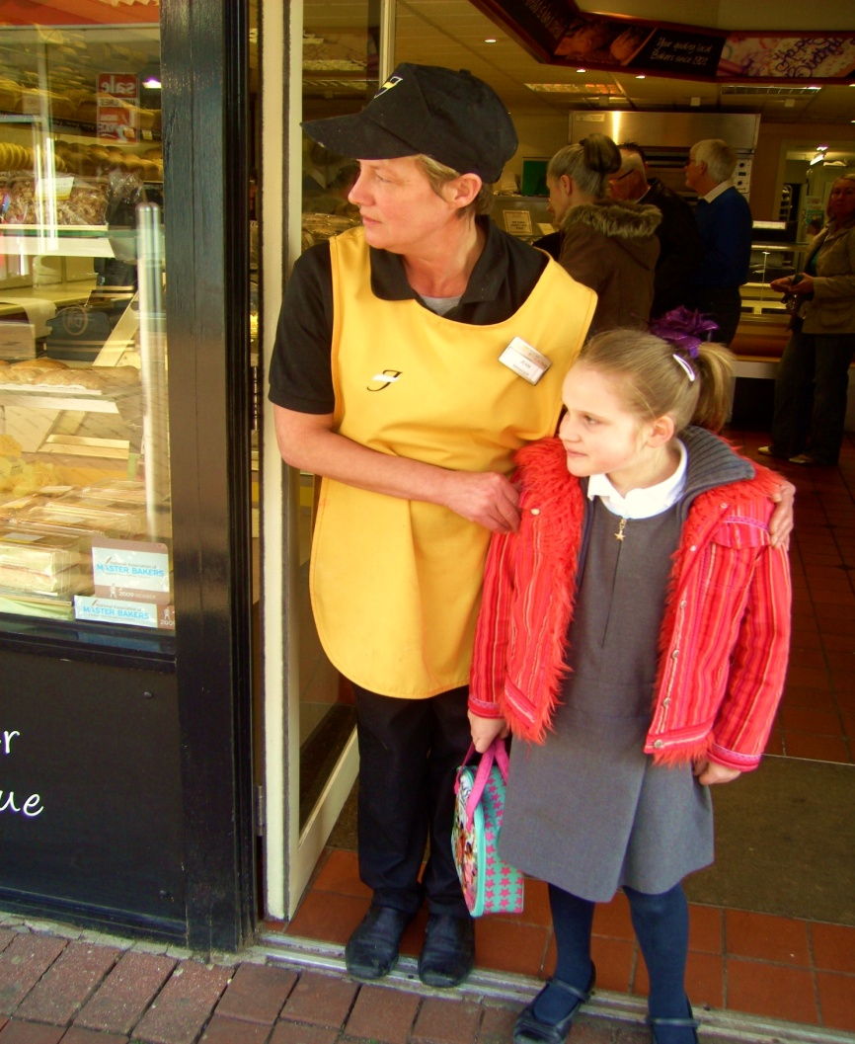
Who? Hold up your answer!
Ready?
C
Lady in the baker’s shop

Slide 15
What happened next?
The kind lady in the baker’s shop helped Anna.
Straight away, she telephoned her school where her dad was waiting in the office.
He came to collect her from the baker’s and took her to school.
The End

Slide 16
Over to you!
Think – Pair – Share
In small groups, decide what you would do in the following situation!

Slide 17
You go shopping to a large supermarket with a parent.
You spend too long looking at the toy section.
When you look around, you can’t find your parent.
What do you do?
Who would you go to for help?

Slide 18
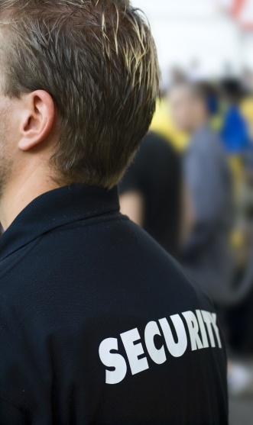
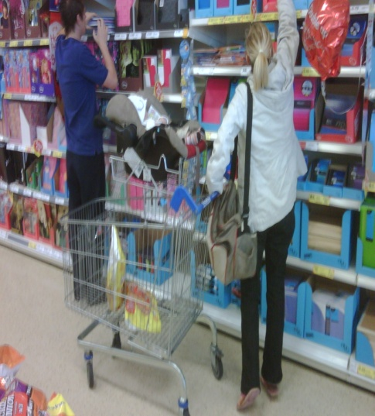
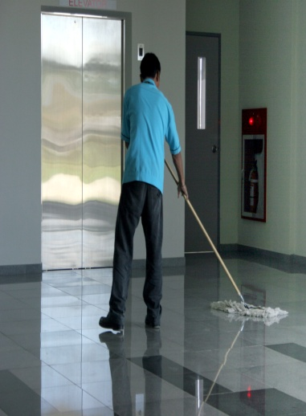
Place the following people in order of who you should go to for help.
1 = most safe
4 = least safe
Security guard
Lady pushing a trolley with a baby
Man shopping on his own
Shop cleaner
1 = most safe
4 = least safe

