Slide 1
The body warning signs

Slide 2
Some ‘things’ happen to your body as a natural way to protect it when you feel unsafe or anxious

Slide 3
What happens to your heart?
It beats more quickly or rapidly

Slide 4
What happens to your
muscles?
They feel
tight or
become
more tense

Slide 5
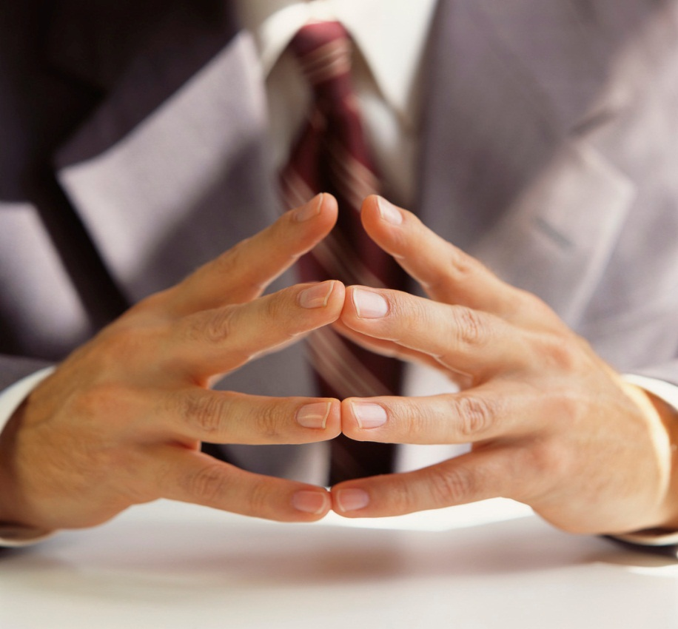
What happens to your hands?
They shake
or feel
sweaty or
clammy

Slide 6
What happens to your teeth?
They
clatter or
clench and
get tight

Slide 7
What happens to your
breathing?
It gets
faster

Slide 8
What happens to your
stomach?
It feels pain
or flutters
like
‘butterflies’

Slide 9
What happens to your mouth?
It goes dry

Slide 10
What happens to your head?
It sweats

Slide 11
Remember…
These are normal body reactions.
These things happen as a natural form of protection or as a defence mechanism.

