Slide 1
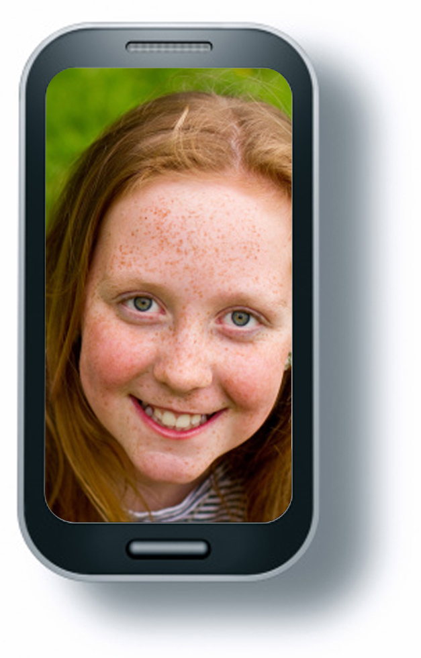
How many people would see the picture?
You have had a sleepover at your house and one of your friends takes a photograph of you in the morning, not looking your best. They put this up online for the rest of your class to see.

