Slide 1
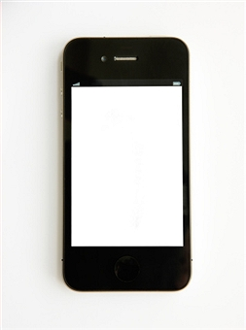
Resource 1a
Picture This
Mobilephone survey

Slide 2
Part 1 - Ask the class...results
How many have a mobile phone? ___
How many have a mobile phone with Internet access? ___
How many have access to a friend or relative’s mobile? ___
How many use a mobile every day? ___
How many use a mobile to access the Internet everyday?___
How many use it as a phone to talk? ___
How many use it to text messages? ___
How many use it for other purposes? ___

Slide 3
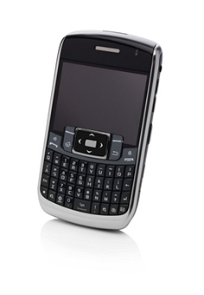
Part 2. In groups of four …
What do you use the mobile for?
Why do you need a mobile phone?
Are mobile phones a risk to you?
How did people communicate before the invention of mobiles?

