Slide 1
Paracetamol Packet
Resource 4b

Slide 2
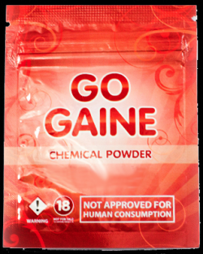
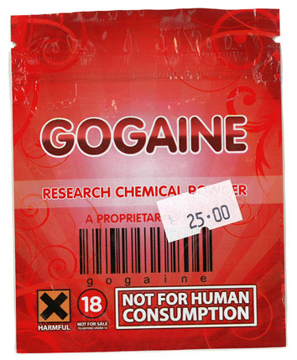
NPS sample packaging

