Slide 1
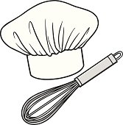
Recipe for Disaster
Ingredients
A few tablets
A pinch of white powder
A handful of brown powder
A sprinkling of green herby substance
A dusting of the other white stuff
Method
Into the bowl, add a few tablets and a pinch of white powder.
Mix together for 30 seconds
Add a handful of brown powder and stir carefully
To the bowl add a sprinkling of green herby substance and whisk for 1 minute until all the ingredients are mixed together well
Finally to your mixture add a dusting of the other white stuff and stir into the other ingredients carefully
Check your mixture is all mixed together and then place spoon on the table next to bowl
Next, turn around to face your fellow Chef and
compare the mixtures in both bowls
Who has followed the recipe correctly????????
Resource 4d

