Slide 1
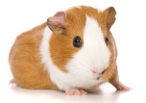
Resource 4f
Guinea Pig

