Slide 1
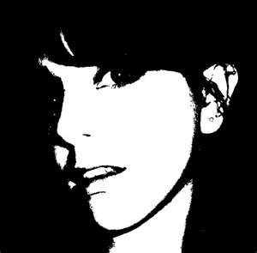
Resource 5e Statements
My best friend lost her virginity last week. I want to be the same.

Slide 2
My boyfriend is encouraging me to have sex. I had better please him.

Slide 3
My boyfriend is threatening to leave me unless I have sex with him.

Slide 4
I am going on holiday this summer. I plan to come back having lost my virginity.

Slide 5
I am 15. My friends say it is about time I lost my virginity.

Slide 6
My friends were talking about having sex. I was embarrassed as I haven’t lost my virginity yet, so I lied.

Slide 7
My friends said it was alright to drink alcohol and have sex as I wouldn’t remember.

Slide 8
It’s ok to have sex if both of us are 15 years old.

Slide 9
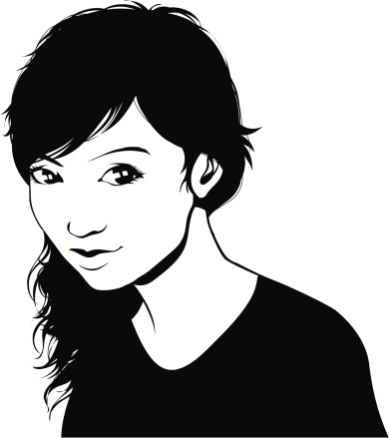
My boyfriend says sex is better if we don’t use a condom.

Slide 10
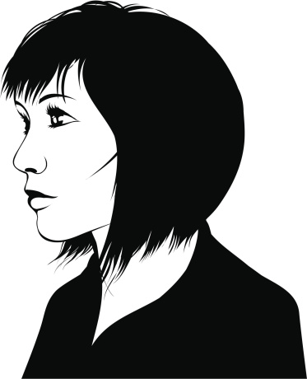
I am proud to be a virgin.

Slide 11
I want to make love to my girlfriend as I love her very much.

Slide 12
I respect my girlfriend so I am willing to wait.

Slide 13
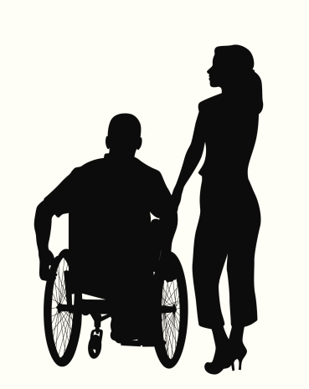
Both of us have discussed making love and we have both consented.

Slide 14
I am scared to have sex in case I contract a sexually transmitted infection (STI).

Slide 15
My faith says that we shouldn’t make love until we are married.

Slide 16
We are in the 21st century, as long as you use protection, I don’t see the problem.

Slide 17
Virginity is precious and no one should be pressured into sex.

Slide 18
I am not ready to
have sex.

Slide 19
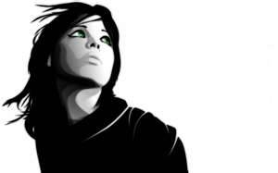
My friend is embarrassed to spend time with me; as everyone knows I am a virgin.

Slide 20
I want the new boy in my class to be my boyfriend. Perhaps if I offered him sex he would be.

Slide 21
I agreed to sex as I wanted a baby.

Slide 22
Sex is sex. I can’t think of anyone who isn’t doing it.

Slide 23
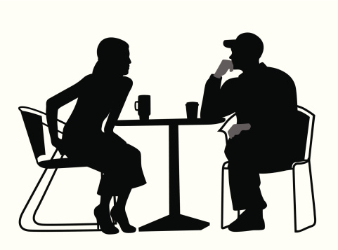
The entire rugby team claims they have had sex, so should I?

Slide 24
I haven’t met anyone I want to make love to.

Slide 25
We had better have sex or he will get bored and leave.

Slide 26
I want to really get to know my partner before I start a sexual relationship.

Slide 27
I want the first time I make love to mean something.

Slide 28
Even though my friends have lost their virginity, I don’t intend to until I am ready.

