Slide 1
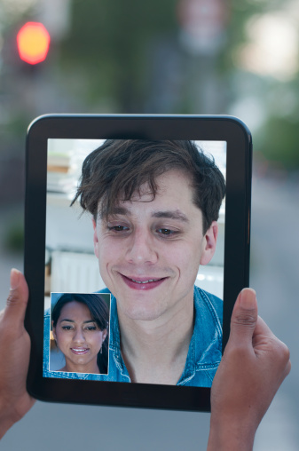
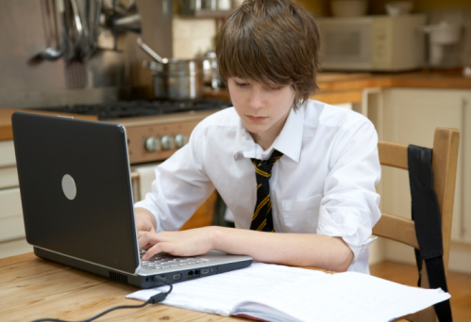
Lowri’s
Story
Resource 3a.

Slide 2
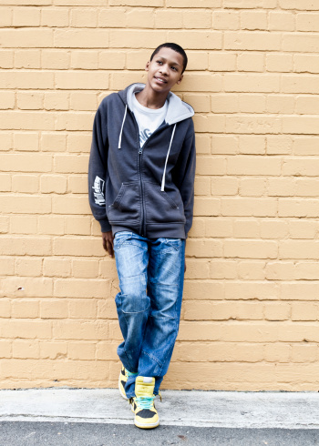
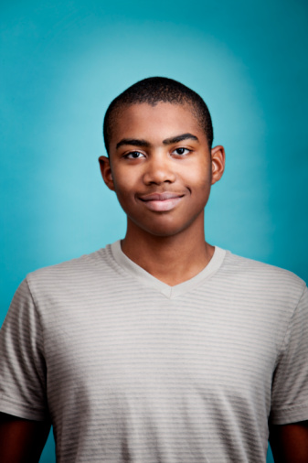
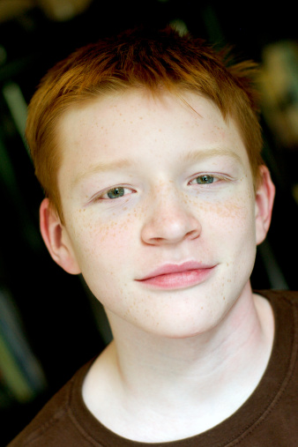
Lowri’s story
The friends
Azuben
Lowri
Ryan
Marcus
Kat
Naomi
Notes:
In Lowri’s story you are going to hear of the simple mistake Ryan made that resulted in him getting into a lot of trouble.
You will also hear of the poor choices made by 3 friends and the impact those choices would have on them, especially Lowri.
CLICK
Ryan is 15, his friends are
CLICK Azuben and Lowri, (who have been dating for 3 months).
CLICK Then there’s Marcus, Kat and Naomi. They all go to the same school and are in year 10.
Click for next slide

Slide 3
Best mates
Best mates
Notes:
CLICK Lowri and Naomi are best friends.
CLICK Ryan and Marcus had been best mates since primary school
CLICK and they both fancied Kat – she secretly has a crush on Ryan, but was good friends with Marcus.
All of them had Facebook accounts and kept in touch through texts throughout the day.
Click for next slide

Slide 4
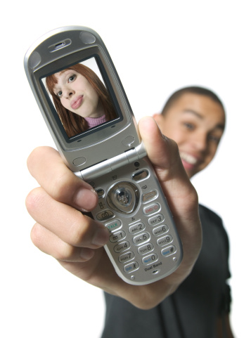
Notes:
4
CLICK Lowri and Azuben would send photos back and forth to each other regularly. The photos were silly but harmless.
CLICK Azuben would some times show some of the photos Lowri sent him, to the rest of the group.
Click for next slide

Slide 5
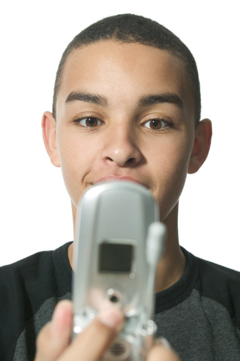
topless
Notes:
5
Marcus wanted Lowri to send Azuben a topless picture for fun. Azuben thought that it was a good idea and begun to pressurise Lowri into sending a naked picture. He promised to keep it a secret. After a lot of nagging and at times perhaps up to 20 texts a day she gave in and sent the topless picture. CLICK
CLICK for next slide

Slide 6
You’re just making it up! Show me!
Get rid of the picture mate!
Notes:
6
Azuben told Ryan and Marcus about the picture .
CLICK Ryan told Azuben to get rid of the picture as he had read somewhere that if you got caught with it on your phone you could get into trouble.
CLICK Marcus on the other hand nagged Azuben senseless for a look, saying he didn't believe him and that he was just making it up. Azuben caved in under the pressure from Marcus and sent him Lowri’s photo.
CLICK Marcus immediately sent it to everyone in the group.
CLICK for next slide

Slide 7
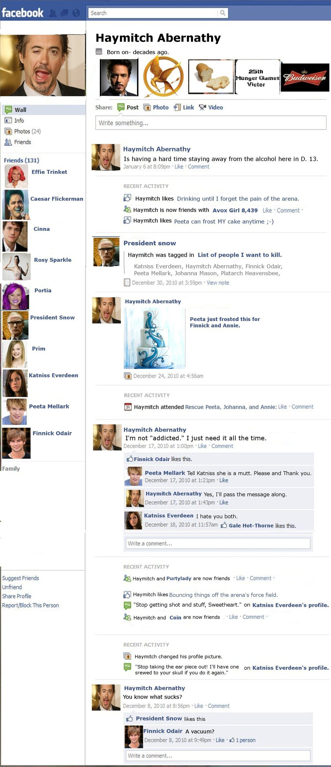
Indecent Image
Notes:
7
It was extremely embarrassing for Lowri, she was devastated that Marcus would do such a thing. She was just thankful that it was only her closest friends who had seen it, and begged them to delete it off their phones.
CLICK for next slide

Slide 8
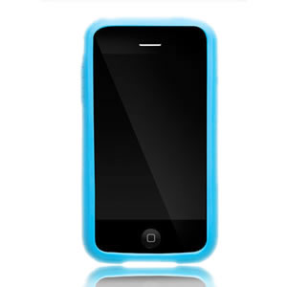
Notes:
8
After school Marcus called at Ryan’s house.
Ryan was speaking on his phone with Kat, they were both shocked about the photo they had received. CLICK Kat said she had deleted it as soon as she had received it and Naomi had done the same. Ryan said that he would be doing the same. Marcus arrived just as Ryan was ending his chat with Kat.
Marcus was annoyed with Ryan as he appeared to be getting too cosy with Kat. He did something dreadful whilst Ryan was making a cup of tea in the kitchen. He checked Ryan’s phone, to find that Ryan was still logged into his Facebook page.
CLICK He found the picture of Lowri in Ryan’s messages and posted the topless picture on Lowri’s wall. He wrote something uncomplimentary pretending to be Ryan. Using his own phone, Marcus texted the rest of the group, telling them what Ryan was supposed to have done.
By the time Ryan came back into the room the damage was done and Marcus had gone.
CLICK for next slide.

Slide 9
Notes:
9
Lowri was devastated. Her family who were also in her friends list were very angry. Although Ryan had taken down the photo as soon as he realised what had happened, the picture was now widely available and difficult to take down – it would circulate for a long time to come. Lowri’s family contacted the Police and an investigation began.
End

