Slide 1
The wrong choices
Lowri
Taking and sending the photo
Resource 3g.
Notes:
Lets look at the wrong choices made by Lowri, Azuben and Marcus.
CLICK
No one should pressurise another to do something that they don’t really want to do. Lowri would not have taken or sent the picture if she had not been pressurised by Azuben.
Ask pupils what offences in law, do they think Lowri has committed?
She has made, possesses and distributed an indecent image of a child.
Remember once you send or post any photo through the Internet you have immediately lost control of it. Think before you click. Who will see this? It will be many more than you intended.
Click for next slide

Slide 2
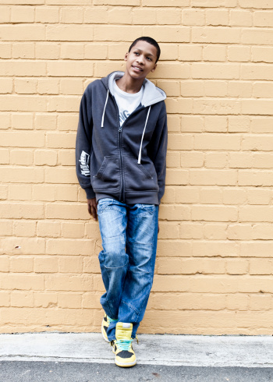
The wrong choices
Azuben
Pressurising Lowri to take and send the photo
Sending the photo to Marcus
Notes:
2
Azuben had no right to pressurise Lowri into taking an indecent image of herself. This is called relationship abuse because she did not give her consent. Lowri could have confided in someone she trusted, perhaps her best friend Naomi, her parent or another trusted adult like a teacher. By sending the photo to Marcus, Azuben not only broke the trust of Lowri, but also the Law.
If your relationship breaks down you don't know what your ex-partner might do with any photos you have sent them electronically.
If this is happening to you, speak to someone you trust.
CLICK for next slide.

Slide 3
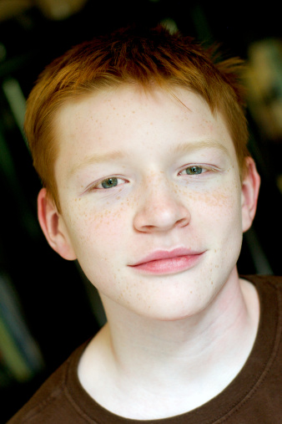
The wrong choices
Marcus
Pressurising Azuben
Sending the photo to all his friends
Posting the photo on Facebook
Blaming Ryan
Notes:
3
Marcus is responsible for a number of wrong choices.
These choices would have considerable consequences. Some of these choices are criminal acts.
Ask the pupils which choices were criminal acts?
Marcus has possessed and distributed an indecent image of a child.
CLICK for next slide

Slide 4
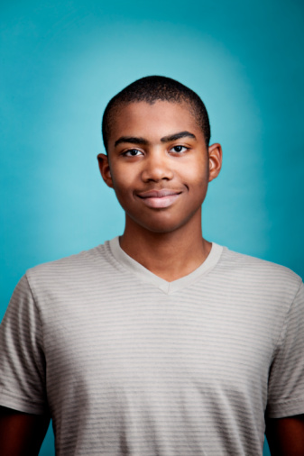
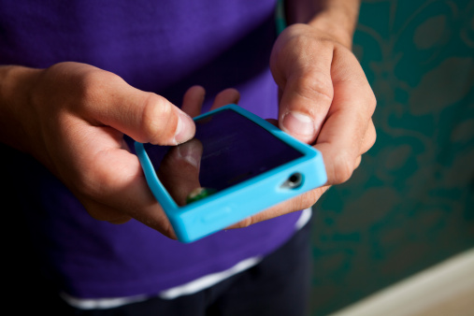
Ryan’s mistake
He left his online Facebook account logged on.
This meant Marcus was able to make a post on his account, when he left his phone unattended.
Notes:
Remember to always log out of your online accounts. It is very risky to remain logged onto any site or lend your phone to another.
Remember to have a strong password to protect your phone and lock your screen.
CLICK for the next slide.

Slide 5
The Law
Taking, distributing, publishing or possession with a view to distribute or show indecent images of a child (under 18) is against the law.
Notes:
Advise pupils:
If you are sent such an image you should delete it from your phone, tablet or computer and report it to the Police. In law this is a serious sexual offence and carries heavy penalties.
Teachers can refer to the teacher support notes resource 3f.
End

