Slide 1
Gweithgaredd Meddyliau a Theimladau
Adnodd 10a.
Thoughts and Feelings Activity

Slide 2
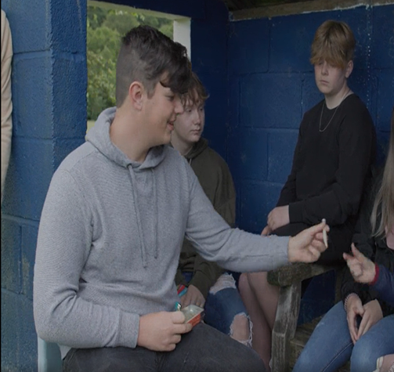
Pan mai chi yw’r deliwr
Meddyliau
___________________________________________________________________________________________________________________
Teimladau
____________________________________________________________________________________________________________________________________

Slide 3
Pan gewch eich arestio gan yr heddlu
Meddyliau
___________________________________________________________________________________________________________________
Teimladau
____________________________________________________________________________________________________________________________________

Slide 4
Pan gaiff eich ystafell ei archwilio
Meddyliau
___________________________________________________________________________________________________________________
Teimladau
____________________________________________________________________________________________________________________________________

Slide 5
Pan gewch reprimand
Meddyliau
___________________________________________________________________________________________________________________
Teimladau
____________________________________________________________________________________________________________________________________

Slide 6
Pan fyddwch yn ystried eich dyfodol
Meddyliau
___________________________________________________________________________________________________________________
Teimladau
____________________________________________________________________________________________________________________________________

