Slide 1
Cyfraith a Chosbau
Law and Penalties
Resource 6b.

Slide 2
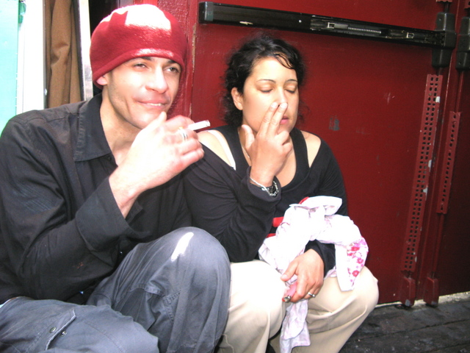
Sharing drugs including joints and spliffs can be considered in law as supplying drugs.

Slide 3
You cannot be charged and sent to court for your first drugs offence.

Slide 4
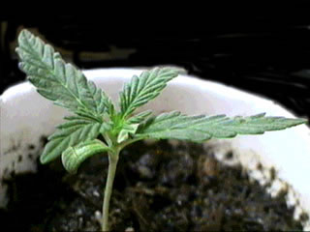
Growing cannabis plants can lead to a prison sentence of fourteen years and /or a fine.

Slide 5
A GP can prescribe cannabis as a medicine in Great Britain.

Slide 6
If you are convicted of a drugs offence you are likely to be barred from entry into other countries.

Slide 7
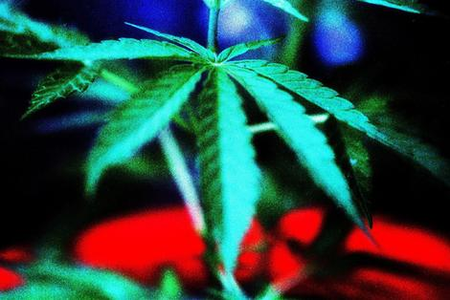
Cannabis has been legalised in this country.

Slide 8
Looking after drugs for a friend is illegal.

Slide 9
Supplying ecstasy could lead to a prison sentence of life, an unlimited fine and seizure of assets.

