Slide 1
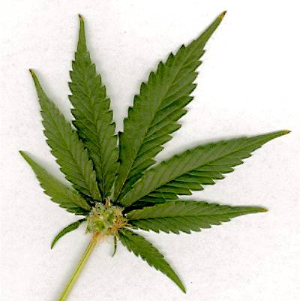
Stori Liam
Resource 7c.
Liam’s Story

Slide 2
What offence have Liam and Salim committed
Liam and Salim are best mates. One weekend they spent the day hanging out with some new friends. They were both offered Cannabis; Salim decided to smoke his straight away whilst Liam decided he would keep his to share his with his girlfriend later.

Slide 3
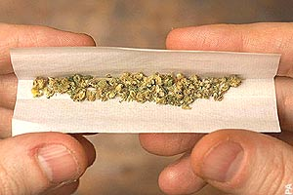
Liam and Salim have committed the offence of…
Possession of a class B drug

Slide 4
Later that day Liam met his girlfriend Louise in the park.
They shared Liam’s joint together.
What offence have both Liam and Louise committed?
What additional offence has Liam now committed?
STOP AND THINK!

Slide 5
Liam and Louise have both committed the offence of…
Possession of a class B drug
Liam has also committed the offense of…
Supplying a class B drug

Slide 6
If Liam had been seen by a police officer in the park and arrested, what might the maximum penalty be for him?
Maximum punishment: 14 years imprisonment, fine or both
What about Louise?
Maximum punishment: 5 years

Slide 7
If Liam is convicted, what impact may it have on his future?

Slide 8
Impact on Liam’s future from a drugs conviction
Affects future employment, especially working with children.
Many countries may refuse him a visa because of his drugs conviction.
It will stay with him for LIFE.
Will often invalidate insurance policies, including holiday, vehicle and health cover.

