Slide 1
Actions have
?
consequences

Slide 2
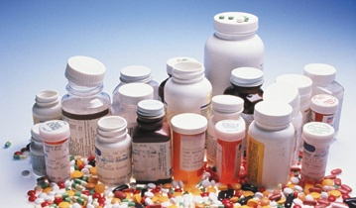
Question Card 1 Use either question card 1 or 2
For each photograph discuss the questions below as a group.
Who?
What?
Where?
Why?
Consequences?

Slide 3
Question Card 2 Use either question card 1 or 2
For each photograph discuss the questions below as a group.
Who is involved?
Where do you think this is taking place?
What do you think is happening?
Why do you think it is happening?
What do you think could happen next?
What do you think could be the consequences?

Slide 4
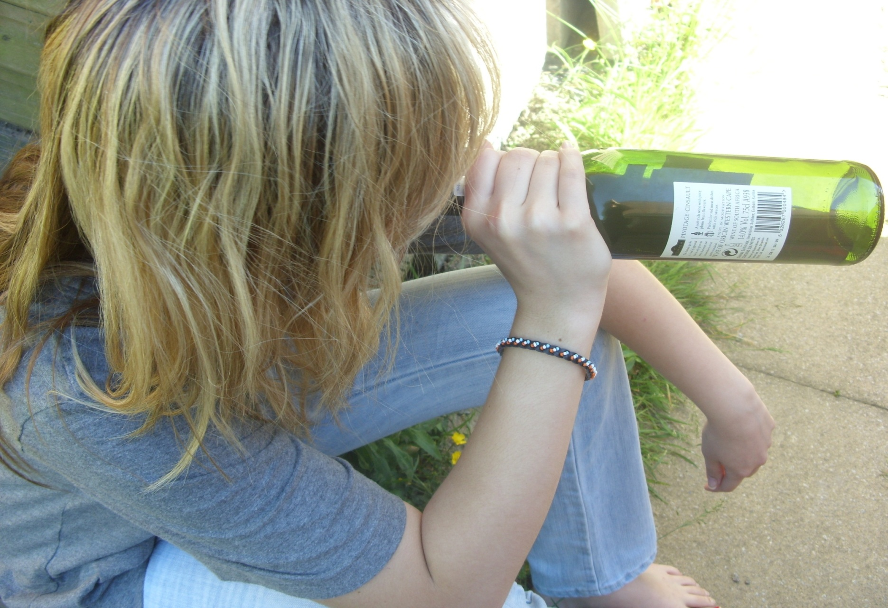

Slide 5
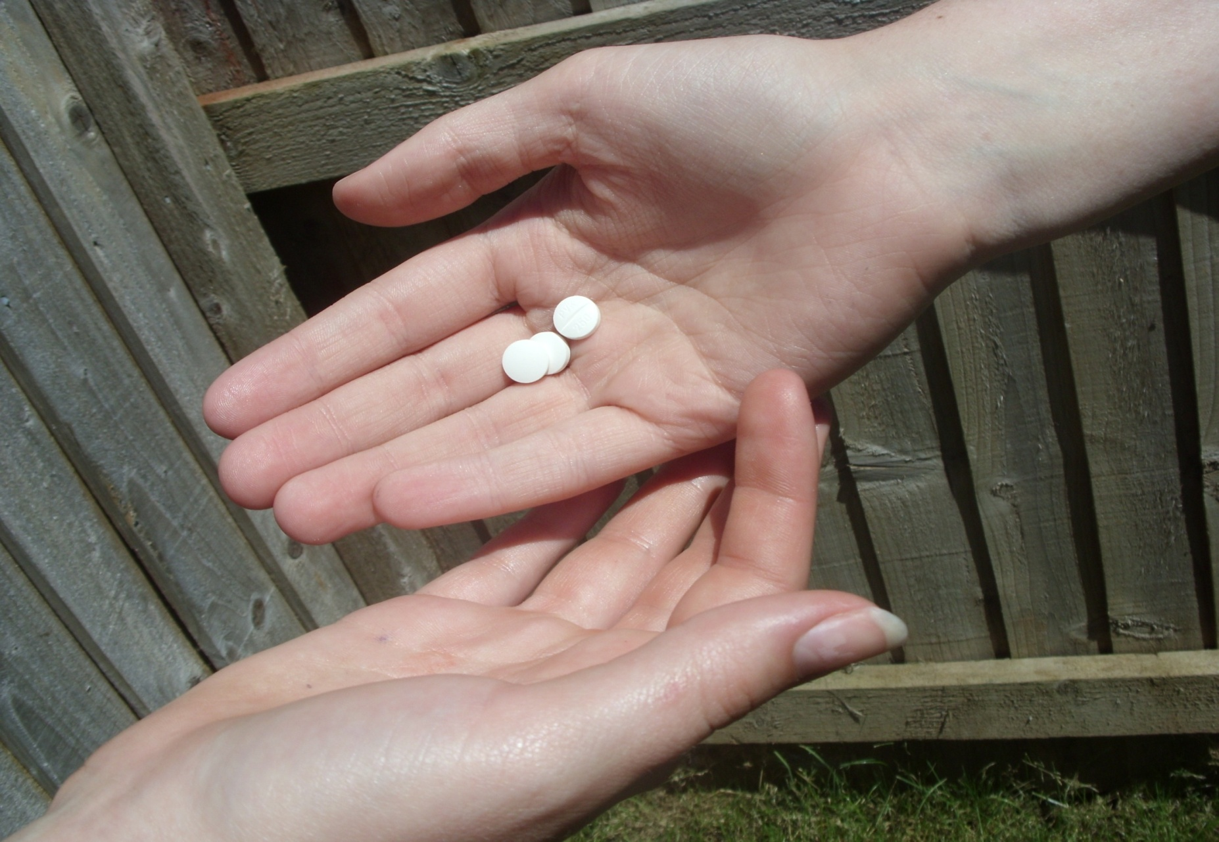

Slide 6
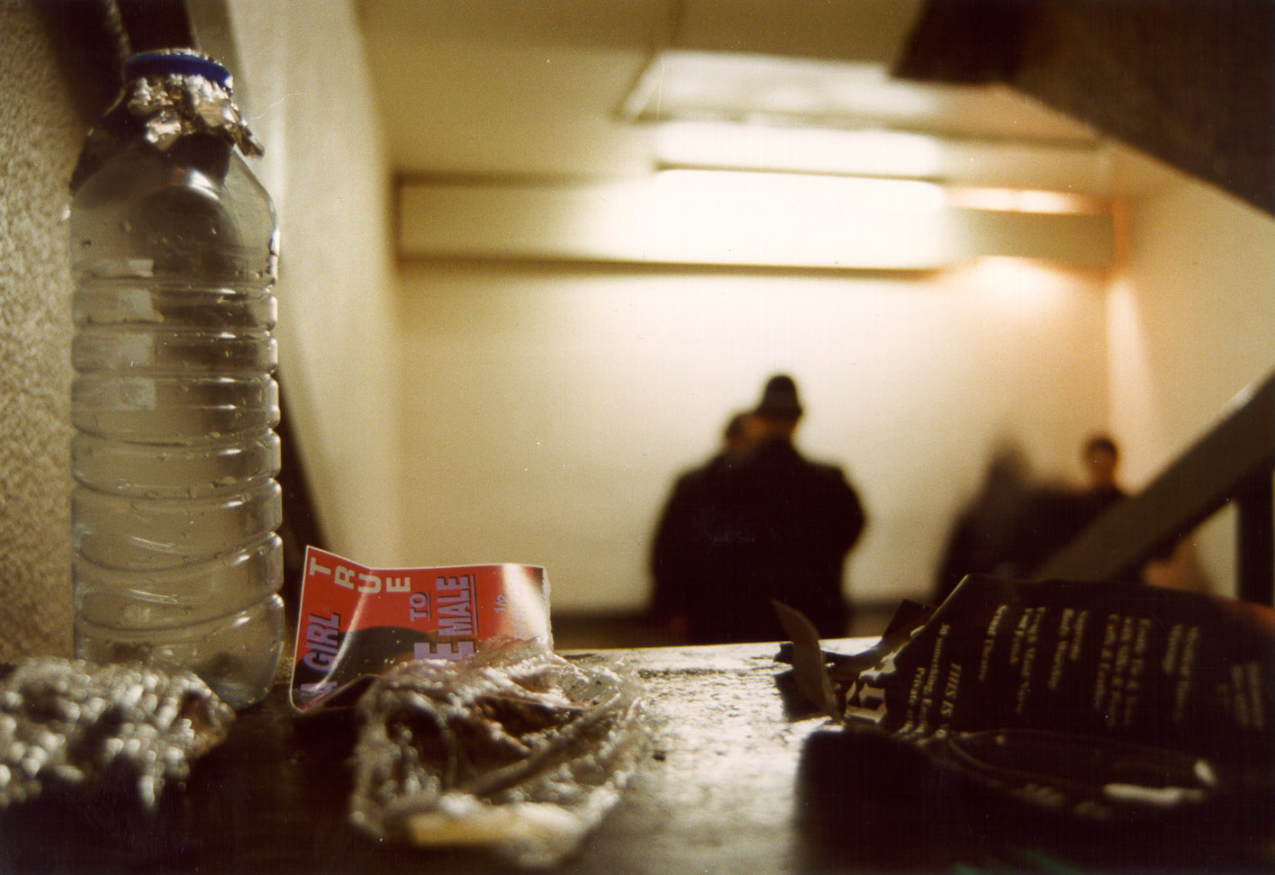

Slide 7
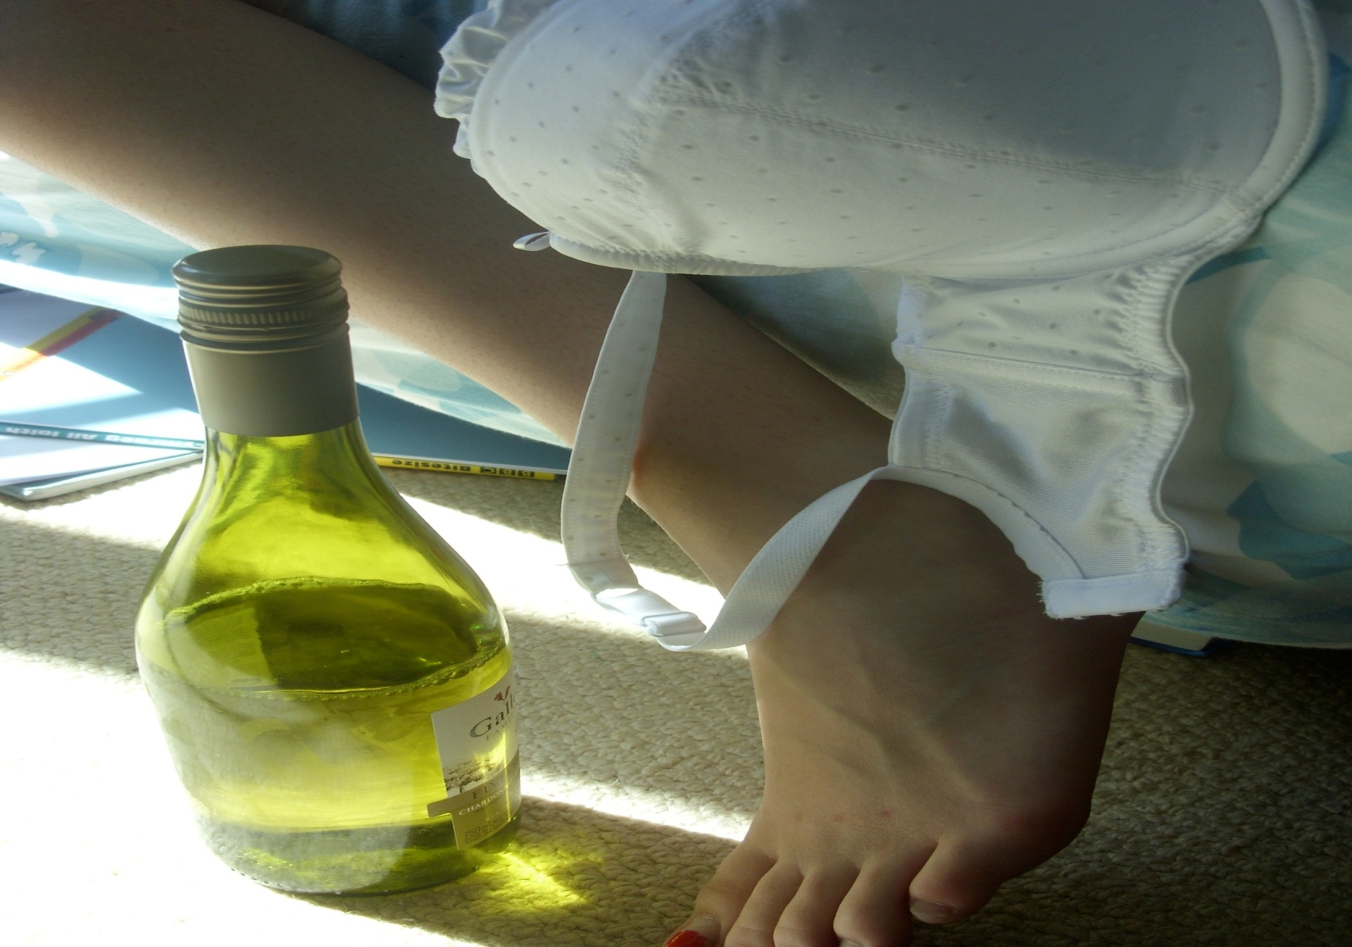

Slide 8
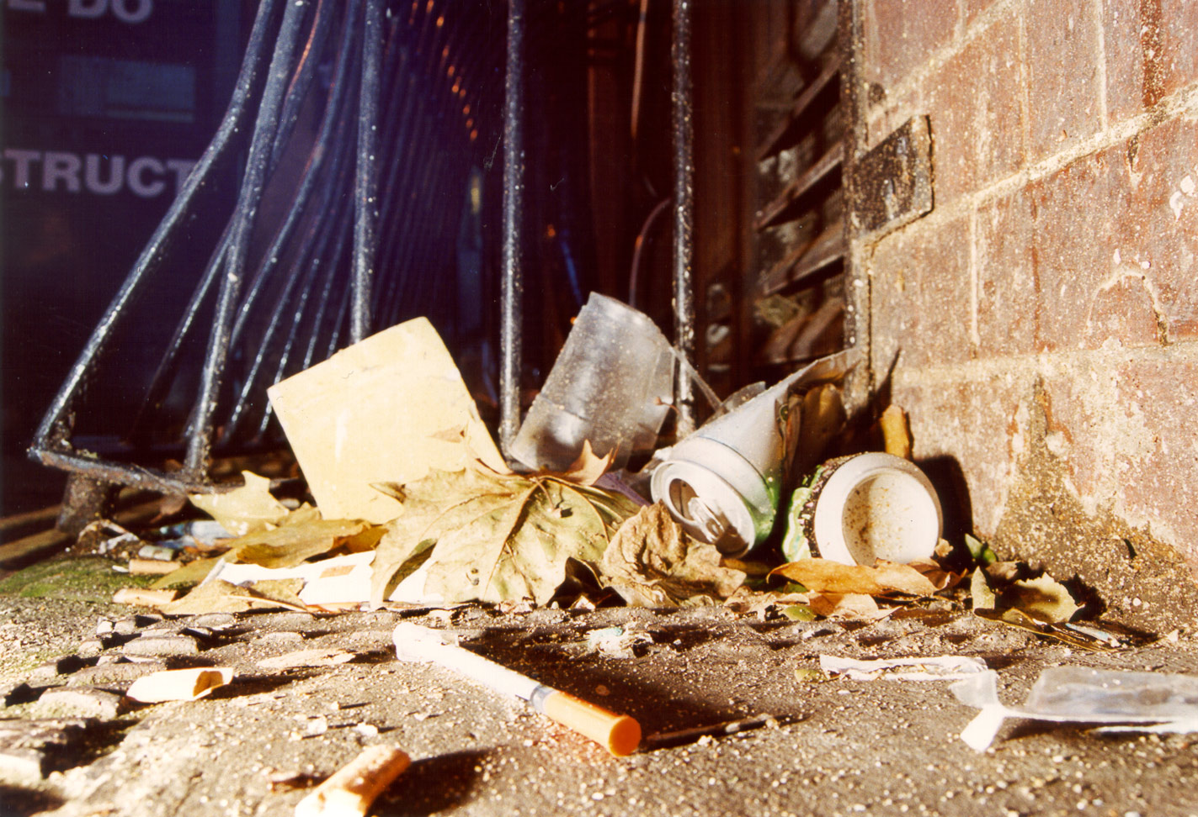

Slide 9
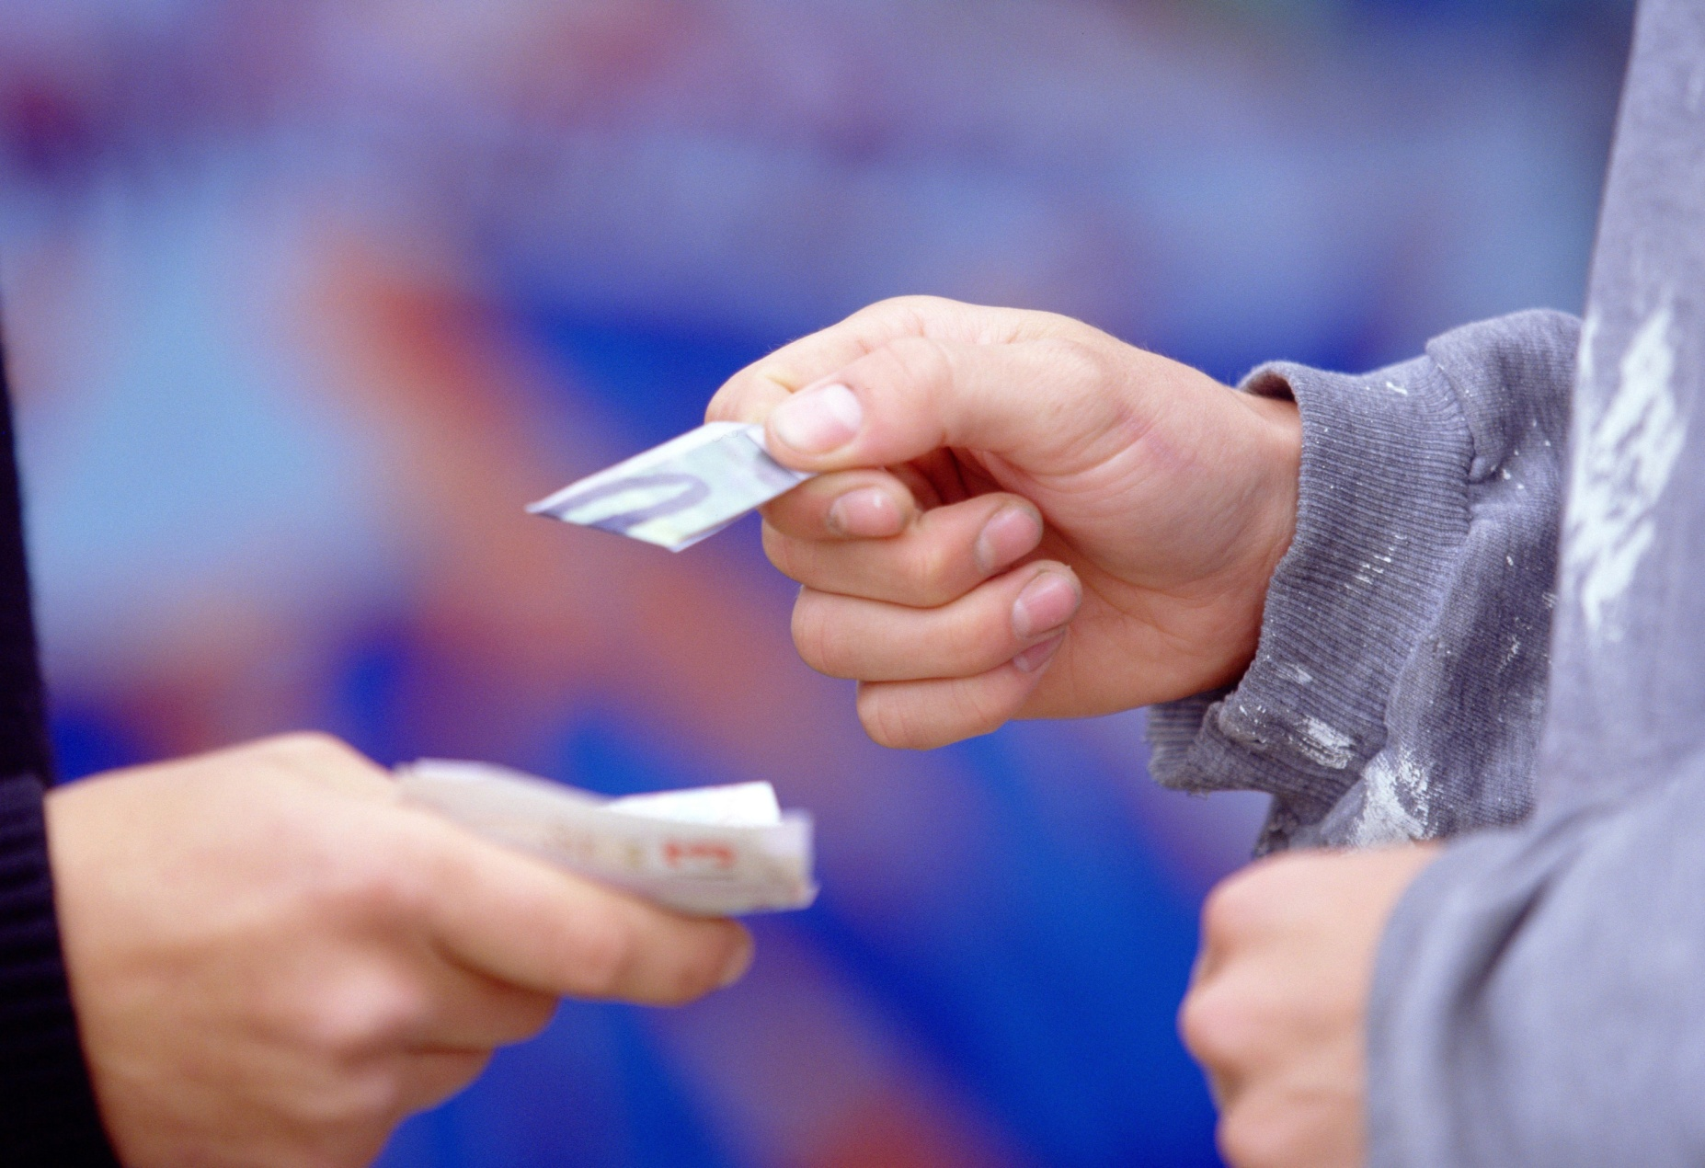

Slide 10
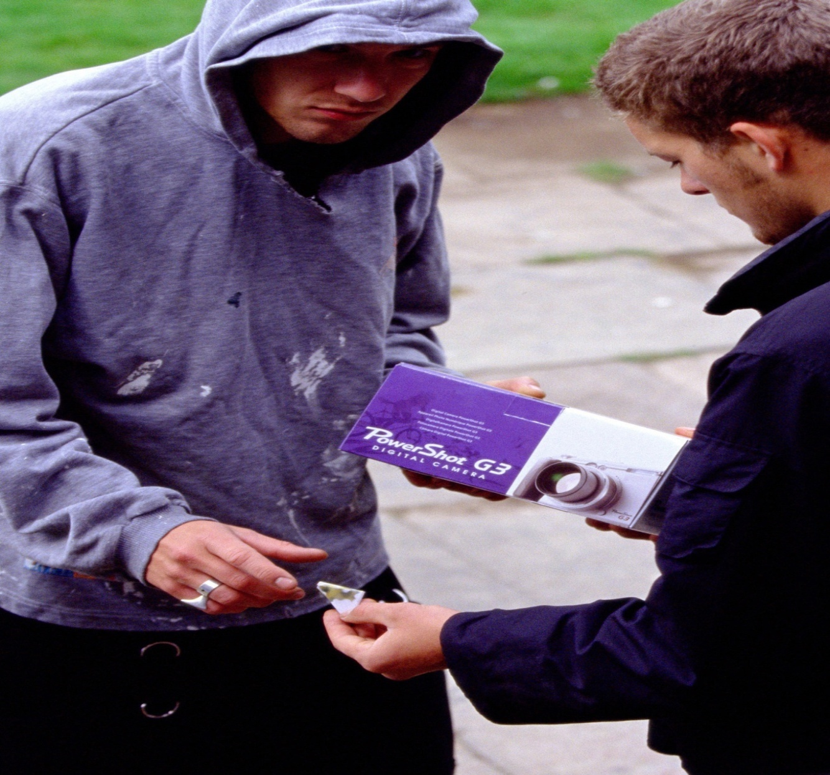

Slide 12
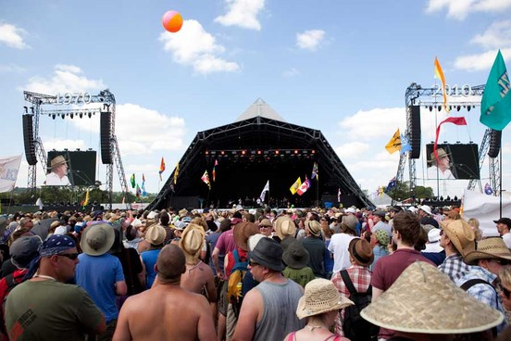

Slide 13
