Slide 1
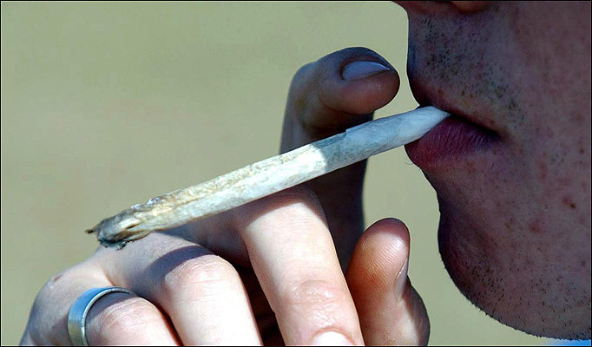
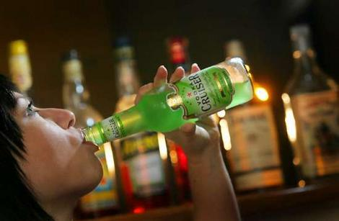
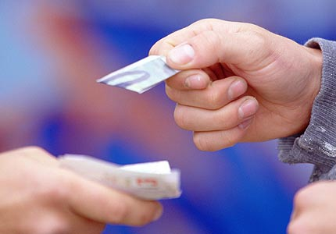
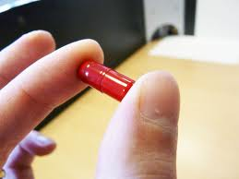

Opinion Finder
AWSLCP
Substance Misuse
Notes:
1

Slide 2

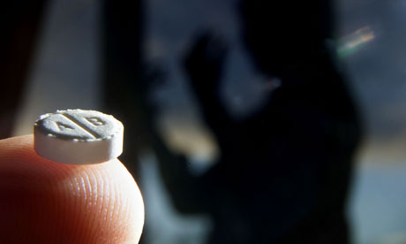
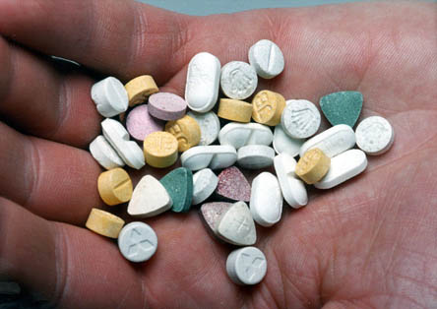
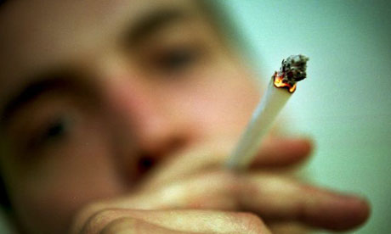
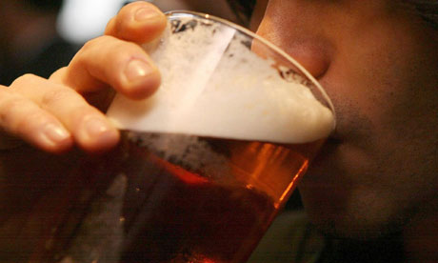
Opinion Finder Activity
agree
disagree
Notes:
New Psychoactive Substances are substances which produce the same, or similar effects, to drugs such as cocaine and ecstasy, but are not controlled under the Misuse of Drugs Act. They are controlled under the Psychoactive Substances Act 2016 ::
It is illegal to produce, supply, offer to supply, possess with intent to supply, possess on custodial premises, import or export psychoactive substances. i.e. any substance intended for human consumption that is capable of producing psychoactive effects. You could go to jail for 7 years!
NPS may contain other controlled (illegal) drugs such as Cocaine, Ecstasy, Cannabis, Heroin, Amphetamines, Methamphetamines, Ecstasy and MCAT (Meow Meow) contrary to the Misuse of Drugs Ac 1971.
You could be arrested for being in possession of NPS because it might contain an illegal substance. If you are arrested, it will remain on police records and will show on any future Disclosure and Barring Service (DBS) checks.
Give out an opinion finder sheet to each pupil. Move freely amongst them asking each one in turn their opinion regarding the 6 statements.
A tally should be kept for each response. This activity can be found on the schoolbeat website. There are an additional 7 statements to choose from.
2

Slide 3

New Psychoactive Substances (NPS) are a more socially acceptable form of drug taking
health risks
impact on community
social risks
safety risks
breaking of laws
impact on others
Notes:
Probably the most socially acceptable legal high (Over 18’s) is alcohol. There are many risks attached to New Psychoactive Substances. Health risks, social risks, breaking of laws through their influence and impact on the wider community through their use.
3

Slide 4
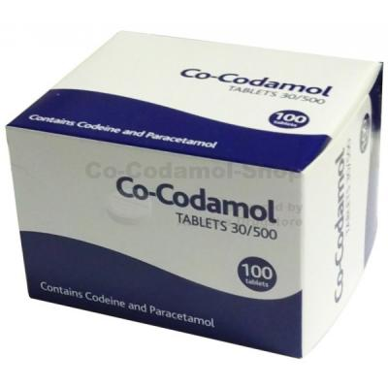
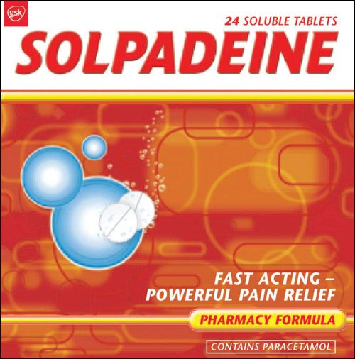
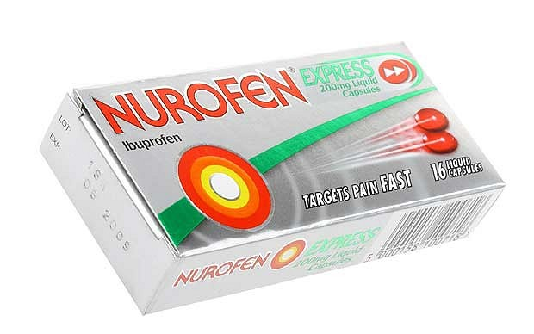
There is an unnecessary fuss over the care needed when using over the counter painkillers
Notes:
Over the counter painkillers can cause addiction in a week. The governments Medicine agency has warned that they may become addictive within a few days of use. New restrictions are being applied to medicines containing codeine; including Nurofen plus, and Solpadine, warnings will be clearly displayed on packs stating ‘Can cause addiction. For three days use only’. A survey found that Solpadine and Nurofen plus were the most commonly misused products, followed by generic co-codomol, Syndol and feminax. Women are feared to be at most risk. A headache that won’t go away can be a sign of painkiller addiction. The only cure for what neurologists refer to as “medication overuse headaches” is to switch to painkillers not containing added ingredients like opioids or caffeine, or going cold turkey and cutting out painkillers altogether.
4

Slide 5
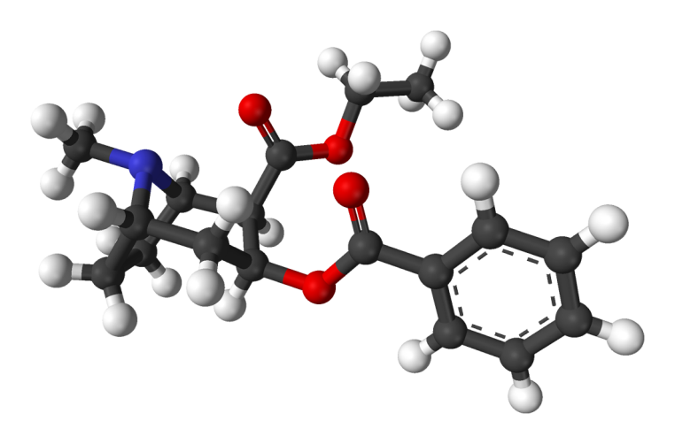
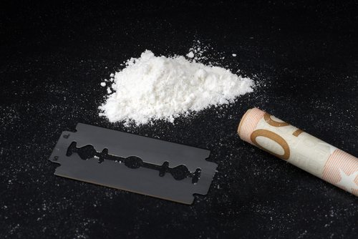
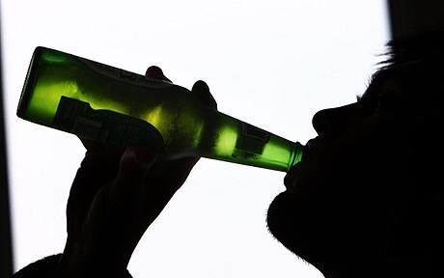
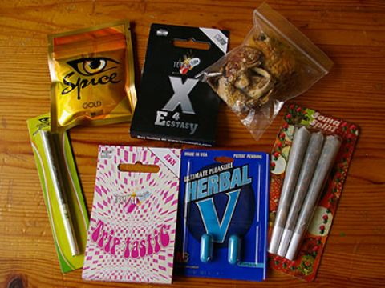
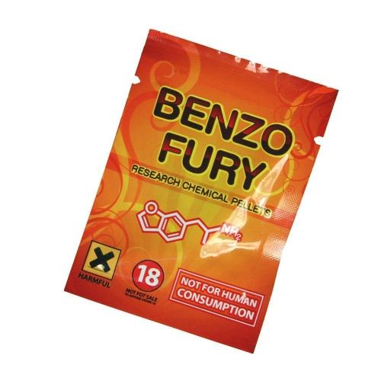
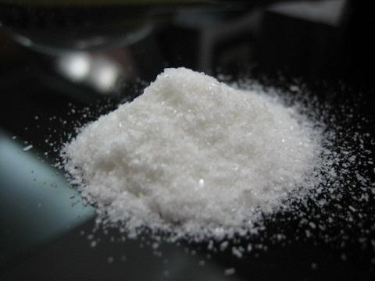

Festivals are all about opportunities to get high
+
=
Cocaethylene
Bromo Dragonfly
Notes:
In addition to great music and fun company, festivals have gained a reputation as being venues for substance misuse. There are significant risks attached to mixing drugs i.e. polydrug use eg. stimulants and depressants such as alcohol and cocaine. The effects of taking cocaine and alcohol together are far more dangerous than taking either drug alone. Cocaethylene is formed when alcohol and cocaine meet in the liver. This ‘metabolite’ remains in the body much longer, subjecting the heart and liver to a prolonged period of stress. That’s why some of the recorded deaths from Cocaethylene occur up to 12 hours after the user has mixed substances. The risk of sudden death is 18 times greater when alcohol and cocaine are used together. And what’s even worse is that you can’t see it coming, you could be feeling completely fine one minute and the next minute, BANG.
A class of substances called benzodifurans. Also known as Benzo fury, B dragonfly or fly and is known to have a similar effect to LSD although it is much longer lasting (1-3 days). Typically bought online it is taken orally in the form of blotter paper, liquid and less commonly pills. The onset of its effects can be delayed for up to six hours. This delay has resulted in the user ingesting more thinking the first dose was inadequate. It is a toxic substance and the risk of overdose is very high.
Risks of choosing to get high at festivals include:
The unknown element of buying substances without understanding effects and risks
Everyone responds differently to substances
Risk taking behaviour increasing in potentially unsafe environment
Substance misuse and driving issues
5

Slide 6
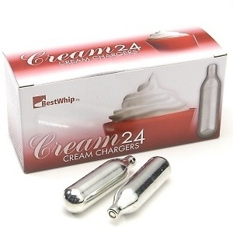
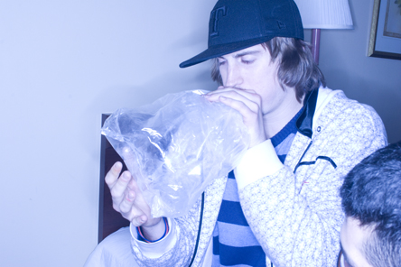
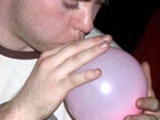
Inhaling Nitrous Oxide (laughing gas) is just a bit of a joke
Notes:
Nitrous oxide is a simple gas that when inhaled causes rapid pain relief, euphoria and mild sedation and sometimes psychedelic dissociation effects.
Used in form of whipped cream chargers dispensed into balloons. In the UK possession of nitrous oxide for non-inhalant use is legal for those over 18. It is illegal to inhale nitrous oxide and sell to under 18’s. Nitrous oxide has gained the nick name ‘hippy-crack’ because it lends itself to repeated and compulsive use for some people. Any form of substance dependency or risk taking behaviour escalating under its influence is no laughing matter.
6

Slide 7


Parents should monitor the sites their children visit on the internet
Notes:
According to a UK Ofcom report, parents in Wales appear to be less concerned about how their children use the internet. They are less likely to say they have internet parental controls set– 37 per cent in 2010 compared to 43 per cent in 2009. Those that don’t have parental controls mainly say it’s either because they trust their child or because they are supervising them. It is important to note that NPS are easily available in numerous online sites and many substances can be purchased cheaply. You tube has numerous films posted of young people taking legal highs along with other forums that advise how to take these drugs by other users.
7

