Slide 1
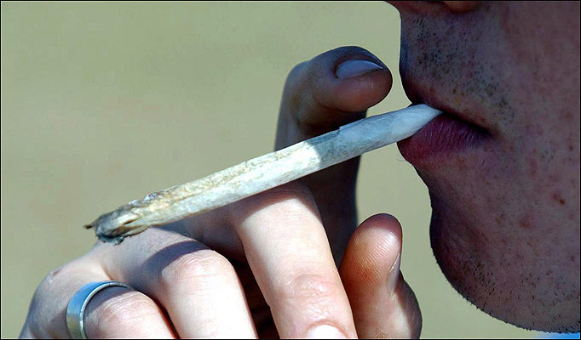
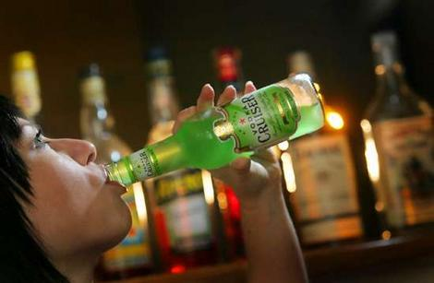
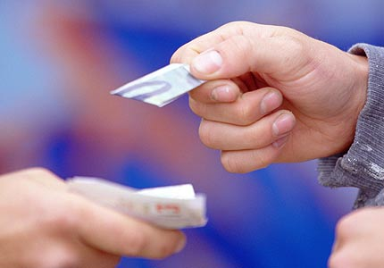
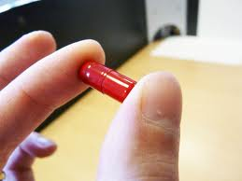

Name that drug
AWSLCP
Substance Misuse
Resource 8.a
Notes:
1

Slide 2
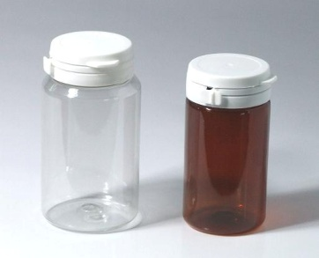
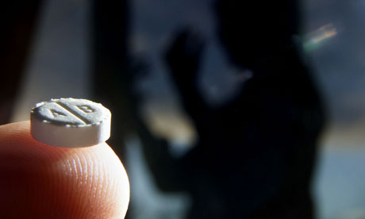
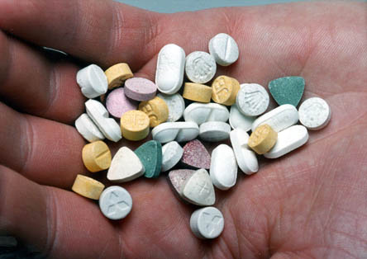
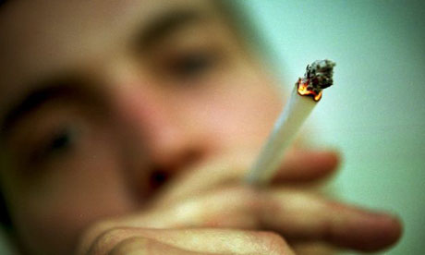

Activity - Name that drug!
Drug name
Facts
Effects
Picture
Law
Signs to look for
Notes:
Divide up into groups of around 4. Give out 6 of the 12 cards to each group. All cards should be used. Each group will have a title flash card and 4 cards that represent each of the 6 drugs under the sub-headings of picture, facts and effects, signs to look for and law. Each group should arrange the information under the heading of the drug name. Groups have 10 minutes to complete the task. Once task completed review each drug using the next 16 slides.
2

Slide 3
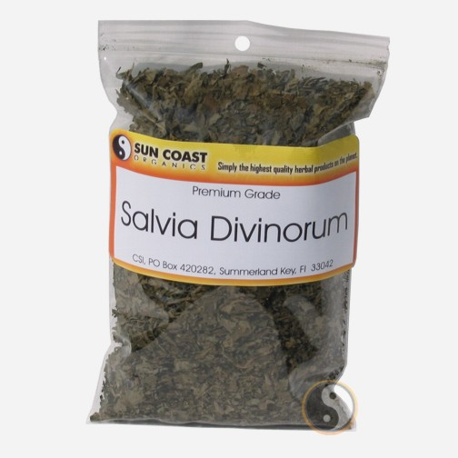
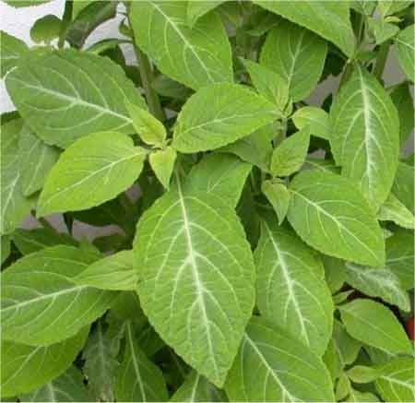
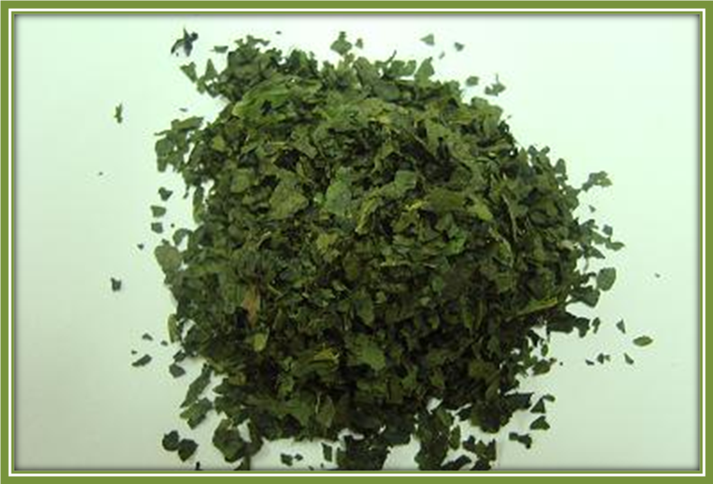
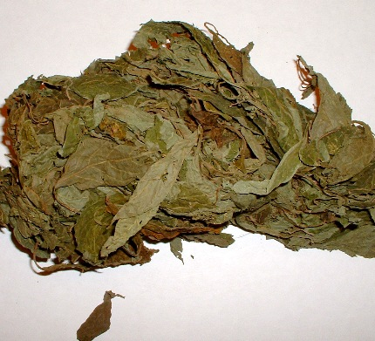
Salvia
hallucinogenic
PSA 2016
Notes:
Psychoactive drugs are - chemical substances that affect brain functioning, causing changes in behaviour, mood, perception and consciousness.
Salvia is one of the most potent naturally occurring hallucinogenic chemicals.
It is sold on the internet and in ‘headshops’ as herbal ecstasy,
Sold in dried leaf form and costs on average £12 for 1oz.
It is either chewed or smoked.
It can cause psychedelic hallucinations that distort reality
They are controlled under the Psychoactive Substances Act 2016
Under this Act is is:
It is illegal to produce, supply, offer to supply, possess with intent to supply, possess on custodial premises, import or export psychoactive substances. i.e. any substance intended for human consumption that is capable of producing psychoactive effects. You could go to jail for 7 years!
NPS may contain other controlled (illegal) drugs such as Cocaine, Ecstasy, Cannabis, Heroin, Amphetamines, Methamphetamines, Ecstasy and MCAT (Meow Meow) contrary to the Misuse of Drugs Ac 1971.
You could be arrested for being in possession of NPS because it might contain an illegal substance. If you are arrested, it will remain on police records and will show on any future Disclosure and Barring Service (DBS) checks.
3

Slide 4
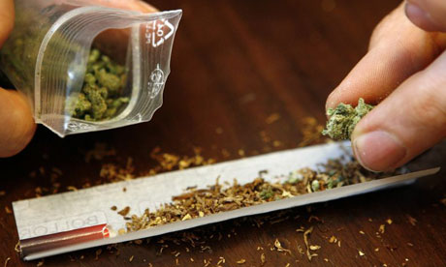
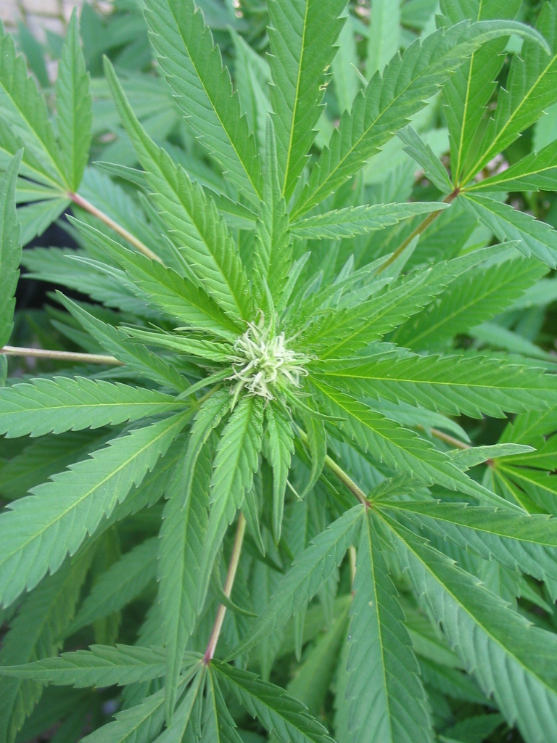
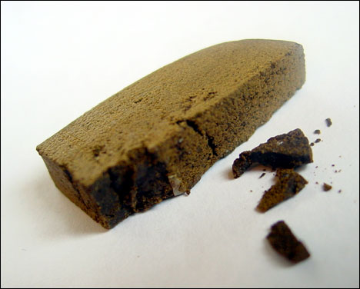
Cannabis
depressant
class B
Notes:
A depressant is a substance that inhibits or slows down the central nervous system
Cannabis usually comes as a solid block of ‘resin’ or in the herbal leaf form
The main active chemical in it is tetrahydrocannabinol (or THC for short).
THC can cause hallucinations, meaning that it can alter senses, so that a person might see, hear or feel things in a different way to normal
Cannabis is still the most commonly used illegal drug.
4

Slide 5
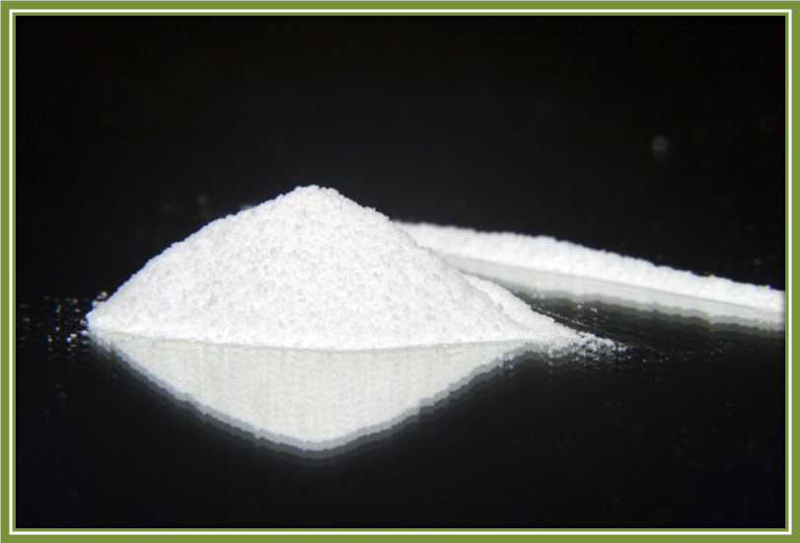
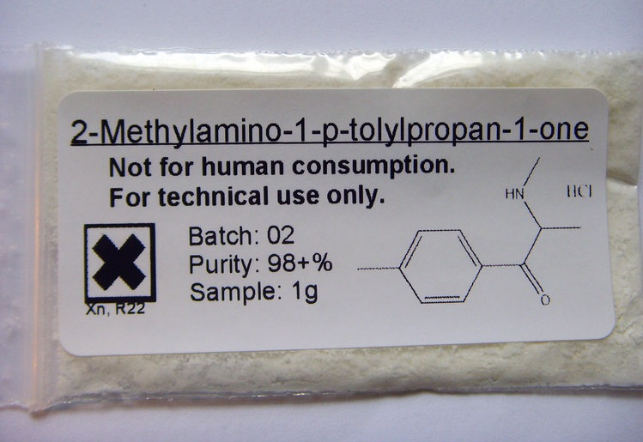
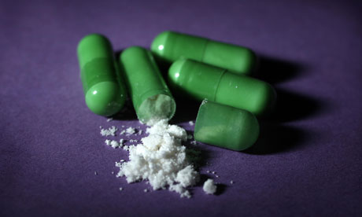
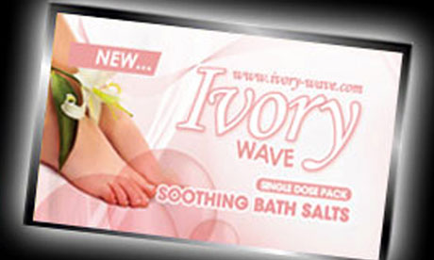
Mephedrone - M Cat
stimulant
2-DPMP
class B
Illegal to sell or supply for human consumption
Notes:
A stimulant is a psychoactive substance that elevates mood, increases feelings of well-being, and increases energy and alertness.
It is similar to ecstasy or speed
Became classified as an illegal drug category B on 16 April 2010
5

Slide 6
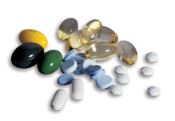
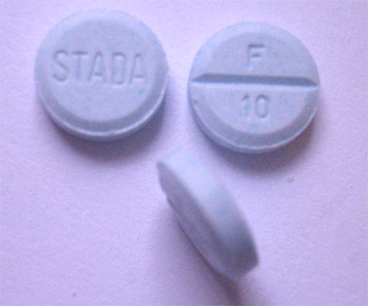
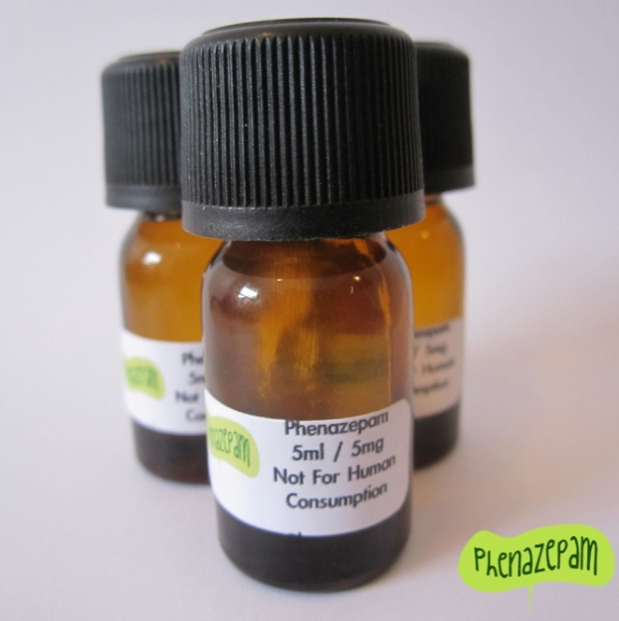
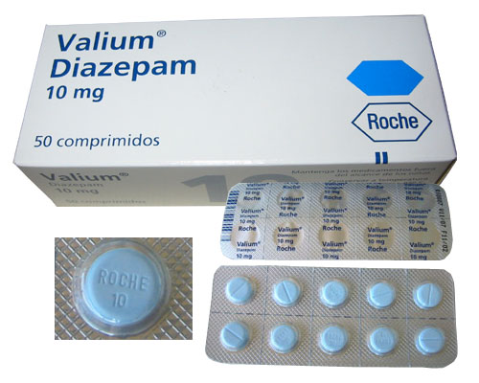
Tranquillisers
depressant
ban on the import of phenazepam 22 July 2011
class C
Notes:
There are two types of tranquillisers – ‘major’ (which are non-addictive antipsychotics) and ‘minor’ (which are relaxants that are addictive and liable to misuse).
minor tranquillisers- can induce periods of calmness, relaxation and sleep and are used to treat anxiety and insomnia.
The most common are the group of drugs called benzodiazepines. These include Rohypnol, Valium (also called diazepam) and temazepam
Using tranquillisers can be risky, and especially dangerous if they are mixed with other depressant drugs like heroin or alcohol.
6

Slide 7
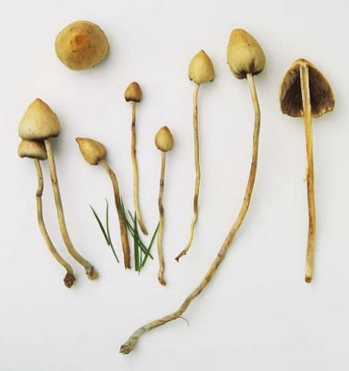
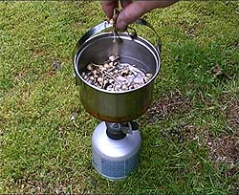
Magic mushrooms
hallucinogenic
class A
Notes:
The most common magic mushroom in the UK is the ‘liberty cap’ while the other more potent type is the ‘fly agaric’.
The 2005 Drugs Act changed the law so that now both fresh and prepared (e.g. dried or stewed) magic mushrooms that contain psilocin or psilocybin are classified as Class A drugs – so that means it’s illegal to have magic mushrooms for yourself, to give away or to sell.
Magic mushrooms can distort colours, sounds and objects. They can make you feel as if your senses are mixed up so that, for example, you think you can hear colours and you can see sounds. Some people can feel more emotionally sensitive or more creative or feel enlightened.
Magic mushrooms (except Fly Agaric) are usually eaten raw but are also dried out and stored for later use. They can also be cooked into food or made into a tea or infusion and drunk.
7

Slide 8
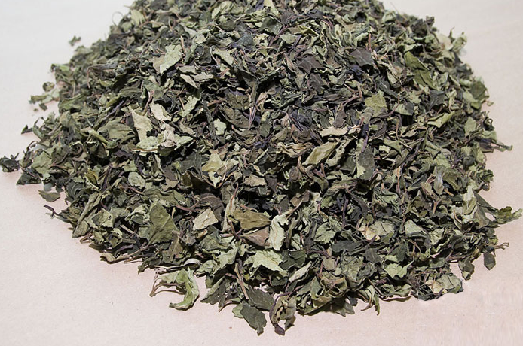
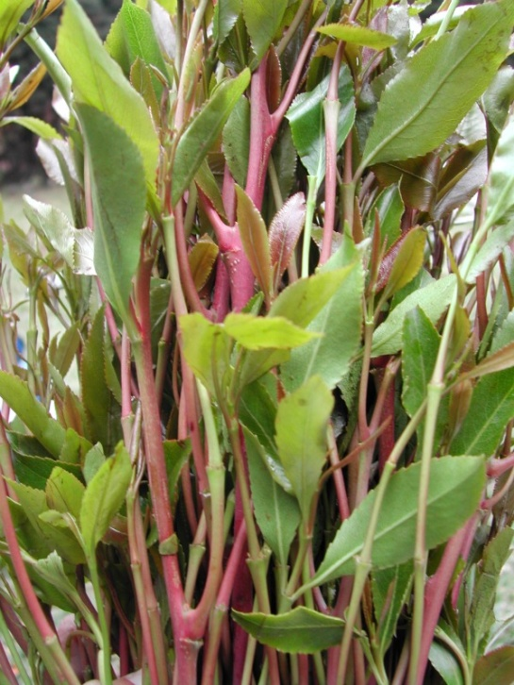
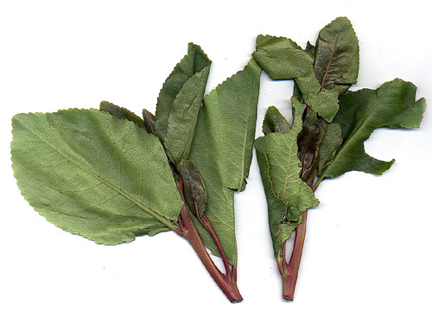
Khat
stimulant
Class C
Notes:
Khat is used mostly in Africa, but it is becoming more common in Europe and the UK
Khat (Catha edulis) is a leafy green plant containing 2 main stimulants. Their main effects are similar to, but less powerful than, amphetamine
Produce a feeling of calm if it's chewed over a few hours, with some describing it as being 'blissed out'
Khat is now classified as Class C now the UK.
Khat is an illegal substance in many other countries like the US and taking khat into the US could attract a heavy prison sentence.
8

Slide 9
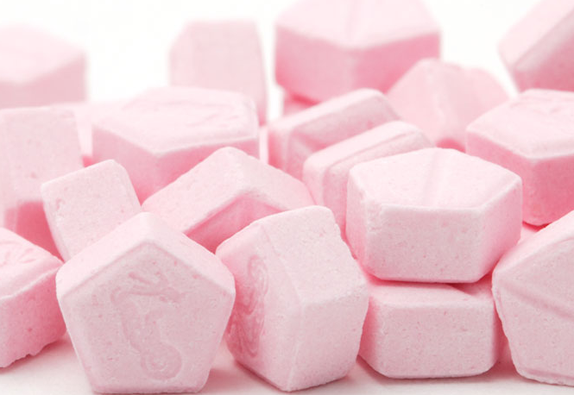
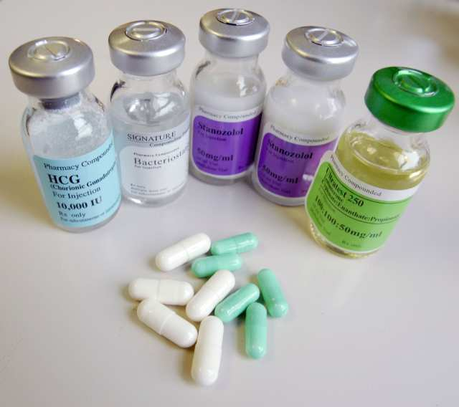
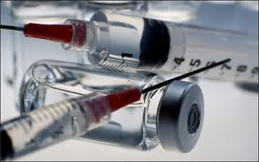
Anabolic steroids
steroid
class C
Notes:
Steroids are drugs that mimic certain natural hormones in the body that regulate and control how the body works and develops.
There are two main groups of natural steroids - anabolic steroids and corticosteroids. It is the anabolic steroids that tend to be misused, mainly because they are similar to the male hormone testosterone and they can improve endurance and performance and stimulate muscle growth.
In the young, anabolic steroids can mess up how their body develops, stopping them from growing properly.
9

Slide 10
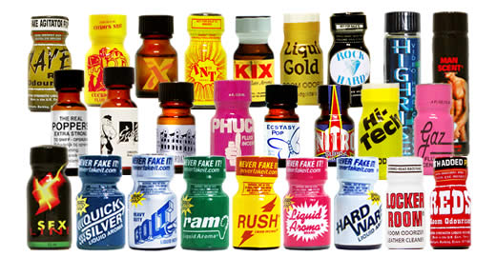
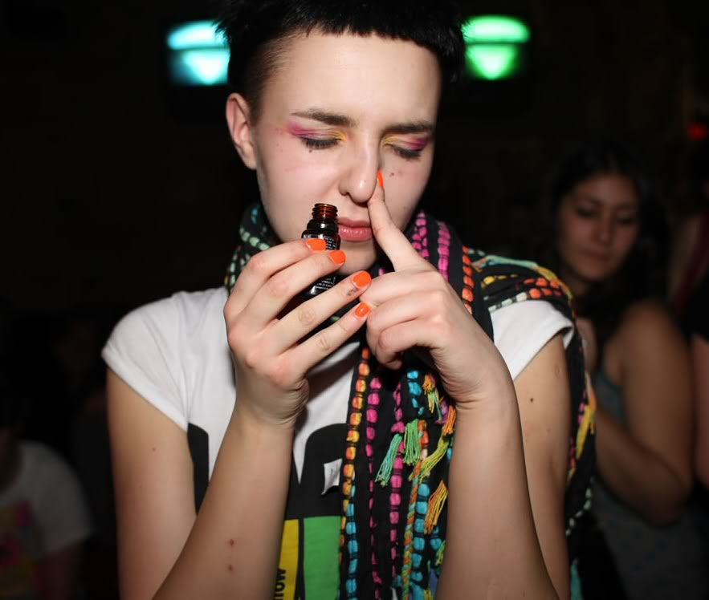
Poppers
vasodilators
unclassified
alkyl nitrates
Notes:
Vasodilators are a class of medications or substances that cause blood vessels to widen (dilate). Nitrates are the most common type of vasodilator medication.
Poppers are usually found in the form of a liquid chemical (a nitrite) sold in a small bottle. Commonly, the chemical is alkyl nitrite.
Signs of abuse may be chemical burns to body tissues – with the development of a rash around the nose and mouth, and/or irritation of the nose and throat.
They have been reported to have short-lived effects on sexual experience, specifically that they may make an orgasm feel like it lasts longer; may make an erection feel stronger (although some men have trouble getting an erection after sniffing poppers); and may make it easier for some people to have anal sex by helping to relax anal sphincter muscles). Suggest if teachers download this PPT for use they may wish to not reference the sexual effects of poppers with their pupils unless this is prompted by the class or teacher feels is appropriate to pupils.
10

Slide 11

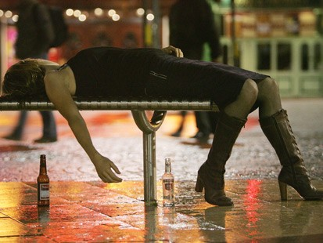
Alcohol
depressant
unclassified
Notes:
Alcohol acts as a depressant and slows down the activity of the brain, lowering your inhibitions and giving you a false sense of confidence. It also makes you less regretful of the things you do whilst intoxicated. It also affects the nervous system, so messages sent from various parts of the body take longer to reach the brain, this will slow down your reaction time/reflexes.
Alcohol is the most common drug implicated in date rapes.
Binge drinking is where a lot of alcohol is consumed in a short period of time. There is a much higher risk of sexual assaults or unplanned pregnancy or transmission of sexually transmitted infections occurring when young people misuse alcohol.
11

Slide 12
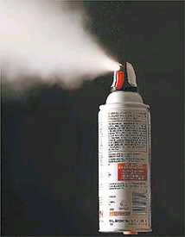
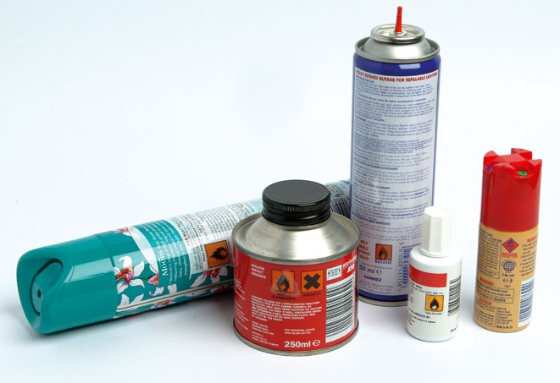
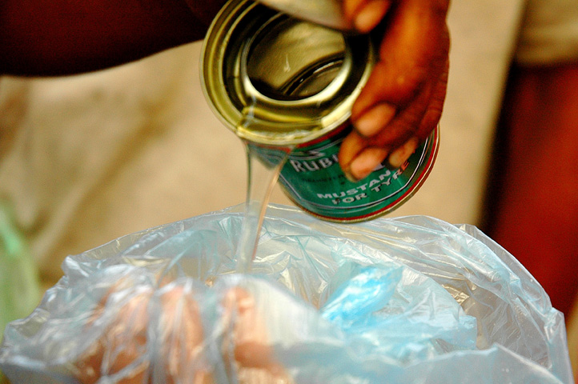
solvents
depressant
unclassified
Notes:
. Solvents can kill the first time they are used.
Squirting gas products down the throat is a particularly dangerous way of taking the drug. It can make the throat swell so that the substance abuser can't breathe, it can slow down the heart and can cause a heart attack. And the substance abuser may die from the physical depressant effects with loss of consciousness and choking on vomit.
12

Slide 13

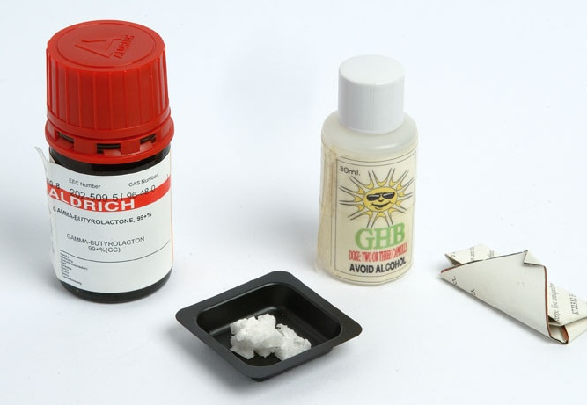
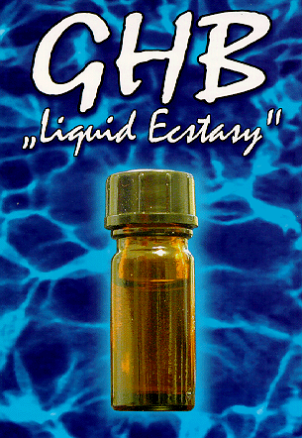
GHB
depressant
class C
Notes:
Gammahydroxybutrate is a, dangerous drug with sedative and anaesthetic effects.
Due to this effect it has been linked to drug assisted sexual assault.
GHB shortly after entering the body produces afeeling of euphoria and can reduce inhibitions and cause sleepiness. It can kill and is particularly dangerous when used with alcohol and other depressant or sedative substances.
13

Slide 14
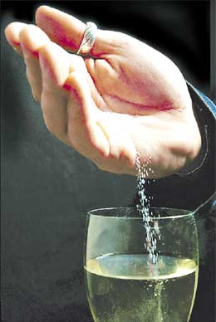
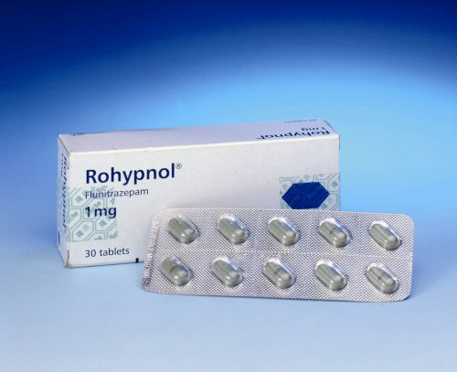
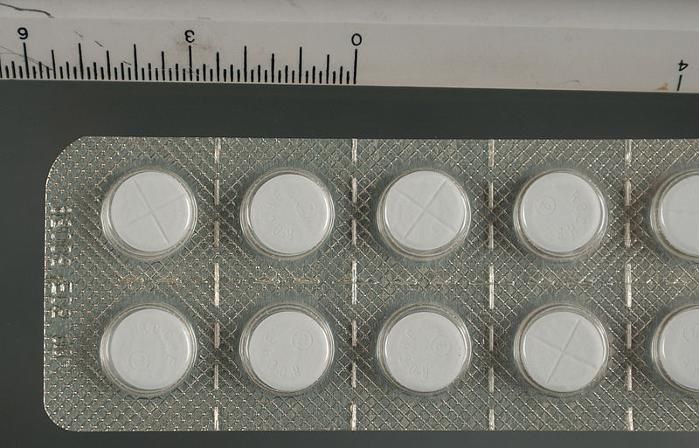
Rohypnol
depressant
class C
Notes:
The drug’s brand name is flunitrazepam and belongs to the Valium family. It is, however, 10 times more potent than Valium
There are concerns that rohypnol has been used in sex crimes, where a victim’s drink is spiked with a tranquilliser, making them very drowsy or knocking them out so they're either unaware of or unable to prevent a sexual assault.
14

Slide 15
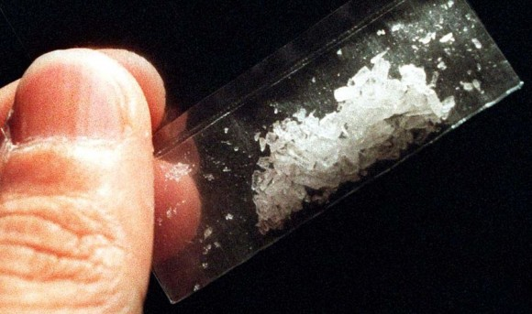
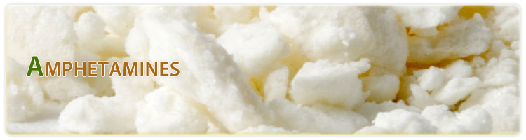
Amphetamine
stimulant
class B
Notes:
Base is stronger at roughly 50 per cent purity or more, but this is declining. A similar though some say stronger form of the drug is methamphetamine. This comes as powder, crystals (known as ice) or in tablet form.
The powders are snorted up the nose, mixed in a drink or, by some heavy users, prepared for injection. Base is usually swallowed or, because of its bad taste, wrapped in (cigarette) paper and bombed (swallowed). It can be snorted if dried out properly.
Amphetamines were first discovered in the 1800s but their medical uses were not recognised until the 1930s. Then they were used to counter low blood pressure, help asthmatics breathe more easily and suppress appetite. Later amphetamines were prescribed for a whole range of disorders including inability to sleep, epilepsy, migraine, depression and hyperactivity in children. In the 1950s and 1960s they were widely marketed as slimming tablets.
2-DPMP is an amphetamine-type stimulant that has been found in some Ivory Wave products. Although we can’t say for sure what is in any particular product sold as Ivory Wave, we do know that the effects reported are those of a strong stimulant, with similar effects to amphetamines (speed) and MDMA (ecstasy), such as alertness, talkativeness and feelings of euphoria and empathy. 15 September 2011 desoxypipradrol (2-DPMP), the active compound found in some legal highs branded ‘Ivory Wave’, has been brought under control under the Misuse of Drugs Act 1971. 2-DPMP and its related compounds, D2PM and diphenylmethylpyrrolidine, will become class B drugs. It is not legal to sell or supply.
15

Slide 16
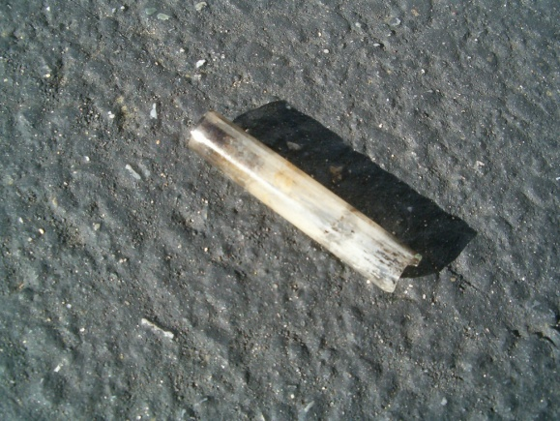
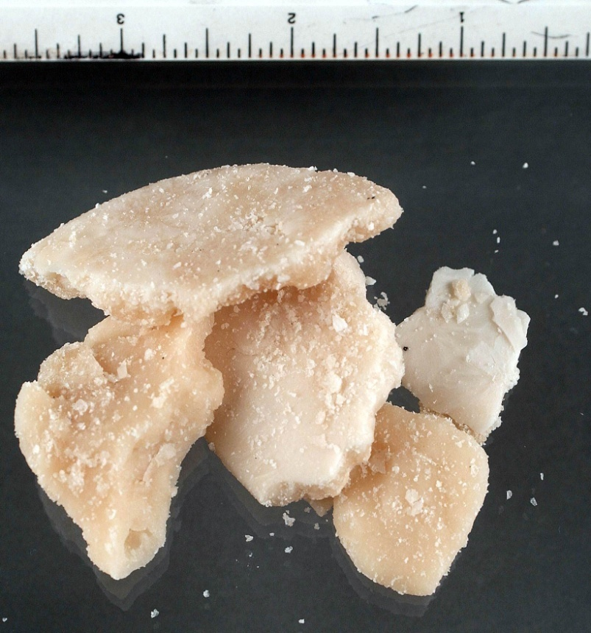
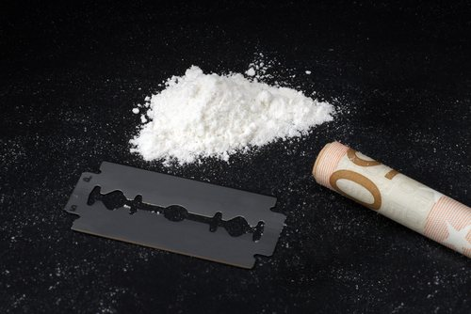
Cocaine
stimulant
class A
Notes:
The intense high from a cocaine hit can be within seconds and the ‘crash’ or ‘comedown’ can be devastating, resulting in the immediate and overwhelming desire to take more.
The term “crack” comes from the street and refers to the cracking sound the drug makes when it is smoked. Crack cocaine is made by combining the powder form of the drug with ammonia or baking soda and water, then heating the mixture to remove the hydrochloride. The drug produces an almost immediate high, usually within 10 seconds.
16

Slide 17
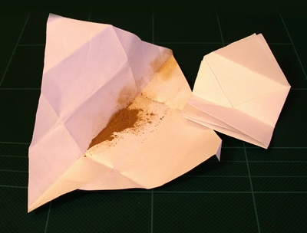
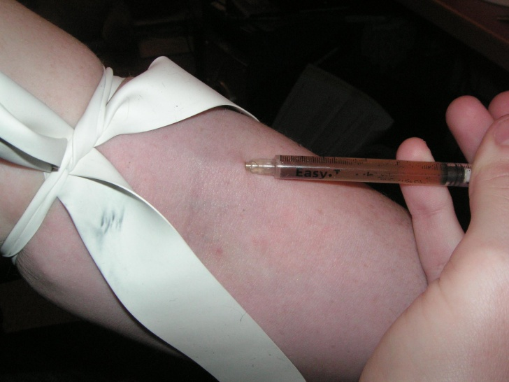
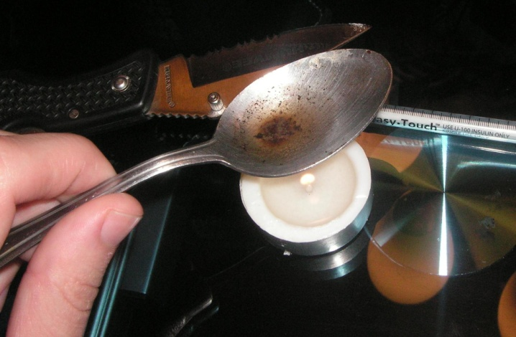
Heroin
analgesic
class A
Notes:
Injecting heroin can do nasty damage to your veins and arteries, and has been known to lead to gangrene (death of body tissue, usually a finger, toe or a limb) and to infections.
17

Slide 18

Ketamine
analgesic
class B
Notes:
K-Hole: Users who are unable to move, or who are having a bad experience on ketamine, are said to be in a K-Hole.
A BBC report in May 2000 claimed that medical research had shown that controlled tests on Ketamine users had revealed impaired memory and mild schizophrenia several days after taking the drug.
Hallucinations- it blocks chemical messengers in the brain that carry sensory input; the brain fills the resulting void with visions, dreams, or memories
Extreme ketamine use can injure the bladder, causing ulcers (wounds) in the bladder, as well as fibrosis (stiffening of the bladder walls and shrinkage). Patients often struggle with urinary frequency, urgency, pressure, pain, incontinence and/or bleeding from the bladder. They can receive a variety of diagnoses including ulcerative bladder, interstitial cystitis or ketamine cystitis. This has resulted in some cases of the need to remove the damaged bladder.
18

Slide 19




Notes:
Information advice sites
19

